Slide 1
Forms of drugs and how they act

Slide 2
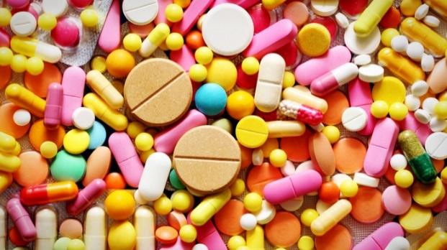
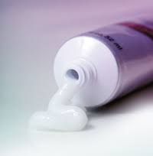
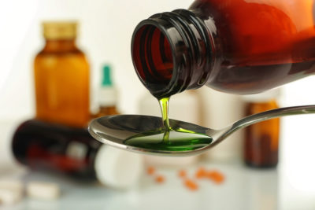
Introduction
Drugs are compounded in three basic types of preparations: liquids, solids, and semisolids.

Slide 3
Introduction
●The ease with which a drug’s ingredients can be dissolved largely determines the variety of forms manufactured. Some drug agents are soluble in water, others in alcohol, and others in a mixture of several solvents.
●The method for administering a drug depends upon its form, its properties, and the effects desired
solvent: a substance that dissolves another to form a solution
Water is a solvent for sugar.

Slide 4
Introduction
When given orally, a drug may be in the form of a liquid, powder, tablet, capsule, or, caplet.
If it is to be injected, it must be in the form of a liquid.
For topical use, the drug may be in the form of a liquid, a powder, or a semisolid.
Oral and injectable medications are examples of preparations designed for internal use.

Slide 5
Liquid Preparations
Liquid preparations are those containing a drug that has been dissolved or suspended.
Depending upon the solvent used, the drug may be further classified as an aqueous (water) or alcohol preparation.
When prescribed for internal use, liquid preparations other than emulsions are rapidly absorbed through the stomach or intestinal walls.

Slide 6
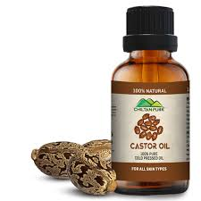
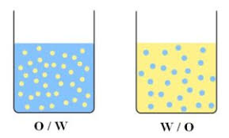
Types of liquid preparations
Emulsions consist of fine droplets of
oil in water or water in oil. They separate into layers after standing for long periods of time and must be shaken vigorously before they are ready for use.
An example of an emulsion is castor oil.

Slide 7
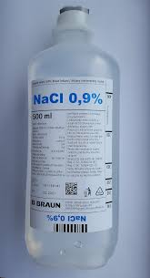
Types of liquid preparations
Solutions One or more drugs can be dissolved in an appropriate solvent to make a solution. The solution will appear to be clear and homogeneous.
An example of a solution is normal saline.

Slide 9
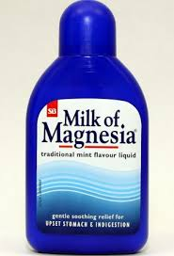
Types of liquid preparations
Mixtures and suspensions Drugs that have been mixed with a liquid, but not dissolved, are called mixtures or suspensions. These preparations must be shaken before being administered to the patient.
Milk of Magnesia (MOM) is an example of a mixture or suspension.

Slide 10
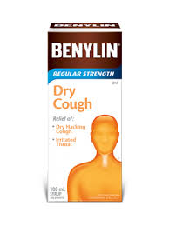
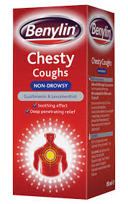
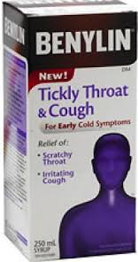
Types of liquid preparations
Syrups Drugs dissolved in a solution of sugar and water and then flavored are called syrups.
An example is Benylin DM cough syrup.

Slide 11
Types of liquid preparations
Elixirs Drugs dissolved in a solution of alcohol and water that has been sweetened and flavored are elixirs.
When prepared in this manner, the bitter or salty taste of the drug is disguised.
For this reason, elixirs are frequently used for children’s medications.

Slide 12
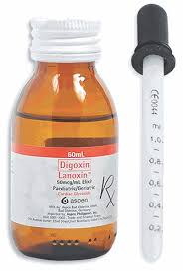
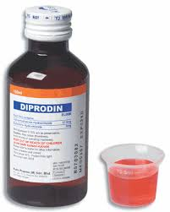
Palatable: pleasant to taste
Viscous: thick and sticky

Slide 13
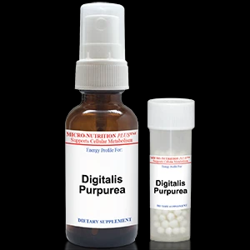
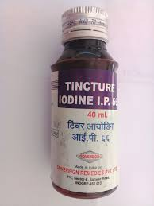
Types of liquid preparations
Tinctures Drugs dissolved in alcohol or alcohol and water. For the most part, they are made to represent 10 percent of the drug agent.
An example is tincture of digitalis. Another example, tincture of iodine, is an exception to the 10 percent rule. It may be found as a 7 percent or as a 2 percent tincture.

Slide 14
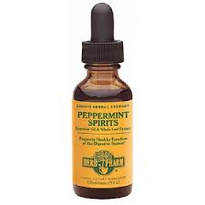
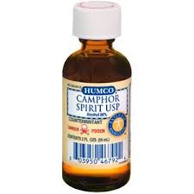
Types of liquid preparations
• Spirits. Alcoholic solutions of volatile (easily vaporized) drugs are called spirits. A spirit is also called an essence.
Examples are spirits of peppermint and aromatic spirits of ammonia.
Volatile:(of a substance) capable of readily changing from a
solid or liquid form to a vapour; having a high vapour pressure
and a low boiling point
Acetone is a volatile solvent.

Slide 15
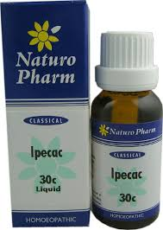
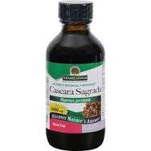
Types of liquid preparations
•Fluidextracts Drugs that have been processed to a concentrated strength using alcohol as the solvent are called fluidextracts.
Examples include fluidextract of ergot, fluidextract of ipecac, and cascara sagrada fluidextract.

Slide 16
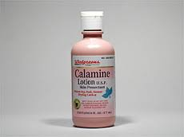
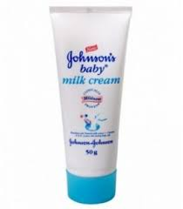
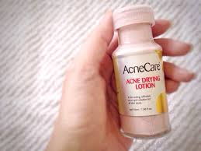
Types of liquid preparations
• Lotions Aqueous preparations of suspended ingredients used externally (without massage) to treat skin conditions are lotions.
They may be a clear solution, suspension, or emulsion.
Examples are calamine lotion and Caladryl.

Slide 17
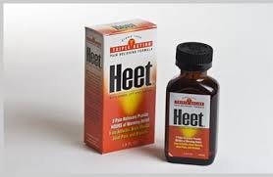
Types of liquid preparations
• Liniments Drugs that are used externally, with massage, to produce a feeling of heat to the area.
An example is methyl salicylate.

Slide 18
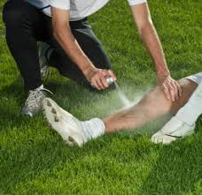
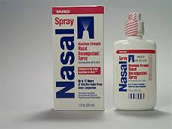
Types of liquid preparations
• Sprays As the name implies, sprays are drugs prepared to such a consistency that they may be administered by an atomizer.
They are used primarily to treat nose and throat conditions.

Slide 19
Types of liquid preparations
Some drugs administered by this method function as astringents and produce a shrinking or contracting effect.
astringent: noun
Medicine/Medical. a substance that contracts the tissues or canals of the body, thereby diminishing discharges, as of mucus or blood.
a cosmetic that cleans the skin and constricts the pores.
astringent: noun
Medicine/Medical. a substance that contracts the tissues or canals of the body, thereby diminishing discharges, as of mucus or blood.
a cosmetic that cleans the skin and constricts the pores.

Slide 20
Types of liquid preparations
Others function as antiseptics and inhibit the growth of bacteria.
Antiseptic: Of, relating to, or producing antisepsis.
Capable of preventing infection by inhibiting the growth of infectious agents.

Slide 21
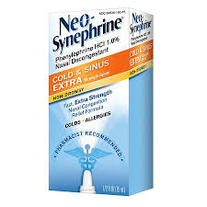
Types of liquid preparations
Oil is usually used as a solvent.
An example of a spray is Neo-synephrine®.

Slide 22
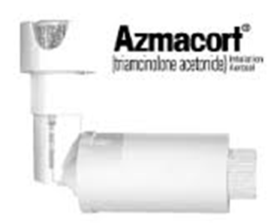
• Aerosols These preparations may contain medications, ointments, creams, lotions, powders, or liquids.
They utilize a propellant, such as butane, and are packaged in pressurized units.

Slide 23
Solid and Semisolid Preparations
Tablets, capsules, caplets, troches or lozenges, suppositories, and ointments are examples of solid and semisolid preparations.
These products offer great flexibility as a means of dispensing different dosages of drugs.
dispense: Pharmacology. to make up and distribute (medicine), especially on prescription.

Slide 24
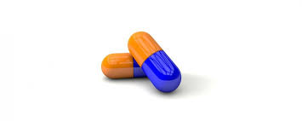
Types of Solid and Semisolid Preparations
• Capsules are small, two-part containers (hard or soft shell), which are usually made of a gelatin substance that is designed to dissolve in the stomach or gastrointestinal tract.
Some capsules contain drug-impregnated beads (sustained-action) that are designed to release the medication at different rates.
impregnate: to fill throughout; saturate
sustain: to support; hold

Slide 25
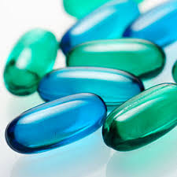
Types of Solid and Semisolid Preparations
Gelcaps Oil-based medication that is enclosed in a soft gelatin capsule.

Slide 26
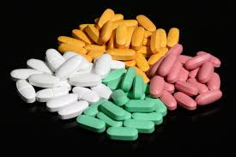
Types of Solid and Semisolid Preparations
Caplets have the size and shape of a capsule, but the consistency of a tablet.
They are coated, solid preparations for oral administration.
consistency: a degree of density, firmness, viscosity, etc.:
The liquid has the consistency of cream.

Slide 27
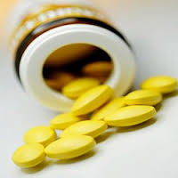
Types of Solid and Semisolid Preparations
Tablets are medication, in the form of a powder, that has been compressed into a small, disk-like shape.
Tablets come in various sizes, shapes, colors, and compositions.
compress: to press together; force into less space.

Slide 28
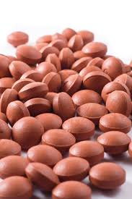
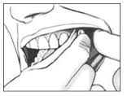
Types of Solid and Semisolid Preparations (tablets)
The following are some of the descriptive names for certain tablets:
Enteric-coated tablets are designed to pass through the stomach without dissolving.
Their special coating will dissolve in the small intestine.
Buccal tablets are formulated to be dissolved and absorbed when placed between the cheek and gum.

Slide 29
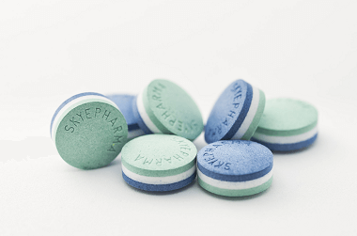
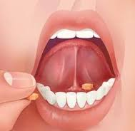
Types of Solid and Semisolid Preparations (tablets)
•Sublingual tablets are designed to be placed under the tongue where they dissolve and are absorbed.
•Layered tablets may contain two or more layers of ingredients, or the same ingredient that has been treated to provide a different absorption rate.

Slide 30
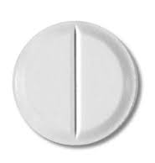
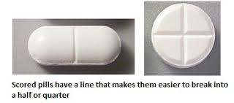
Types of Solid and Semisolid Preparations (tablets)
Scored tablets are those whose surface has been bisected by a groove to make it easy for the user to break them into halves or quarters in order to vary the dosage.

Slide 31
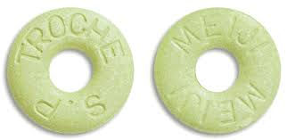
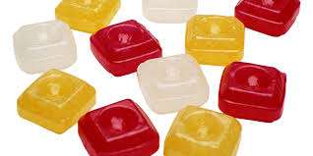
Types of Solid and Semisolid Preparations (tablets)
• Troches or lozenges are hard, circular, or oblong discs that consist of a medication in a candy-like base. These medications are designed to dissolve in the mouth and are commonly used to relieve the discomfort of a sore throat.
Advise the patient not to chew the troche or lozenge; but to let is dissolve in the mouth.
The effectiveness of this medication is destroyed by drinking liquids too soon after use.

Slide 32
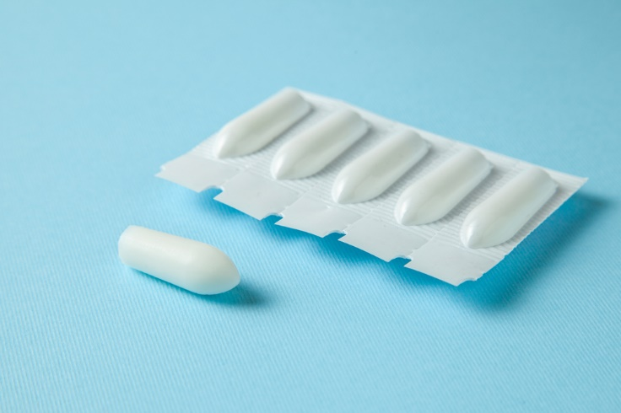
Types of Solid and Semisolid Preparations (tablets)
• Suppositories are semisolid preparations designed for insertion into the rectum, vagina, or urethra.
A suppository consists of a drug agent or agents combined with a base of soap, glycerinated gelatin, or cocoa butter oil.
These bases are selected because they are readily fusible (will melt) when subjected to body heat.

Slide 33
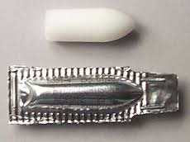
Types of Solid and Semisolid Preparations (tablets)
Suppositories are usually shaped like a cylinder or cone and are classified as drugs for external use.
Often supplied in a foil or other wrapper that must be removed before insertion, suppositories are usually lubricated with a water-soluble jelly.

Slide 34
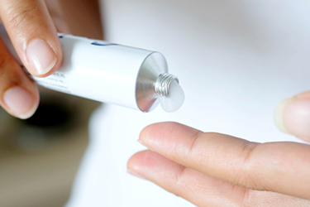
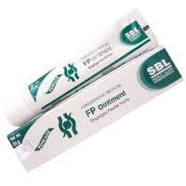
Types of Solid and Semisolid Preparations (tablets)
• Ointments are semisolid preparations consisting of a drug combined with lard, lanolin, or petroleum jelly.
They are applied externally to the skin.

Slide 35
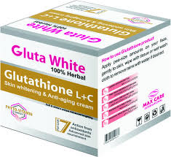
Types of Solid and Semisolid Preparations (tablets)
• Creams are semisolid preparations that are usually white, non-greasy, and have a water base.
Creams may contain a drug or other substances depending upon their purpose.
They may be applied externally to the skin, or administered via an applicator intra-vaginally.

Slide 36
Other Drug Delivery Systems
Technological advances have introduced new ways by which drugs can be prepared and delivered to a patient.
Some of these preparations are known as “special delivery systems” that provide the drug to a targeted area.
Others are modified preparations of the conventional form of the drug.

Slide 37
Other Drug Delivery Systems: Transdermal System
A small adhesive patch or disc that may be attached to the body near the treatment site.
A transdermal system consists of four layers:
1. An impermeable backing that keeps the drug from leaking out of the system. 2. A reservoir containing the drug. 3. A membrane with tiny holes in it that controls the rate of drug release. 4. An adhesive layer or gel that keeps the device in place.

Slide 38
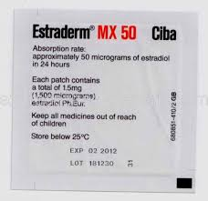
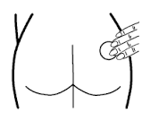
Other Drug Delivery Systems: Transdermal System
Examples:
●Estraderm® (estradiol transdermal system). Delivers natural ovarian estrogen, 17-beta-estradiol directly to the bloodstream and target organs.
Relieves hot flashes, menopausal symptoms associated with hot flashes, and vaginal discomfort.

Slide 39
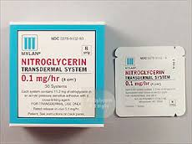
Other Drug Delivery Systems: Transdermal System
●Transderm®Nitro (nitroglycerin). Used in the prevention and treatment of angina pectoris due to coronary artery disease.
angina pectoris: Severe constricting chest pain, often radiating from the precordium to the left shoulder and down the arm, due to insufficient blood supply to the heart that is usually caused by coronary disease. Also called stenocardia.

Slide 40
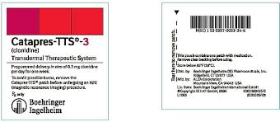
Other Drug Delivery Systems: Transdermal System
●CatapresTTS® (1,2,3 Transdermal Therapeutic System clonidine). A once-a-week transdermal antihypertensive system.

Slide 41
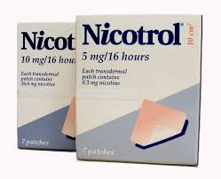
Other Drug Delivery Systems: Transdermal System
●Nicotrol® (Nicotine Transdermal System). Used as an aid to stop smoking and for the relief of nicotine withdrawal symptoms.

Slide 42
Other Drug Delivery Systems: eye curing lens
Another innovative drug delivery system in which a drug, contained between two ultrathin plastic membranes, is placed inside the lower eyelid.
It appears to cause little or no discomfort and provides a controlled release of the medication for an extended period of time.
Pilocarpine, a miotic that causes contraction of the pupil, is being used in this method for the treatment of glaucoma.

Slide 43
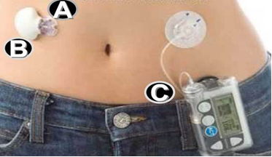
Other Drug Delivery Systems: Implantable devices
These devices come in several shapes and sizes and are positioned, just beneath the skin, near blood vessels that lead directly to an area to be medicated.
Figure: Sensor-augmented pump consisting of a Guardian RT sensor (A), which is attached to a Minilink transmitter (B) and they communicate with an insulin infusion pump (C).

Slide 44
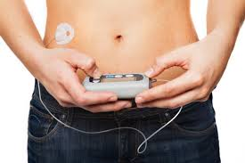
Other Drug Delivery Systems: Implantable devices
For example, an infusion pump that is about the size of a hockey puck has been implanted below the skin, near the waist, to provide continuous delivery of chemotherapy to patients with liver cancer.

Slide 45
Other Drug Delivery Systems: Implantable devices
This device, which has a refillable drug reservoir, is connected by an outlet catheter to the patient’s blood vessel.
In addition to providing a continuous supply of medication, these devices have the advantage of delivering higher doses with fewer side effects than can be realized through the systemic route.

Slide 46
Routes of Administration
The route of administration refers to the way, channel, or
method by which a drug is delivered to a patient.
The most frequently utilized routes of administering medications to a patient are the oral and parenteral. Parenteral medications enter the body by injection through the tissue and circulatory system.

Slide 47
Routes of Administration
Selected types of injections are: 1. Subcutaneous (hypodermic)—pertains to beneath, below, or under the skin. 2. Intramuscular—pertains to within a muscle. 3.Intradermal—pertains to within the dermis. 4. Intravenous—pertains to within a vein. 5. Intra-articular—pertains to within a joint.

Slide 48
Routes of Administration
Other routes of administration are: ●direct application to the skin (lotions, creams, liniments, ointments, and transdermal systems) ●sublingual (tablets, liquid: drops) ●buccal (tablets) ●rectal (suppositories, ointments) ●vaginal (suppositories, creams, tablets)
inhalation (sprays, aerosols) ●instillation (liquid: drops)

