Slide 1
Introduction to MATLAB
Kadin Tseng
Boston University
Scientific Computing and Visualization

Slide 2
What is MATrix LABoratory ?
It is developed by The Mathworks, Inc. (http://www.mathworks.com)
It is an interactive, integrated, environment
for numerical/symbolic, scientific computations and other apps.
shorter program development and debugging time than traditional programming languages such as FORTRAN and C.
slow (compared with FORTRAN or C) because it is interpreted.
automatic memory management; no need to declare arrays.
intuitive, easy to use.
compact notations.

Slide 3
Getting Started With MATLAB
Latest version is MATLAB 2012b
For Windows: double click MATLAB icon
For Linux Cluster: katana% matlab
Either case spawns a MATLAB window with >> prompt.
>> % from % to end of line used for code documentation
>> version % this will tell you the running MATLAB version
ans =
7.12.0.635 (R2011a)
>> help % lists available packages/toolboxes on system.
>> help elfun % lists functions in elementary functions package
>> help sin % instructions on the sine function
>> lookfor sine % if you don’t know the function name …
>> doc sin % for full details o ffunction
>> quit % to quit MATLAB

Slide 4
Rules on Variables and File Names
Variable, function, file names
is case sensitive, e.g., NAME and Name are 2 distinct names.
variable begins with a letter, e.g., A2z or a2z
can be a mix of letters, digits, and underscores (e.g., vector_A)
reserved characters: % = + – ~ ; : ! ' [ ] ( ) , @ # $ & ^
up to 63 characters
A function performs a pre-defined task based on input to yield certain outcome.
File name
MATLAB command files should be named with a suffix of ".m", e.g., myfile.m. An m-file typically contains a sequence of MATLAB commands that will be executed in order
A file may contain a collection of commands, functions
Note: To run, enter m-file, without .m, e.g.,
>> myfile

Slide 5
Reserved Characters % = ; ,
Some characters are reserved by MATLAB for various purposes. Some as arithmetic or matrix operators: =, +, - , *, / , \ and others are used to perform a multitude of operations. Reserved characters cannot be used in variable or function names.
>> % anything after % until the end of line is treated as comments
>>
>> a = 3 % define a to have the value 3
a =
3
>> a = 3; % “;” suppresses printing
>>
>> b = 4; c = 5; % “;” enables multiple commands on same line
>>
>> d = 6, e = 7; % “,” delimits commands but enables printing
d =
6

Slide 6
Reserved Characters : [ ] ( )
>> x = 1:2:9 % define vector x with : operator (begin:interval:end)
x =
1 3 5 7 9
>> y = 3:5 % interval is defaulted to 1; same as y=[3:5]
y =
3 4 5
>> X = [1, 2, 3; 4, 5, 6] % 2D array. The ; is vertical concatenation.
% [ ] for arrays. Prevents ambiguity
% ; concatenates vertically (new row)
% , concatenates horizontally (new columns)
X =
1 2 3
4 5 6
>> X(2,3) % ( ) for subscripting; why ans ?
ans =
6

Slide 7
Reserved Characters … and '
>> x = [1 2 3 … % elipses … means to be continued on the next line
4 5 6]
x =
1 2 3 4 5 6
>> s = 'this is a character string'; % blanks preserved within quotes
>> x = [1 2 3]' % ' performs transpose (e.g., turns row into column)
x =
1
2
3
>> X = [1 2 3; 4 5 6]; size(X) % figure out the size (dimensions) of X
ans =
2 3
>> X = [1 2 3; 4 5 6]; numel(X) % total number of entries in X
ans =
6

Slide 8
Reserved Character ! (or system)
>> !dir % “!” lets you run a command in MS Windows
Volume in drive C has no label.
Volume Serial Number is 6860-EA46
Directory of C:\Program Files\MATLAB704\work
01/31/2007 10:56 AM <DIR> .
01/31/2007 10:56 AM <DIR> ..
06/13/2006 12:09 PM 12 foo.exe
06/13/2006 08:57 AM 77 mkcopy.m
>> !ls -l % “!” lets you run a similar command in Unix/Linux
total 0
-rw-r--r-- 1 kadin scv 0 Jan 19 15:53 file1.m
-rw-r--r-- 1 kadin scv 0 Jan 19 15:53 file2.m
-rw-r--r-- 1 kadin scv 0 Jan 19 15:53 file3.m
>> system(‘ls -l’) % more general form; also unix(‘ls -l’)

Slide 9
Array operations
>> a = 1:3; % a is a row vector
>> b = 4:6; % b is a row vector
>> c = a + b % c has same shape as a & b
c =
5 7 9
>> A = [a;b] % combines rows to generate 2x3 matrix A; A=a;b ?
A =
1 2 3
4 5 6
>> B = A' % B is transpose of A
B =
1 4
2 5
3 6
Other ways to create B ? (hint: with a and b )

Slide 10
Matrix Operations
>> C = A*B % * is overloaded as matrix multiply operator
C =
14 32
32 77
>> D = A.*A % a .* turns matrix multiply to elemental multiply
D =
1 4 9
16 25 36
>> E = A./A % elemental divide
E =
1 1 1
1 1 1
>> who % list existing variables in workspace
Your variables are:
A B C D E a b d

Slide 11
Data Precisions
>> whos % detail listing of workspace variables
Name Size Bytes Class Attributes
A 2x3 48 double
B 3x2 48 double
C 2x2 32 double
D 2x3 48 double
E 2x3 48 double
a 1x3 24 double
b 1x3 24 double
c 1x3 24 double
>> A = single(A); % recast A to single data type to save memory
>> whos
Name Size Bytes Class
A 2x3 24 single
>> clear % delete all workspace variables

Slide 12
For Loops
for j=1:5 % use for-loops to execute iterations / repetitions
for i=1:3
a(i, j) = i + j ;
end
end
Utilities to initialize or define arrays: ones, rand, eye, . . .
Trigonometric and hyperbolic functions : sin, cos, sqrt, exp, . . .
These utilities can be used on scalar or vector inputs
>> a = sqrt(5); v = [1 2 3]; A = sqrt(v);

Slide 13
if Conditional
Scalar operation . . .
a = zeros(3); b = zeros(3);
for j=1:3
for i=1:3
a(i,j) = rand; % use rand to generate a random number
if a(i,j) > 0.5
b(i,j) = 1;
end
end
end
Equivalent vector operations . . .
A = rand(3); % A is a 3x3 random number double array
B = zeros(3); % Initialize B as a 3x3 array of zeroes
B(A > 0.5) = 1; % set to 1 all elements of B for which A > 0.5

Slide 14
Cell Arrays
A cell array is a special array of arrays. Each element of the cell array may point to a scalar, an array, or another cell array.
>> C = cell(2, 3); % create 2x3 empty cell array
>> M = magic(2);
>> a = 1:3; b = [4;5;6]; s = 'This is a string.';
>> C{1,1} = M; C{1,2} = a; C{2,1} = b; C{2,2} = s; C{1,3} = {1};
C =
[2x2 double] [1x3 double] {1x1 cell}
[2x1 double] ‘This is a string.‘ []
>> C{1,1} % prints contents of a specific cell element
ans =
1 3
4 2
>> C(1,:) % prints first row of cell array C; not its content
Related utilities: iscell, cell2mat

Slide 15
Structures
Ideal layout for grouping arrays that are related.
>> name(1).last = ‘Smith’; name(2).last = ‘Hess’;
>> name(1).first = ‘Mary’; name(2).first = ‘Robert’;
>> name(1).sex = ‘female’; name(2).sex = ‘male’;
>> name(1).age = 45; name(2).age = 50;
>> name(2)
ans =
last: 'Hess'
first: 'Robert'
sex: 'male'
age: 50
Alternative style:
>> name = struct(‘last’,{Smith’,’Hess’}, ‘first’,{Mary’,’Robert’},…
(‘sex’,{female’,’male’}, ‘age’,{45,50});
Related utilities: isstruct, fieldnames, getfield, isfield

Slide 16
File Types
There are many types of files in MATLAB.
Only script-, function-, and mat-files are covered here:
script m-files (.m) -- group of commands; reside in base workspace
function m-files (.m) -- memory access controlled; parameters passed as input, output arguments; reside in own workspace
mat files (.mat) -- binary (or text) files handled with save and load
mex files (.mex) -- runs C/FORTRAN codes from m-file
eng files (.eng) -- runs m-file from C/FORTRAN code
C codes (.c) – C codes generated by MATLAB compiler
P codes (.p) – converted m-files to hide source for security

Slide 17
Script m-file
If you have a group of commands that are expected to be executed repeatedly, it is convenient to save them in a file . . .
>> edit mytrig.m % enter commands in editor window
a=sin(x); % compute sine x (radians)
b=cos(x); % compute cosine x (radians)
disp( [‘a = ‘ num2str(a) ] ) % prints a; here, [ . . . ] constitutes a string array
disp( [‘b = ‘ num2str(b) ] ) % prints b
Select File/Save to save it as mytrig.m.
A script shares the same scope with that which it operates. For example, if it runs from the matlab
Define x, then use it in mytrig.m:
>> x=30*pi/180; % converts 30 degrees to radians
>> mytrig % x is accessible to mytrig.m; share same workspace
a = 0.5000
b = 0.8660

Slide 18
Function m-files
It is declared with the key word function, with optional input parameters on the right and optional output on the left of =. All other parameters within function reside in function’s own workspace.
Use MATLAB editor to create file: >> edit average.m
function avg=average(x)
% function avg=average(x)
% Computes the average of x
% x (input) matrix for which an average is sought
% avg (output) the average of x
avg = sum(x)/numel(x); % the average
end
Save the above with File/Save
Recommendation: saves file with name same as function name
It may be called from a script, another function, or on command line:
>> a = average(1:3) % a = (1 + 2 + 3) / 3
a =
2
>> help average % prints contiguous lines with % in average

Slide 19
Script or Function m-file ?
Scripts
Pros:
- convenient; script’s variables are in same workspace as caller’s
Cons:
- slow; script comands loaded and interpreted each time it is used
- risks of variable name conflict inside & outside of script
Functions
Pros:
Scope of function’s variables is confined to within function. No worry for name conflict with those outside of function.
What comes in and goes out are tightly controlled which helps when debugging becomes necessary.
Compiled the first time it is used; runs faster subsequent times.
Easily be deployed in another project.
Auto cleaning of temporary variables.
Cons:
I/O are highly regulated, if the function requires many pre-defined variables, it is cumbersome to pass in and out of the function – a script m-file is more convenient.

Slide 20
Some Frequently Used Functions
>> magic(n) % creates a special n x n matrix; handy for testing
>> zeros(n,m) % creates n x m matrix of zeroes (0)
>> ones(n,m) % creates n x m matrix of ones (1)
>> rand(n,m) % creates n x m matrix of random numbers
>> repmat(a,n,m) % replicates a by n rows and m columns
>> diag(M) % extracts the diagonals of a matrix M
>> help elmat % list all elementary matrix operations ( or elfun)
>> abs(x); % absolute value of x
>> exp(x); % e to the x-th power
>> fix(x); % rounds x to integer towards 0
>> log10(x); % common logarithm of x to the base 10
>> rem(x,y); % remainder of x/y
>> mod(x, y); % modulus after division – unsigned rem
>> sqrt(x); % square root of x
>> sin(x); % sine of x; x in radians
>> acoth(x) % inversion hyperbolic cotangent of x

Slide 21
MATLAB Graphics
Line plot
Bar graph
Surface plot
Contour plot
MATLAB tutorial on 2D, 3D visualization tools as well as other graphics packages available in our tutorial series.

Slide 22
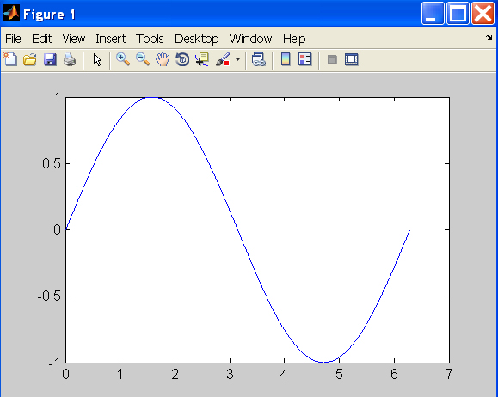
Line Plot
>> t = 0:pi/100:2*pi;
>> y = sin(t);
>> plot(t,y)

Slide 23
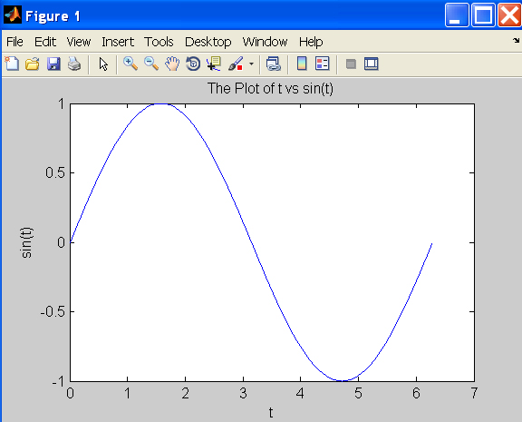
Line Plot
>> xlabel(‘t’);
>> ylabel(‘sin(t)’);
>> title(‘The plot of t vs sin(t)’);

Slide 24
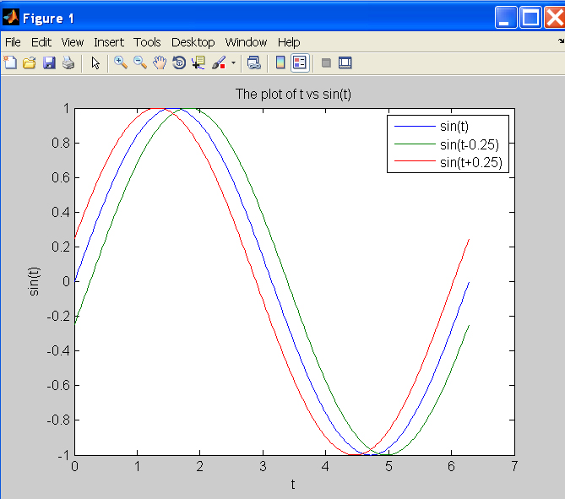
Line Plot
>> y2 = sin(t-0.25);
>> y3 = sin(t+0.25);
>> plot(t,y,t,y2,t,y3) % make 2D line plot of 3 curves
>> legend('sin(t)','sin(t-0.25)','sin(t+0.25',1)

Slide 25
Customizing Graphical Effects
Generally, MATLAB’s default graphical settings are adequate which make plotting fairly effortless. For more customized effects, use the get and set commands to change the behavior of specific rendering properties.
>> hp1 = plot(1:5) % returns the handle of this line plot
>> get(hp1) % to view line plot’s properties and their values
>> set(hp1, ‘lineWidth’) % show possible values for lineWidth
>> set(hp1, ‘lineWidth’, 2) % change line width of plot to 2
>> gcf % returns current figure handle
>> gca % returns current axes handle
>> get(gcf) % gets current figure’s property settings
>> set(gcf, ‘Name’, ‘My First Plot’) % Figure 1 => Figure 1: My First Plot
>> get(gca) % gets the current axes’ property settings
>> figure(1) % create/switch to Figure 1 or pop Figure 1 to the front
>> clf % clears current figure
>> close % close current figure; “close 3” closes Figure 3
>> close all % close all figures

Slide 26
Save A Plot With print
>> x = magic(3); % generate data for bar graph
>> bar(x) % create bar chart
>> grid % add grid
To add a legend, either use the legend command or via insert in the Menu Bar on the figure. Many other actions are available in Tools.
It is convenient to use the Menu Bar to change a figure’s properties interactively. However, the set command is handy for non-interactive changes, as in an m-file.
Similarly, save a graph via the Menu Bar’s File / Save as or
>> print –djpeg 'mybar' % file mybar.jpg saved in current dir

Slide 27
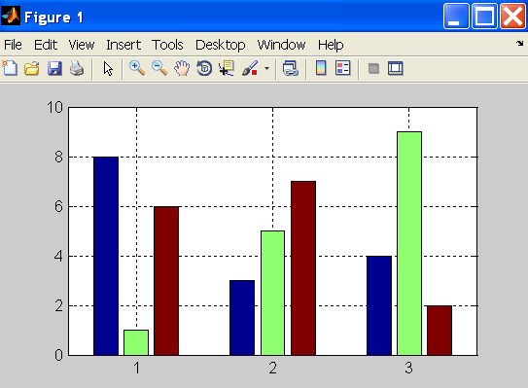
2D Bar Graph
>> x = magic(3); % generate data for bar graph
>> bar(x) % create bar chart
>> grid % add grid for clarity

Slide 28
Use MATLAB Command or Function ?
Many MATLAB utilities are available in both command and function forms.
For this example, both forms produce the same effect:
>> print –djpeg 'mybar' % print as a command
>> print('-djpeg', 'mybar') % print as a function
For this example, the command form yields an unintentional outcome:
>> myfile = 'mybar'; % myfile is defined as a string
>> print –djpeg myfile % as a command, myfile is treated as text
>> print('-djpeg', myfile) % as a function, myfile is treated as a variable
Other frequently used utilities that are available in both forms are:
save, load

Slide 29
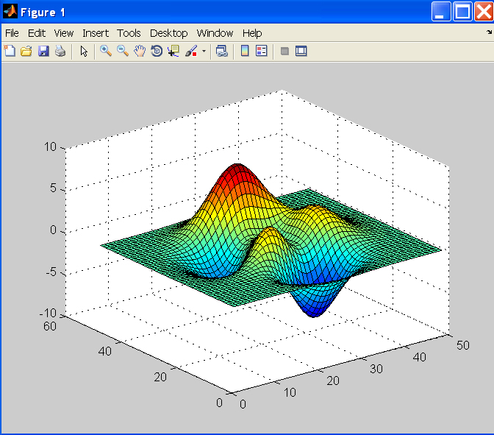
Surface Plot
>> Z = peaks; % generate data for plot; peaks returns function values
>> surf(Z) % surface plot of Z
Try these commands also:
>> shading flat
>> shading interp
>> shading faceted
>> grid off
>> axis off
>> colorbar
>> colormap(‘winter’)
>> colormap(‘jet’)

Slide 30
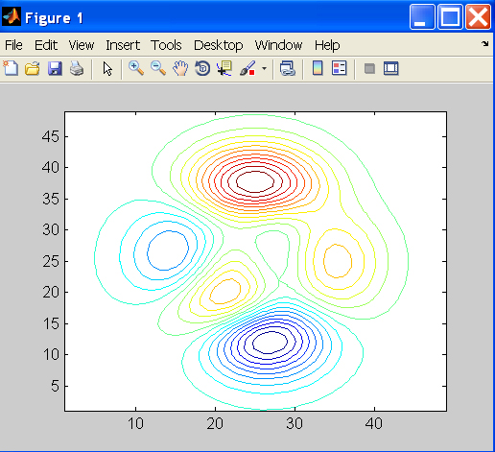
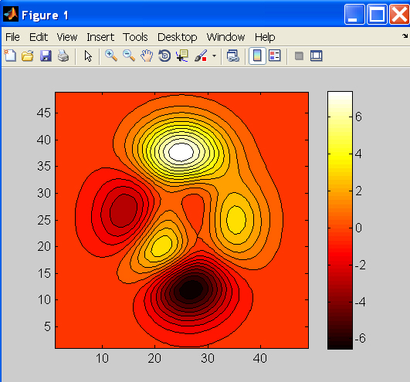
Contour Plots
>> Z = peaks;
>> contour(Z, 20) % contour plot of Z with 20 contours
>> contourf(Z, 20); % with color fill
>> colormap('hot') % map option
>> colorbar % make color bar

Slide 31
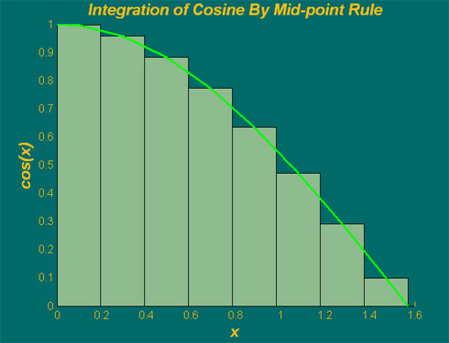
Integration Example
Integration of cosine from 0 to π/2.
Use mid-point rule for simplicity.
mid-point of increment
cos(x)
a = 0; b = pi/2; % range
m = 8; % # of increments
h = (b-a)/m; % increment
h

Slide 32
Integration Example — using for-loop
% integration with for-loop
tic
m = 100;
a = 0; % lower limit of integration
b = pi/2; % upper limit of integration
h = (b – a)/m; % increment length
integral = 0; % initialize integral
for i=1:m
x = a+(i-0.5)*h; % mid-point of increment i
integral = integral + cos(x)*h;
end
toc
h
a
b
X(1) = a + h/2
X(m) = b - h/2

Slide 33
Integration Example — using vector form
% integration with vector form
tic
m = 100;
a = 0; % lower limit of integration
b = pi/2; % upper limit of integration
h = (b – a)/m; % increment length
x = a+h/2:h:b-h/2; % mid-point of m increments
integral = sum(cos(x))*h;
toc
h
a
b
X(1) = a + h/2
X(m) = b - h/2

Slide 34
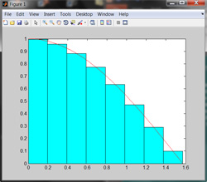
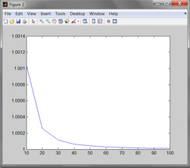
Hands On Exercise
Use the editor to write a program to generate the figure that describe the integration scheme we discussed. (Hint: use plot to plot the cosine curve. Use bar to draw the rectangles that depict the integrated value for each interval. Save as plotIntegral.m
Compute the integrals using 10 different increment sizes (h), for m=10, 20, 30, . . . , 100. Plot these 10 values to see how the solution converges to the analytical value of 1.

Slide 35
Hands On Exercise Solution
a = 0; b=pi/2; % lower and upper limits of integration
m = 8; % number of increments
h = (b-a)/m; % increment size
x= a+h/2:h:b-h/2; % m mid-points
bh = bar(x,cos(x),1,'c'); % make bar chart with the bars in cyan
hold % all plots will be superposed on same figure
x = a:h/10:b; % use more points at which to evaluate cosine
f = cos(x); % compute cosine at x
ph = plot(x,f,'r'); % plots x vs f, in red
% Compute integral with different values of m to study convergence
for i=1:10
n(i) = 10+(i-1)*10;
h = (b-a)/n(i);
x = a+h/2:h:b-h/2;
integral(i) = sum(cos(x)*h);
end
figure % create a new figure
plot(n, integral)

Slide 36
Useful SCV Info
SCV home page (www.bu.edu/tech/research)
Resource Applications www.bu.edu/tech/accounts/special/research/accounts
Help
System
help@katana.bu.edu, bu.service-now.com
Web-based tutorials (www.bu.edu/tech/research/training/tutorials)
(MPI, OpenMP, MATLAB, IDL, Graphics tools)
HPC consultations by appointment
Kadin Tseng (kadin@bu.edu)
Yann Tambouret (yannpaul@bu.edu)

