Slide 1
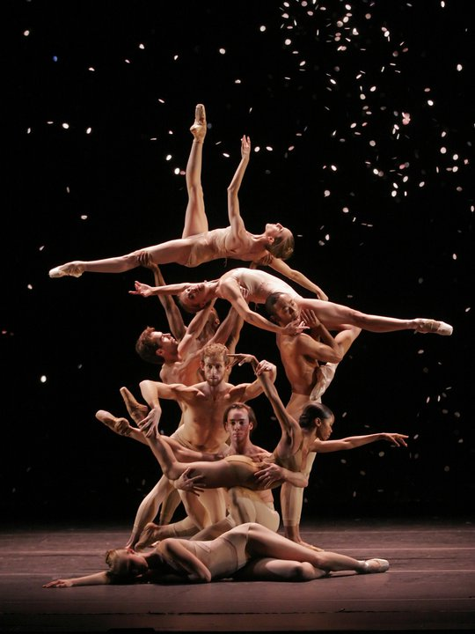
Dancing: expanding our potential to the stars Elisana Pollatou, associate prof. DPESS, University of Thessaly, Greece

Slide 2
‘‘With the creation of the universe, the dance too came into being, which signiﬁes the union of the elements. The round dance of the stars, the constellation of planets in relation to the ﬁxed stars, the beautiful order and harmony in all its movements, is a mirror of the original dance at the time of creation.’’
Lucian of Samosata (;125 to 180 A.D.), On Dance (De Saltatione)

Slide 3
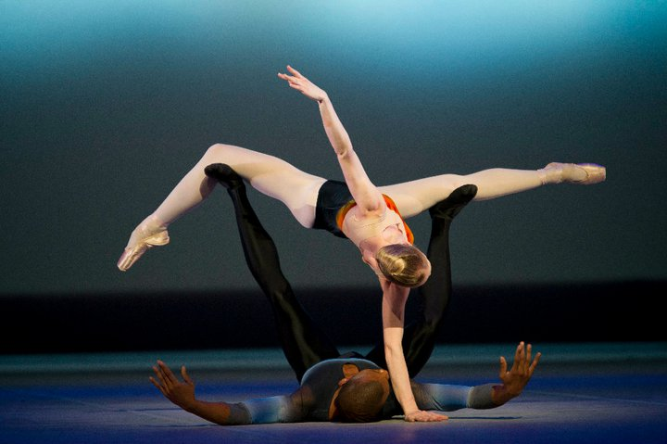
Do you like dancing? maybe there is a genetic reason for that…
Dancing
origins close to the birth of homo sapiens
differences among individuals in aptitude, propensity, and need for dancing may partially be based on differences in common genetic polymorphisms
Identifying such differences may lead to an understanding of the neurobiological basis of one of mankind’s most universal and appealing behavioral traits—dancing.
Bachner-Melman, Dina, Zohar, Constantin, Lerer, Hoch, Sella, Nemanov, Gritsenko, Lichtenberg, Grano,Ebstein, (2005). AVPR1A and SLC6A4 gene polymorphisms are associated with creative dance performance. Plos Genetics, www.plosgnetics.com,September 2005,vol.1,issue 3, 394-403

Slide 4
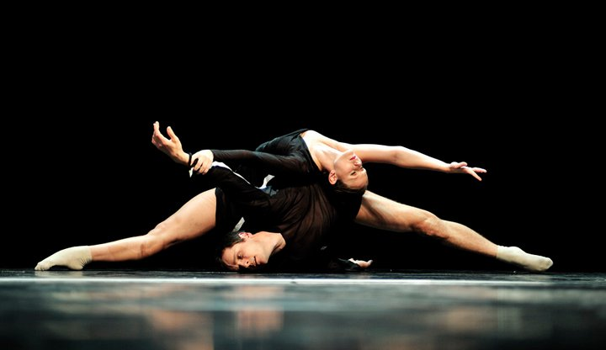
Variants of the serotonin transporter ((SLC6A4) and the arginine vasopressin receptor 1A (AVPR1A) genes were examined in performing dancers, elite athletes, and nonathletes/nondancers.
The serotonin transporter regulates the level of serotonin, a brain transmitter that contributes to spiritual experience.
The vasopressin receptor has been shown in many animal studies to modulate social communication and affiliative behaviors
Significant differences were observed in frequencies for both genes when dancers were compared to athletes as well as to nondancers/nonathletes. These two genes were also associated with scores on the Tellegen Absorption Scale and Tridimensional Personality Questionnaire Reward Dependence, suggesting that the association between these genes and dance is mediated by personality factors reflecting the social communication, courtship, and spiritual facets of the dancing phenotype

Slide 5
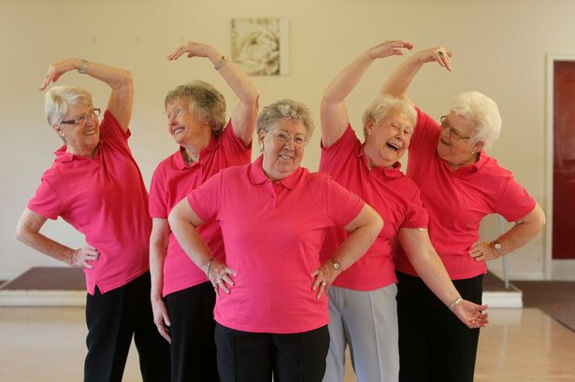
From genes to cure…
Dance (movement) therapy had a positive impact for patients with breast cancer, improving quality of life, shoulder range of motion and body image.
In patients with depression, psychological distress was reduced by dance therapy.
Ballroom dances improved balance and coordination in patients with Parkinson’s disease and disease-speciﬁc quality of life in patients with heart failure & diabetes T2.
Kiepe, Stöckigt, Keil (2012). Effects of dance therapy and ballroom dances in physical and mental illnesses. A systematic review. The Arts in Psychotherapy 39 (2012) 404–411

Slide 6
Greek folk dances enhances cognitive function in seniors!
A very recent study with 262 participants divided into two age categories (young adults: 24-35 years old, seniors> 60 years) revealed that senior Greek folk dancers had better cognitive function than exercisers and sedentary participants of the same age.
The higher cognitive function of senior folk dancers as opposed to exercisers and nonexercisers, might be attributed to the complexity of the Hellenic folk dance as a motor task but it might also linked to other characteristics of this dance, such as the circular form and the haptic connection among the participants
Bougiesi, Zisi & Zisi (2016). Differences in Cognitive Function Among Hellenic Folk Dancers, Exercisers and Non-exercisers. School of Physical Education and Sport Science, University of Thessaly, Journal of Physical Activity, Nutrition and Rehabilitation, 1, http://www.panr.com.cy/?p=1384

Slide 7
Greek folk dances enhances the quality of life in seniors
The traditional Greek dance is a physical activity with many benefits for the psychological and physical health of dancers.
The participants were 150 people (57 men, 93 women) from 60 to 70 years old, randomly selected from different areas of Greece, so that to correspond to one of the three, equal in number, groups: traditional dancers, exercisers and sedentary. The participants completed the SF-36 questionnaire for quality of life measures.
The results showed that dancers scoring higher than the two other groups on the factors of Physical Functioning, Physical Role, Bodily Pain, General Health, Vitality, Social Functioning, Role Emotional, and Mental Health
Zisi, Gianni, Bougiesi, Pollatou, Michalopoulou (2014).Systematic Participation in Folk Dance or Physical Activity? Effects in Quality of Life in the Elderly. Inquiries in Sport & Physical Education Volume 12 (1), 1 - 8 Released: January 2014 University of Thessaly, Trikala, Democritus University of Thrace, Komotini, Greece

Slide 8
Perceiving dance as a duet between science & art…
Human Movement Neuroscience from 1960’s onwards offered a new vital field for researching movement and set the ground to scientifically explain the brain, in an attempt to bridge the gap between embodied experience and cognition In dance improvisation the ‘living body’ through the experiential practice of active bodily perception
In dance improvisation the ‘living body’ through the experiential practice of active bodily perception is invited to directly respond to internal or external stimuli. That is a spontaneous kinesthetic response in a spatiotemporal vigorous qualitative dynamic happening of affect and movement; a momentum that allows dancers to perform ‘new’ aesthetic material
Savrami (2017). A duet between science and art: neural correlates of dance improvisation. Research in Dance Education, 2017 https://doi.org/10.1080/14647893.2017.1369509

Slide 9
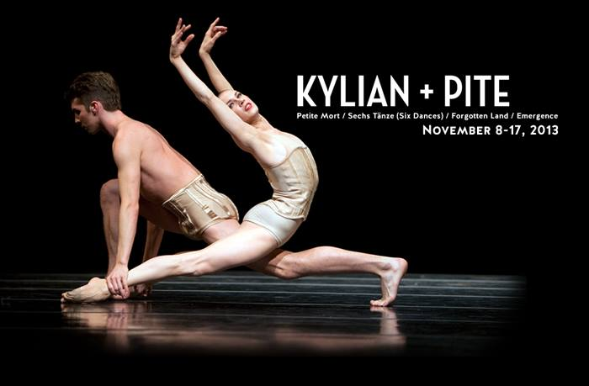
improvisation
In many aspects improvised movements arise by the same mechanisms as any other movement. Their basis is spinal cord reflexes and central pattern generators as well as their central afferents maintaining muscle tone level, appropriate posture and innate rhythms
Learning correct posture, alignment, mechanical balance and fluency of movement via visualization of motor imagery with no perceivable sensations of muscular effort, is gained through Ideokinesis.
dancers in improvisation ‘rather than “neutralize” their bodies they have to learn how to move by recognizing their feelings and resistances and search into themselves, to find a new way to move through them

Slide 10
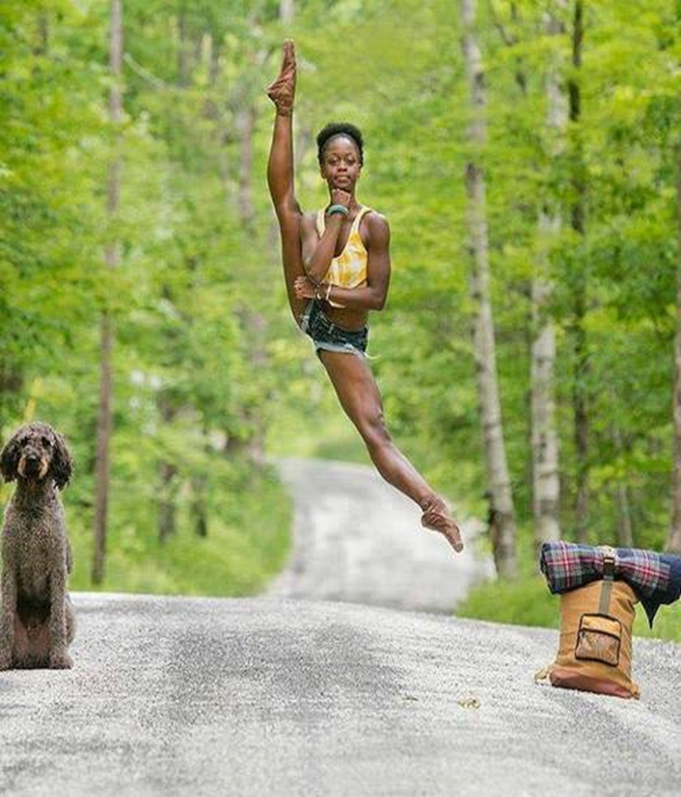
which brain mechanism and/or dance practice will reveal the creative, new experience?

Slide 11
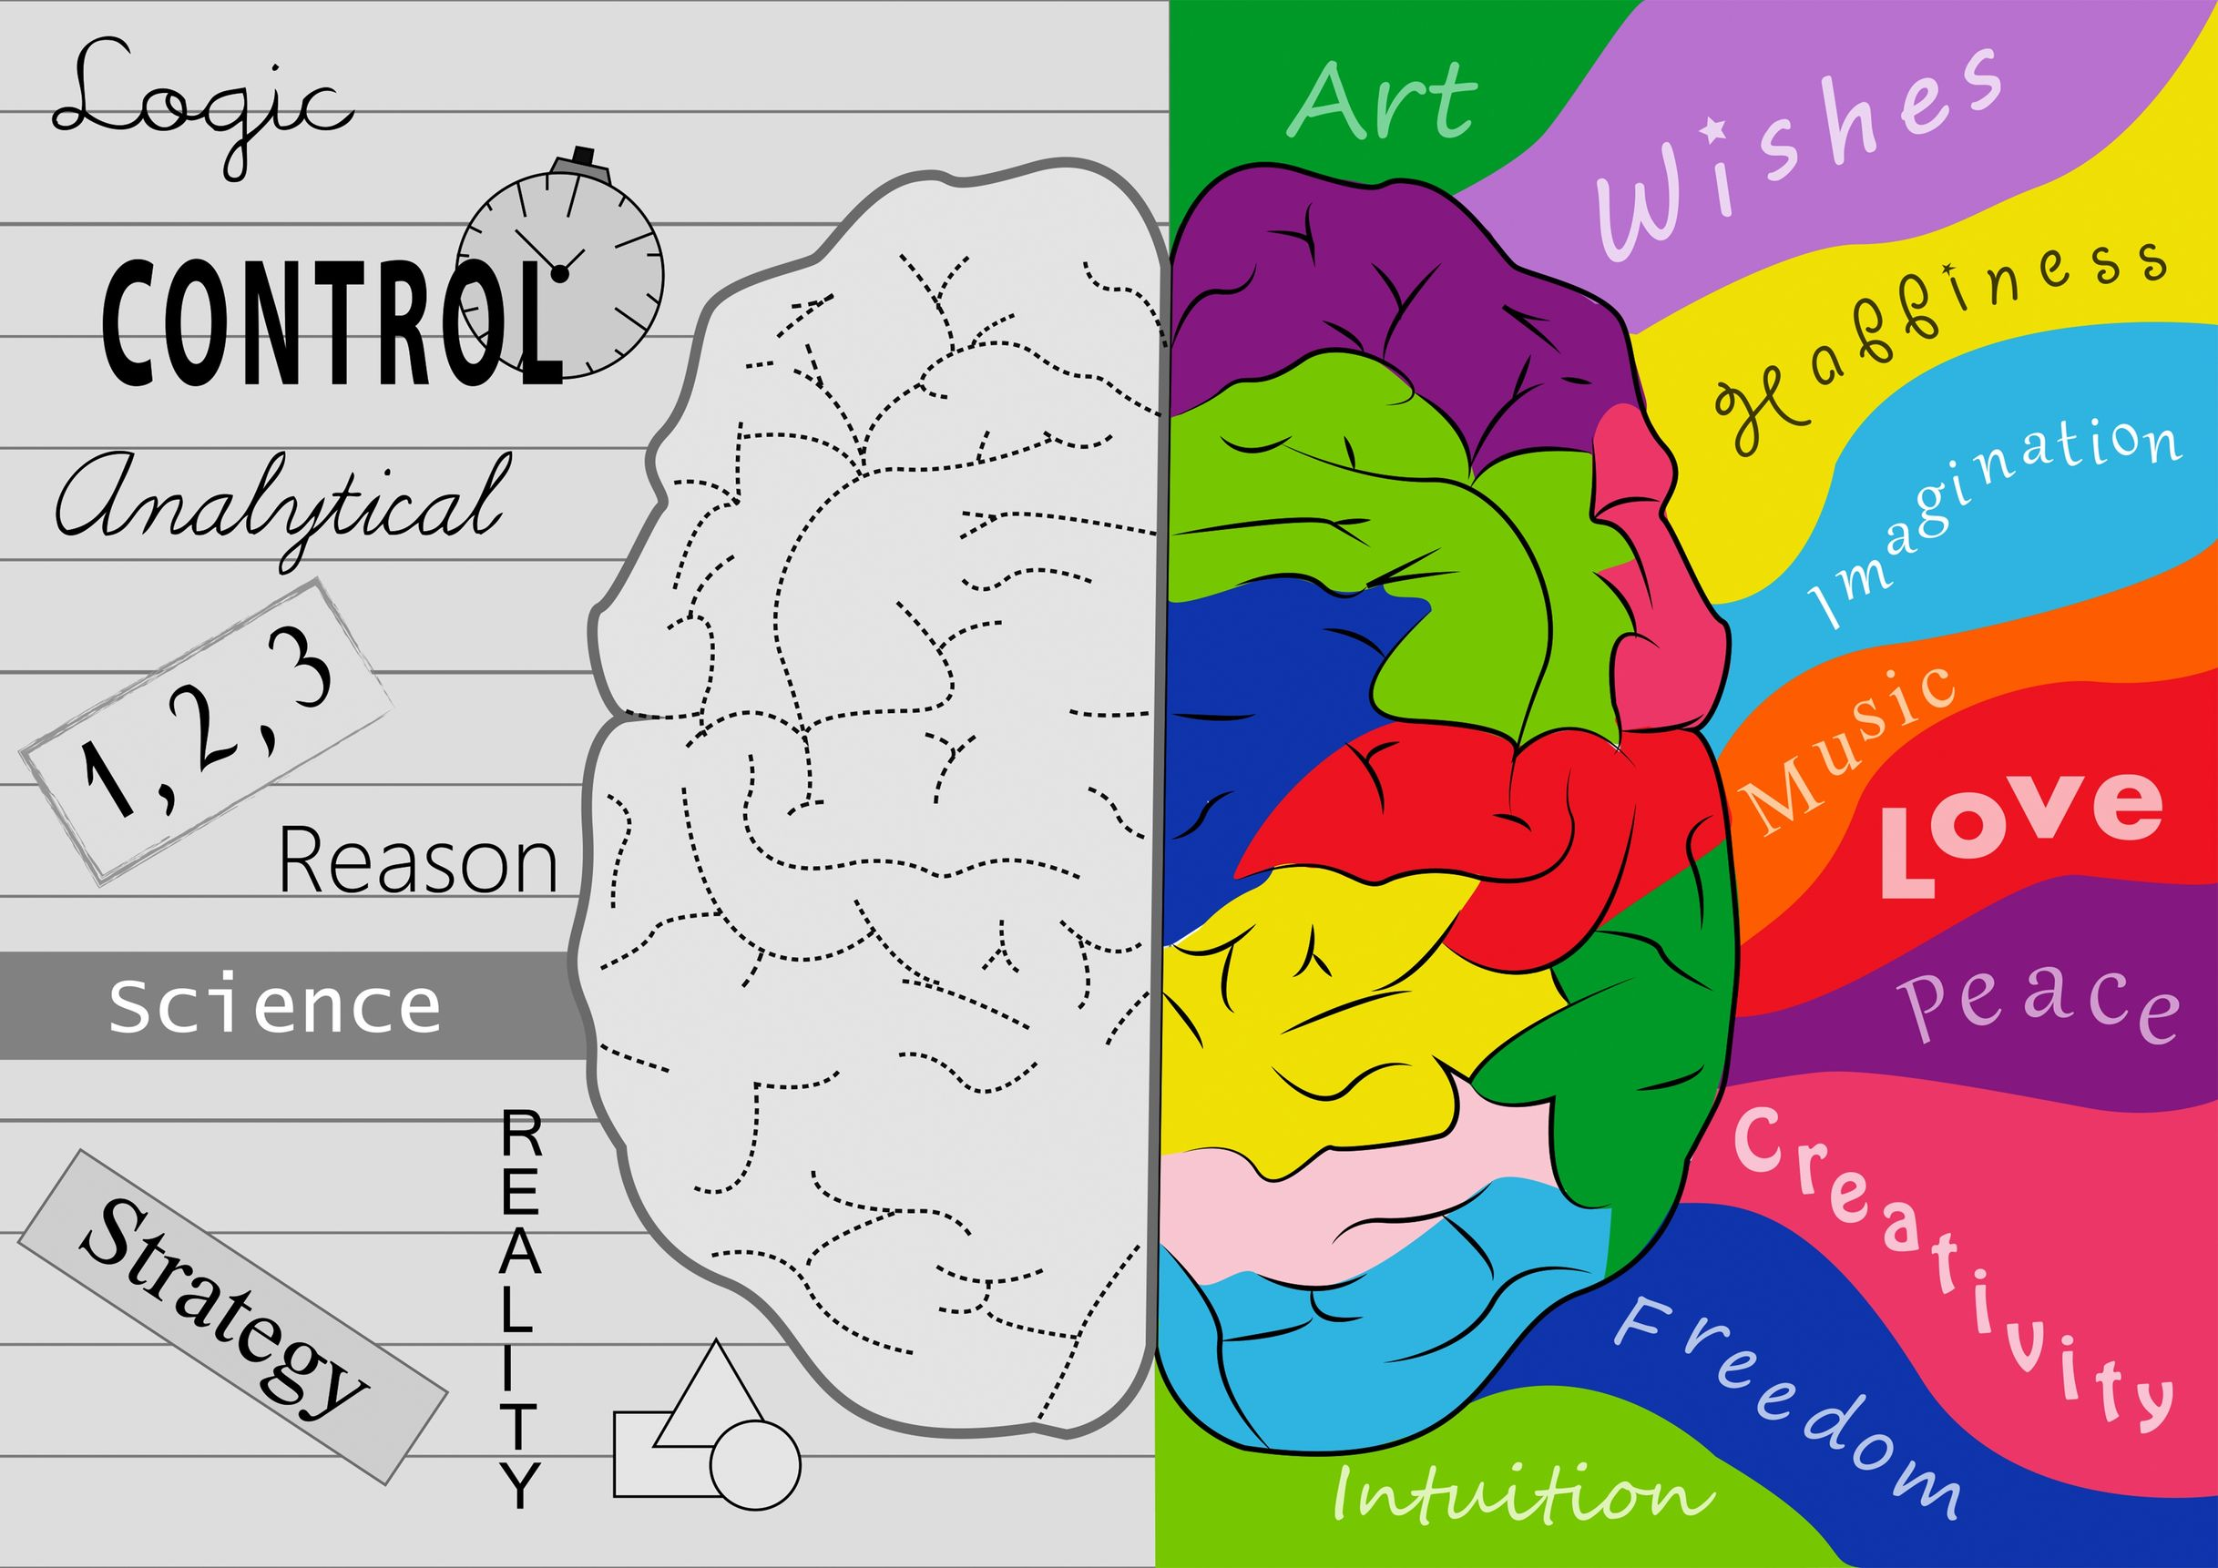
As neurological and psychological experiments have indicated, it is through divergent thinking that the capacity of humans to view a situation in a completely different light and possibilities is revealed Divergent thinking is predominantly depending on processes in the right hemisphere The right side is more imaginative and intuitive and tends to work holistically, integrating pieces of an informational puzzle into a whole; Left brain sphere, through convergent thinking, examines details and process them logically and analytically, but lacks a sense of overriding abstract connections.

Slide 12
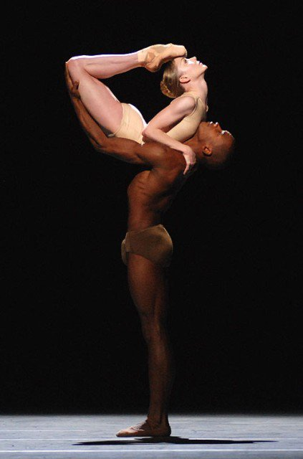
The ‘movements’ of dancers, can be understood in relation to words, as with everyday conversations For dance, though, that meaning or intending is centrally bodily (..body may says more than words…) McFee, ( 2012.) “In Remembrance of Dance Lost.” Choros International Dance Journal 1: 1–13.

Slide 13
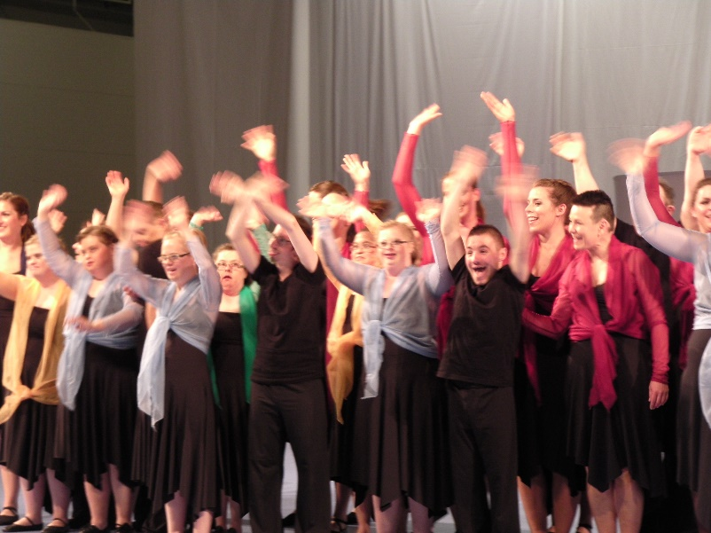
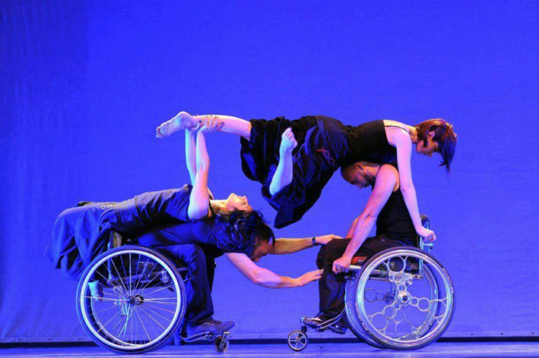
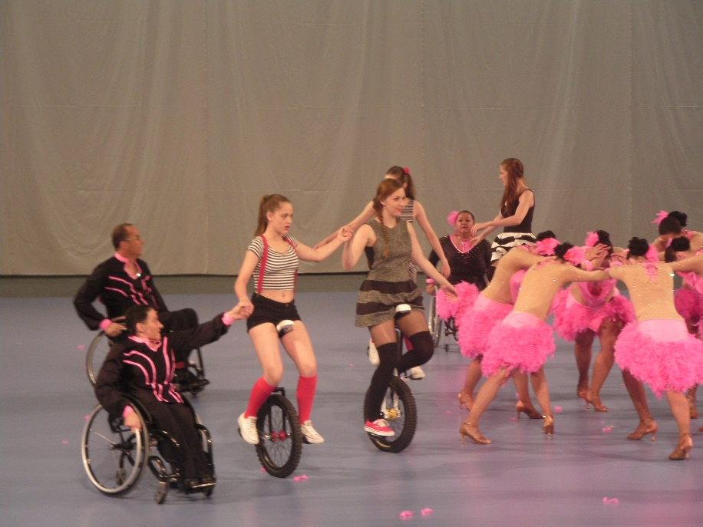
Body can be rhetoric… ‘Rhetoric is the artificer of persuasion’, Plato, Gorgias (456a-457c)
THANK YOU

