Slide 1
EE421: Introduction to Scientific Computing with Matlab

Slide 2
Course Outline
Variables, scripts and operations
Matrix computation and linear algebra
Visualization and programming
Solving equations and curve fitting
Control systems related toolboxes
Simulink
File I/O, building GUIs
Notes:
GUI: Graphical User Interface

Slide 3
Textbook(s) and/or other required material:
C.B Moler, Numerical Computing with MATLAB, 2nd Ed, SIM, 2008
D.B O’Leary, Scientific computing with Case Studies, 1st Ed, SIM, 2008
A.Quarteroni, F. Saleri, Scientific Computing with Matlab and Octave, 2nd Ed, Springer, 2006

Slide 4
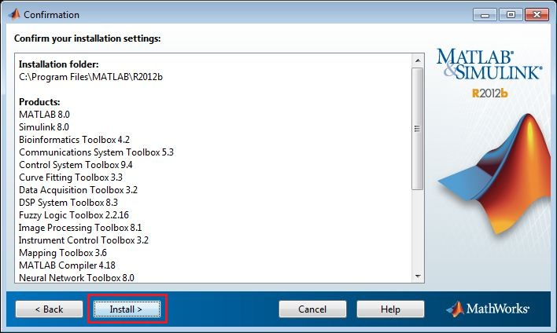
Installation
Select the tool boxes that you need
e.g. Matlab, curve fitting, optimization, statistics, symbolic math, control systems, etc.

Slide 5
Introduction to Matlab
The emphasis here is “learning by doing". Therefore, the best way to learn is by trying it yourself. Working through the examples will give you a feel for the way that MATLAB operates.
MATLAB was written originally to provide easy access to matrix software developed by the LINPACK (linear system package) and EISPACK (Eigen system package) projects.

Slide 6
History: A numerical analyst called Cleve Moler wrote the first version of Matlab in the 1970s. It has since changed into a successful commercial software package. The software package has been commercially available since 1984 and is now considered as a standard tool at most universities and industries worldwide.
A MathWorks Web site, MATLAB Tutorials and Learning Resources, offers a number of introductory videos and a PDF manual entitled Getting Started with MATLAB.

Slide 7
Introduction to MATLAB
The name MATLAB stands for MATrix LABoratory.
MATLAB is a high-performance language for technical computing. It integrates computation, visualization, and programming environment.
It allows you to solve many technical computing problems, especially those with matrix and vector formulas, in a fraction of the time it would take to write a program in a scalar non-interactive language such as C or Fortran.

Slide 8
MATLAB is matrix-oriented, so what would take several statements in C or Fortran can usually be accomplished in just a few lines using MATLAB's built-in matrix and vector operations
FORTRAN:
real*8 A(10,10), B(10,10), C(10,10) do i=1,10 do j=1,10 C(i,j) = A(i,j) + B(i,j) 10 continue 20 continue
MATLAB:
C = A + B

Slide 9
It has powerful built-in routines that enable a very wide variety of computations. It also has easy to use graphics commands that make the visualization of results immediately available. This allows you to spend more time thinking, and encourages you to experiment.
Matlab makes use of highly respected algorithms and hence you can be confident about your results. Powerful operations can be performed using just one or two commands.
You can build up your own set of functions for a particular application.
Notes:
Routines: sequences, procedures

Slide 10
MATLAB has many toolboxes:
Control toolbox is one of the important toolbox in MATLAB.
RLC Circuit Response,
Gain and Phase Margins,
PID and ...
System Identification
Fuzzy logic

Slide 11
Starting MATLAB
You can enter MATLAB by double-clicking on the MATLAB shortcut icon on your Windows desktop. When you start MATLAB, a special window called the MATLAB desktop appears. The desktop is a window that contains other windows. The major tools within or accessible from the desktop are:
The Command Window
The Command History
The Workspace
The Current Directory
The Help Browser
The Start button

Slide 12
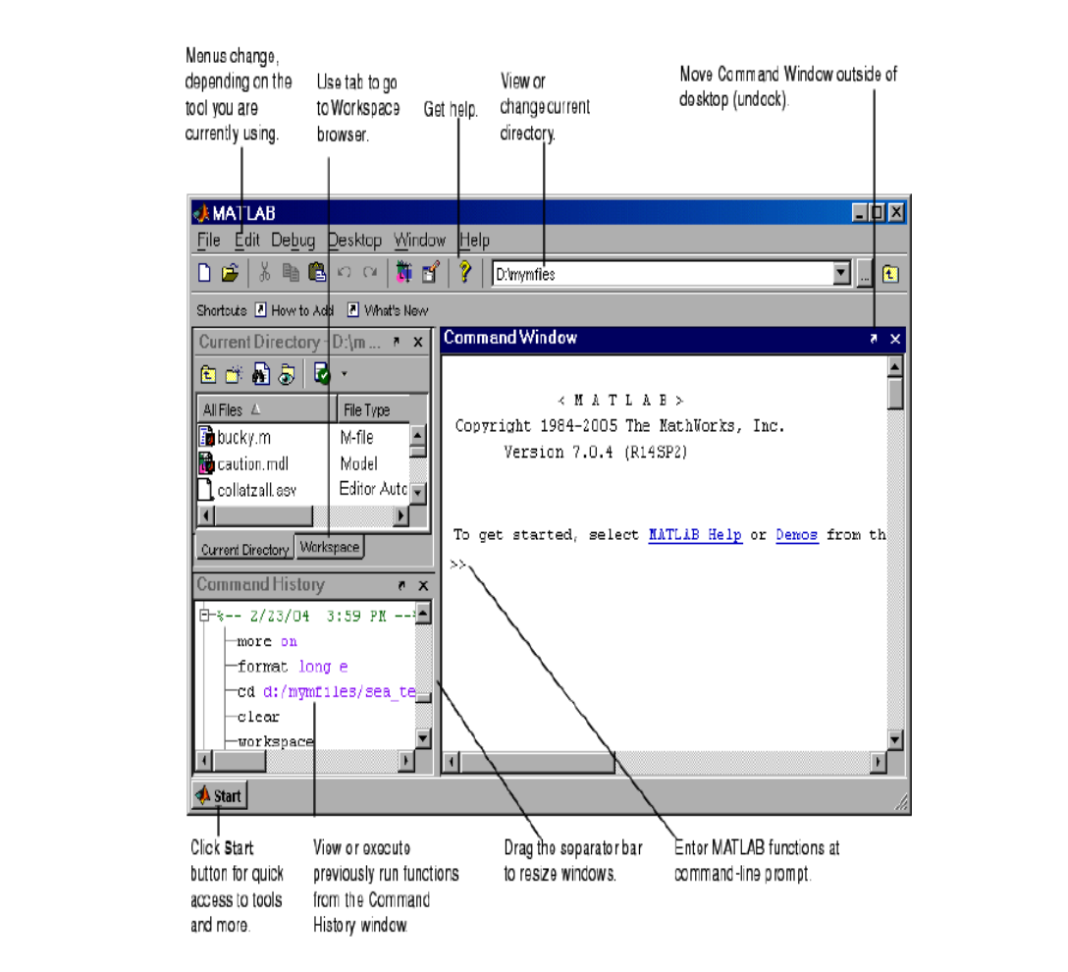

Slide 14
Command Prompt : MATLAB commands are entered here.
Workspace : Displays any variables created (Matrices, Vectors, Singles, etc.)
Command History : Lists all commands previously entered.
Double clicking on a variable in the Workspace will open an Array Editor. This will give you an Excel-like view of your data.

Slide 15
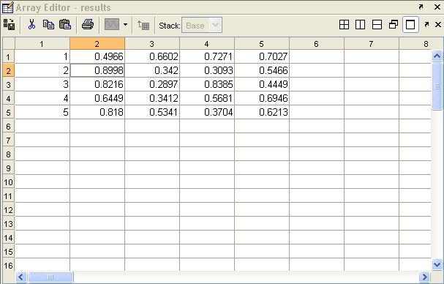

Slide 16
Workspace
Matlab remembers old commands
And variables as well
Each Function maintains its own scope
The keyword clear removes all variables from workspace
The keyword who lists the variables
You can use the command clear all to delete all the variables present in the workspace
You can also clear specific variables using:
>> clear Variable_Name

Slide 17
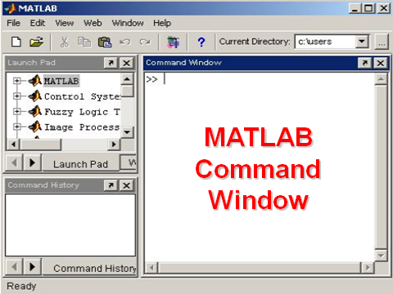
Main Matlab Window

Slide 18
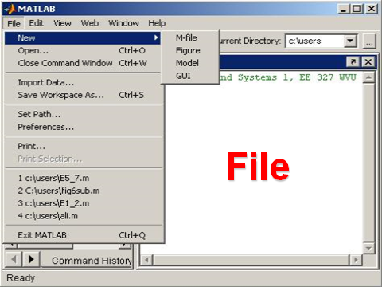

Slide 19
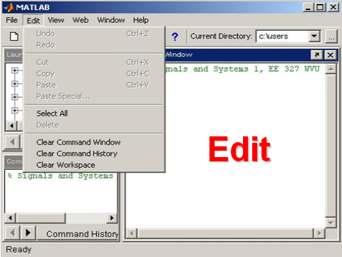

Slide 20
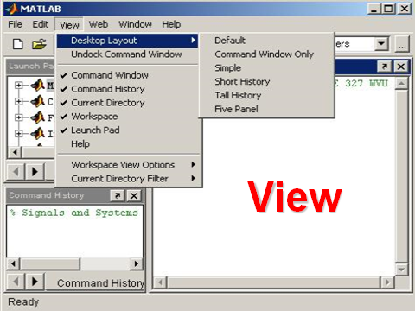

Slide 21
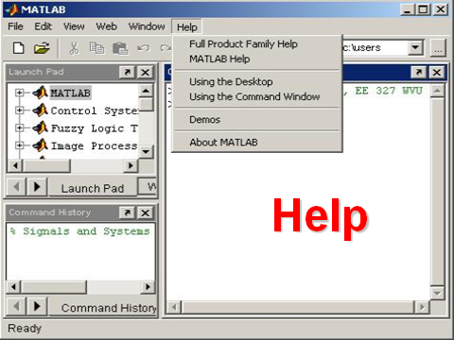

Slide 22
Help
If you want a more comprehensive introduction, there are many resources available. You can select the Help tab in the toolstrip atop the Matlab command window, then select Getting Started.
Extensive documentation is available, either via the command line by using the 'help topic‘ command.
We recommend starting with the command demo
(a link may also be provided on the top line of the
command window).

Slide 23
This brings up a separate window which gives access to a short video entitled ”getting Started" that describes the purpose of the various panes in the main Matlab window.
Help is available from the command line prompt. Type help help for \help" (which gives a brief synopsis of the help system), help for a list of topics.
Then to obtain help on “Elementary math functions",
for instance, type
>> help elfun

Slide 24
Clicking on a key word, for example sin will provide further information together with a link to doc sin which provides the most extensive documentation on a keyword along with examples of its use.
Another way to get help is to use the lookfor command. The lookfor command divers from the help command. The help command searches for an exact function name match, while the lookfor command searches the quick summary information in each function for a match.

Slide 25
For example, suppose that we were looking for a function to take the inverse of a matrix. Since MATLAB does not have a function named inverse, the command help inverse will produce nothing.
On the other hand, the command lookfor inverse will produce detailed information, which includes the function of interest, inv.
>> lookfor inverse
>> help ‘what’
>> lookfor ‘something’
>>help functionname
>>lookfor keyword

Slide 26
Some facts for a first impression:
Everything in MATLAB is a matrix !
MATLAB is an interpreted language, no compilation needed (but possible)
MATLAB does not need any variable declarations, no dimension statements, has no packaging, no storage allocation, no pointers
Programs can be run step by step, with full access to all variables, functions etc.

Slide 27
Chapter I : Variables, scripts and operations
Creating MATLAB variables:
MATLAB variables are created with an assignment statement. The syntax of variable assignment is
variable name = a value (or an expression)
For example,
>> x = expression
where expression is a combination of numerical values, mathematical operators, variables, and function calls.

Slide 28
Variables
As we discussed, MATLAB stands for 'MATrix LABoratory'. This title is appropriate because the structure for the storage of all data in MATLAB is a matrix. We talk more about this in upcoming chapters. Right now we will only work with scalar variables. MATLAB stores these as matrix variables with 1 row and 1 column. These variables show in your workspace is shown as 1x1 matrices.

Slide 29
To create a (scalar) variable in MATLAB simply enter a valid variable name at the command line and assign it a value using =. Once a variable has been assigned a value it is added to the MATLAB Workspace and will be displayed in the Workspace window.
No need for types. i.e.,
int a;
double b;
float c;

Slide 30
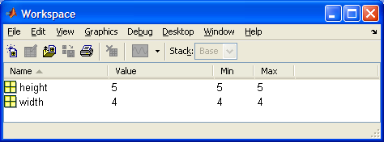
For example, after entering:
>> height = 5
height =
5
>> width = 4
width =
4
the Workspace window will contain both height and width as scalars:

Slide 31
We should NOT use length as a variable name as this is a built-in MATLAB function.
Rules on Variable Names
There are a number of rules as to the variable names you can use:
1. must start with a letter, followed by letters, digits, or underscores. X12, rate_const, Flow_rate are all acceptable variable names but not vector-A (since - is a reserved character);
2. are case sensitive, e.g., FLOW, flow, Flow, FlOw are all different variables;
3. must not be longer than 31 characters;
4. must not be a reserved word (i.e., special names which are part of MATLAB language);
5. must not contain punctuation characters;

Slide 32
Some MATLAB Workspace Functions
You can see the variables in your workspace by looking at the Workspace window or by using the whos command:
>> whos
Name Size Bytes Class Attributes
area 1x1 8 double
height 1x1 8 double
Width 1x1 8 double
If you want to remove a variable from the MATLAB you can use the clear command, e.g.,
>> clear width
removes width from the workspace.
If you want to get rid of all the variables in your workspace just type:
>> clear

Slide 33
Suppose you want to repeat or edit an earlier command. If you dislike typing it all back in, then there is good news for you: MATLAB lets you search through your previous commands using the up-arrow and down-arrow keys. This is a very convenient facility, which can save a considerable amount of time.
Example. Clear the height of the rectangle in the earlier example:
>> clear height
and look at the Workspace window:

Slide 34
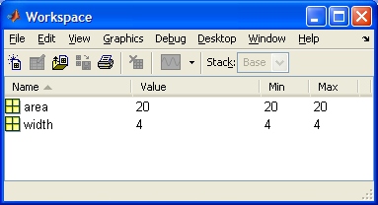
If you want it back! Press the up-arrow key until the earlier command:
>> height = 5
appears in the Command Window. Now press enter

Slide 35
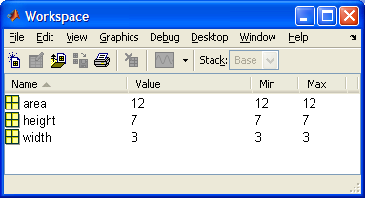
MATLAB suppresses the output of a command if you finish the command with a semi-colon - ;.
Example:
>> height = 7;
If you look at height in your Workspace window you will see its value has changed to 7:

Slide 36
SAVING YOUR WORK - SCRIPT FILES
So far all your work has been at the command line. This is useful for quick calculations. For calculations that are more complex, or that you are likely to perform often it is much more useful to save your work in script files.
To create a new script file (also called an M-file) choose File---New----M-File from the MATLAB menu bar.

Slide 37
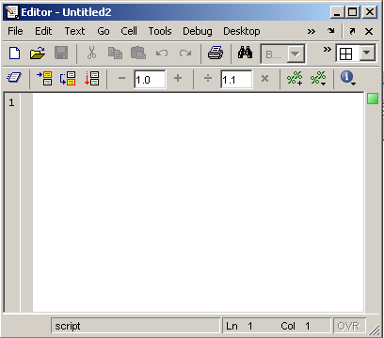
Use of M-File
Click to create a new M-File
Extension “.m”
A text file containing script or function or program to run

Slide 38
In the script file window enter:
height = 5
width = 4
area = height * width
Save your script file by choosing File----Save from the menu in the script file editor.
Give your script file a name, such as area_calcul.m. The .m extension is used to denote MATLAB script files. The file will be saved in the working directory
Filenames cannot include spaces. They also cannot start with a number, include punctuation characters (other than the underscore) or use a reserved MATLAB command.

Slide 39
at the command prompt enter:
>> area_calcul
You will see the height, width and area variables appear with their values.

Slide 40
Mathematical Operators:
Add: +
Subtract: -
Divide: ./
Multiply: .*
Power: .^ (e.g. .^2 means squared)
You can use round brackets to specify the order in which operations will be performed

Slide 41
Scripts and Functions
There are two kinds of M-files:
- Scripts, which do not accept input arguments or return output arguments. They operate on data in the workspace. Any variables that they create remain in the workspace, to be used in subsequent computations
- Functions, which can accept input arguments and return output arguments. Internal variables are local to the function.

Slide 42
Editor

Slide 43
Script or function
Scripts are m-files containing MATLAB statements
Functions are like any other m-file, but they accept arguments
It is always recommended to name function file the same as the function name

Slide 44
Global Variables
If you want more than one function to share a single copy of a variable, simply declare the variable as global in all the functions. The global declaration must occur before the variable is actually used in a function.
Example: function h = falling(t)
global GRAVITY
h = 1/2*GRAVITY*t.^2;

Slide 45
M-Files
You can create your own programs using M-files, which are plain text files containing MATLAB code. Use the MATLAB Editor or another text editor to create a file containing the same statements you would type at the MATLAB command line. Save the file under a name that ends in .m

Slide 46
Writing User Defined Functions
Functions are m-files which can be executed by specifying some inputs and supply some desired outputs.
The code telling the Matlab that an m-file is actually a function is
You should write this command at the beginning of the m-file and you should save the m-file with a file name same as the function name
function out1=functionname(in1)
function out1=functionname(in1,in2,in3)
function [out1,out2]=functionname(in1,in2)

Slide 47
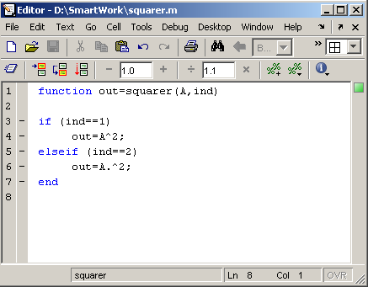
Examples
Write a function : out=squarer (A, ind)
Which takes the square of the input matrix if the input indicator is equal to 1
And takes the element by element square of the input matrix if the input indicator is equal to 2
Same Name

Slide 49
Questions ?????????????????????? Thank you

