Slide 1
Systems of Linear Equations
Successive Over Relaxation method (iterative method)

Slide 2
Iterative Methods
Iterative methods are more appropriate when
the number of equations involved is large (typically of the order of 100 or more)
and/or
the matrix is sparse (less memory requirements)

Slide 3
Jacobi Iteration
Step 1: Construct updating formula as
Step 2: Starts with initial guesses x₁⁽⁰⁾, x₂⁽⁰⁾, x₃⁽⁰⁾
Step 3: Iteratively compute x₁^{(i+1)}, x₂^{(i+1)}, x₃^{(i+1)} based on the updating formula for i = 0, 1, …, until the x's converge

Slide 4
Gauss-Seidel Iteration
Improved version of Jacobi Iteration
Observation: If x's converge, then after computing
x₁^{(i+1)} should be a better approximation of x₁ than x₁^{(i)}.
Thus the updating formula of Gauss-Seidel Iteration becomes

Slide 5
Stopping Criteria
When the estimated percentage relative error of every x's is less then the acceptable error.

Slide 6
Example: Gauss-Seidel Method
Solve
Use Gauss-Seidel Method and obtain the following updating equation.

Slide 7
Example: Gauss-Seidel Method
x₁ | x₂ | x₃
2.616667 | 0 | 0
2.616667 | -2.794524 | 0
2.616667 | 2.794524 | 7.005610
2.990557 | 2.794524 | 7.005610 | |ε_{t}| of x₁ = 0.31%
2.990557 | -2.499625 | 7.005610 | |ε_{t}| of x₂ = 0.015%
2.990557 | -2.499625 | 7.00291 | |ε_{t}| of x₃ = 0.0042%
What would happen if we swap the rows?

Slide 8
Convergence
A simple way to determine the convergence is to inspect the diagonal elements.
All of the diagonal elements must be non-zero.
Convergence is guaranteed if the system is diagonally dominant.
What if the matrix is not diagonally dominant?

Slide 9
Convergence
Good initial guess can greatly improve the chance of convergence.
Convergent rate depends on the properties of the matrix.
The higher the condition number, the slower the convergent rate.

Slide 10
Exercise
How would you solve the following system of equations using the Gauss-Seidel method with guarantee of convergence?

Slide 11
Solution
To guarantee convergence, the matrix on the L.H.S. of the equations must be diagonal dominant.
For the given system of equations, we can reorder the equations so that the system becomes
and construct the updating formula as

Slide 12
Pseudocode for Gauss-Seidel Iteration
// Assume arrays start with index 1 instead of 0.
// a: Matrix A
// b: Vector b
// n: Dimension of the system of equations
// x: Vector x; contains initial values and
// will be used to store the solution
// imax: maximum number of iterations allowed
// es: Acceptable percentage relative error
// lambda: Use to "relax" x's
Gauss_Seidel(a, b, n, x, imax, es, lambda) {
// Normalize elements in every row by
// dividing them by the diagonal
// element. Doing so can save some
// division operations later.
for i = 1 to n {
dummy = a[i, i]
for j = 1 to n
a[i,j] = a[i,j] / dummy
b[i] = b[i] / dummy
}

Slide 13
Pseudocode for Gauss-Seidel Iteration
// Assuming the initial guess (the values in x)
// is not reliable.
// So carry out one iteration of Gauss-Seidel
// without relaxation (to get a better approximation
// of x's)
for i = 1 to n {
sum = b[i]
for j = 1 to n {
if (i != j)
sum = sum - a[i,j] * x[j]
}
x[i] = sum
}
iter = 1;

Slide 14
do {
sentinel = 1 // Assuming iteration converges
// set to 0 if error is still big
for i = 1 to n {
old = x[i] // Save the previous x
// Compute new x and apply relaxation
sum = b[i]
for j = 1 to n
if (i != j)
sum = sum – a[i,j] * x[j]
x[i] = lambda * sum + (1 – lambda) * old
// If "necessary", check if error is too big
if (sentinel == 1 AND x[i] != 0) {
ea = abs((x[i] – old) / x[i]) * 100
if (ea > es)
sentinel = 0
}
}
iter = iter + 1;
} while (sentinel == 0 AND iter < imax)
}

Slide 15
Successive Over Relaxation (SOR)
Introduce an additional parameter, ω, that may accelerate the convergence of the iterations

Slide 16
Successive Over-Relaxation (SOR)
Successive Over-Relaxation is a modification of the Gauss-Seidel method to enhance convergence.
where
is a weighting factor between 0 and 2 (or use ω).
x_{i} is the value computed from the original Gauss-Seidel updating equation (i.e. before applying SOR).
x_{i}^{old} is the value of x_{i} in the previous iteration
x_{i}^{new} is the new value of x_{i}, used for updating.

Slide 17
Relaxation
, x_{i}^{new} = x_{i}
underrelaxation, 0 ≤ λ < 1
to make a non-convergent system converge, or to speedup convergence by avoiding oscillations.
overrelaxation, 1 < λ ≤ 2
to accelerate the convergence, if x_{i} is moving toward the solution at a slow rate. More weighing is given to the current value of x.

Slide 18
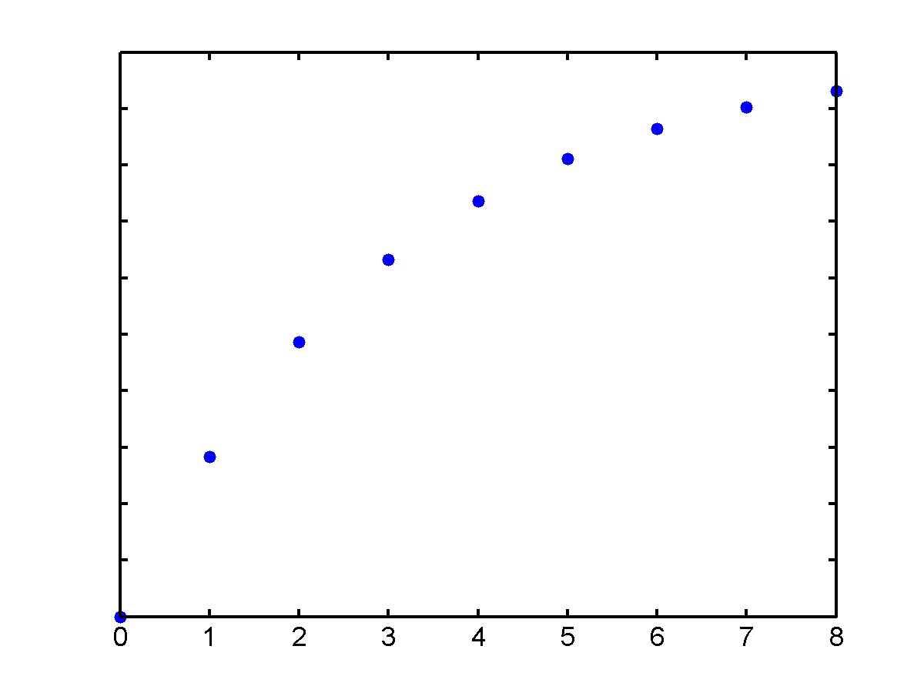
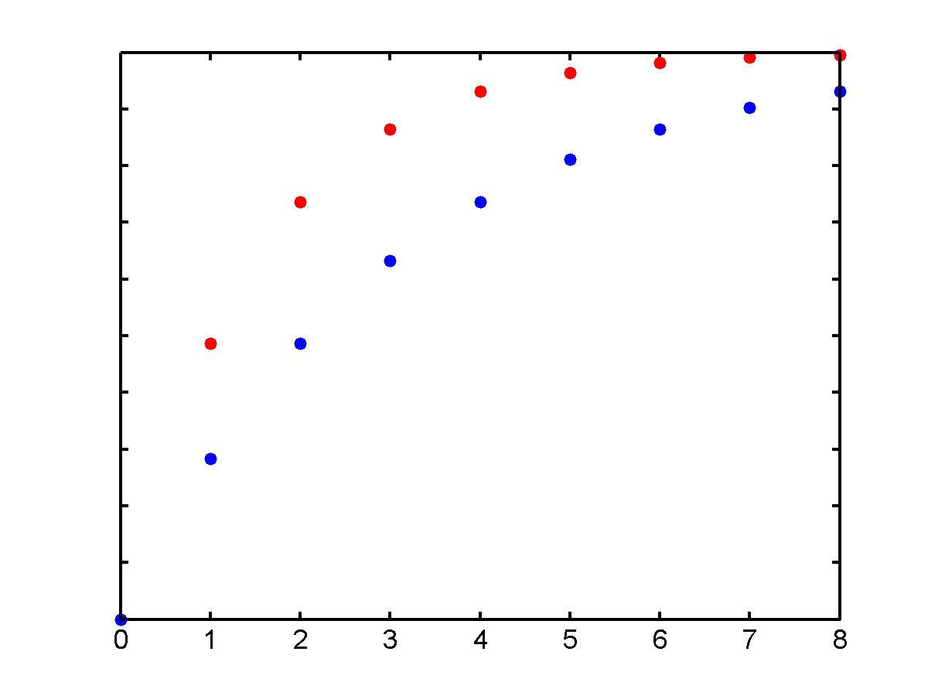
Successive Over Relaxation Method
GS iteration can be also written as follows
Correction term
Faster
convergence
Multiply with

Slide 19
SOR
1< ω <2 over relaxation (faster convergence)
0< ω <1 under relaxation (slower convergence)
There is an optimum value for ω
Find it by trial and error (usually around 1.6)

Slide 20
Successive Over Relaxation (SOR)
Consider the three-by-three system

Slide 21
Successive Over Relaxation (SOR)
Required number of iterations for different values of the relaxation parameter
Start with
Tolerance = 0.00001
ω | 0.8 | 0.9 | 1.0 | 1.2 | 1.25 | 1.3 | 1.4
No. of iterations | 44 | 36 | 29 | 18 | 15 | 13 | 16

Slide 22
Example of SOR
4X₁ + 2X₂ = 2
2X₁ + 10X₂ + 4X₃ = 6
4X₂ + 5X₃ = 5
Solution: (X₁ , X₂ , X₃ ) = (0.41379, 0.17241, 0.86206)

Slide 23
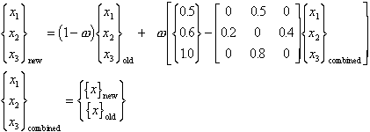
SOR Example
Formulation of the SOR Algorithm

Slide 24
Effects of w Parameter
Using nmax=50 and tol = 0.000001

Slide 25
How to determine λ?
Problem specific
Usually determined empirically
Not useful when the system is only solved once
If the system are solved many times, a carefully selected value of λ can greatly improve the rate of convergence.

Slide 26
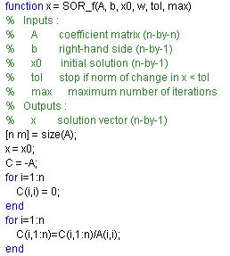
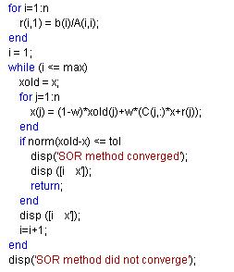
Matlab function for SOR

Slide 27
Summary (3 X 3 system)
Jacobi method
SOR method
Gauss-seidel method

Slide 28
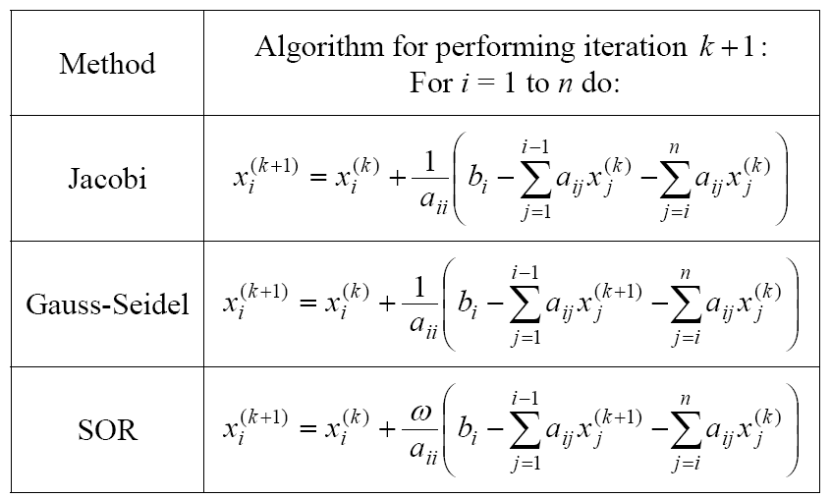
Summary

Slide 29
Exercise
Use Gauss-Seidel method
(a) without relaxation and
(b) with relaxation
to solve the following system to a tolerance of
If necessary, rearrange the equations to achieve convergence.
The system can be re-arranged to the following

Slide 30
Gauss-Seidel
Without Relaxation

