Slide 1
Tutorial on Matlab Basics
EECS 639
August 31, 2016

Slide 2
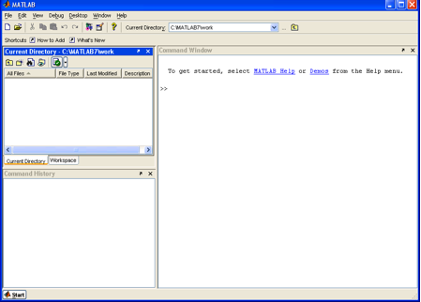
Matlab Basics
To start Matlab: Select MATLAB on the menu (if using Windows). Type “matlab” on the command line (if using Linux).

Slide 3
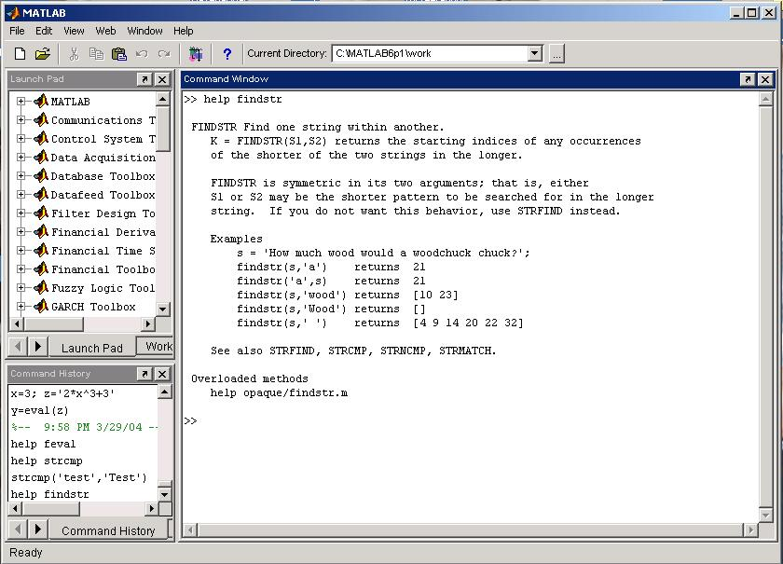
Getting Help and Looking Up Functions
To get help on a function type “help function_name”, e.g., “help plot”.
To find a topic, type “lookfor topic”, e.g., “lookfor matrix”

Slide 4
Matlab’s Workspace
who, whos – current workspace vars.
save – save workspace vars to *.mat file.
load – load variables from *.mat file.
clear all – clear workspace vars.
close all – close all figures
clc – clear screen
clf – clear figure

Slide 5
Basic Commands
% used to denote a comment
; suppresses display of value (when placed at end of a statement)
... continues the statement on next line
eps machine epsilon
inf infinity
NaN not-a number, e.g., 0/0.

Slide 6
Numbers
To change format of numbers:
format long, format short, etc.
See “help format”.
Mathematical functions: sqrt(x), exp(x), cos(x), sin(x), sum(x), etc.
Operations: +, -, *, /
Constants: pi, exp(1), etc.

Slide 7
Arrays and Matrices
v = [-2 3 0 4.5 -1.5]; % length 5 row vector.
v = v’; % transposes v.
v(1); % first element of v.
v(2:4); % entries 2-4 of v.
v([3,5]); % returns entries 3 & 5.
v=[4:-1:2]; % same as v=[4 3 2];
a=1:3; b=2:3; c=[a b]; → c = [1 2 3 2 3];

Slide 8
Arrays and Matrices (2)
x = linspace(-pi,pi,10); % creates 10 linearly-spaced elements from –pi to pi.
logspace is similar.
A = [1 2 3; 4 5 6]; % creates 2x3 matrix
A(1,2) % the element in row 1, column 2.
A(:,2) % the second column.
A(2,:) % the second row.

Slide 9
Arrays and Matrices (3)
A+B, A-B, 2*A, A*B % matrix addition, matrix subtraction, scalar multiplication, matrix multiplication
A.*B % element-by-element mult.
A’ % transpose of A (complex- conjugate transpose)
det(A) % determinant of A

Slide 10
Creating special matrices
diag(v) % change a vector v to a diagonal matrix.
diag(A) % get diagonal of A.
eye(n) % identity matrix of size n.
zeros(m,n) % m-by-n zero matrix.
ones(m,n) % m*n matrix with all ones.

Slide 11
Logical Conditions
==, <, >, <=, >=, ~= (not equal), ~ (not)
& (element-wise logical and), | (or)
find(‘condition’) – Return indices of A’s elements that satisfies the condition.
Example: A = [7 6 5; 4 3 2];
find (‘A == 3’); --> returns 5.

Slide 12
Solving Linear Equations
A = [1 2 3; 2 5 3; 1 0 8];
b = [2; 1; 0];
x = inv(A)*b; % solves Ax=b if A is invertible.
(Note: This is a BAD way to solve the
equations!!! It’s unstable and inefficient.)
x = A\b; % solves Ax = b.
(Note: This way is better, but we’ll learn how to program methods to solve Ax=b.)
Do NOT use either of these commands in your
codes!

Slide 13
More matrix/vector operations
length(v) % determine length of vector.
size(A) % determine size of matrix.
rank(A) % determine rank of matrix.
norm(A), norm(A,1), norm(A,inf)
% determine 2-norm, 1-norm,
and infinity-norm of A.
• norm(v) % compute vector 2-norm.

Slide 14
For loops
x = 0;
for i=1:2:5 % start at 1, increment by 2
x = x+i; % end with 5.
end
This computes x = 0+1+3+5=9.

Slide 15
While loops
x=7;
while (x > = 0)
x = x-2;
end;
This computes x = 7-2-2-2-2 = -1.

Slide 16
If statements
if (x == 3)
disp(‘The value of x is 3.’);
elseif (x == 5)
disp(‘The value of x is 5.’);
else
disp(‘The value of x is not 3 or 5.’);
end;

Slide 17
Switch statement
switch face
case {1}
disp(‘Rolled a 1’);
case {2}
disp(‘Rolled a 2’);
otherwise
disp(‘Rolled a number >= 3’);
end
NOTE: Unlike C, ONLY the SWITCH statement between the matching case and the next case, otherwise, or end are executed. (So breaks are unnecessary.)

Slide 18
Break statements
break – terminates execution of for and while loops. For nested loops, it exits the innermost loop only.

Slide 19
Vectorization
Because Matlab is an interpreted language, i.e., it is not compiled before execution, loops run slowly.
Vectorized code runs faster in Matlab.
Example: x=[1 2 3];
for i=1:3 Vectorized:
x(i) = x(i)+5; VS. x = x+5;
end;

Slide 20
Graphics
x = linspace(-1,1,10);
y = sin(x);
plot(x,y); % plots y vs. x.
plot(x,y,’k-’); % plots a black line
of y vs. x.
• hold on; % put several plots in the same figure window.
• figure; % open new figure window.

Slide 21
Graphics (2)
subplot(m,n,1) % Makes an mxn array
for plots. Will place plot in 1st position.
X
Here m = 2 and n = 3.

Slide 22
Graphics (3)
plot3(x,y,z) % plot 2D function.
mesh(x_ax,y_ax,z_mat) – surface plot.
contour(z_mat) – contour plot of z.
axis([xmin xmax ymin ymax]) – change axes
title(‘My title’); - add title to figure;
xlabel, ylabel – label axes.
legend – add key to figure.

Slide 23
Examples of Matlab Plots

Slide 24
Examples of Matlab Plots

Slide 25
Examples of Matlab Plots

Slide 26
File Input/Output
fid = fopen(‘in.dat’,’rt’); % open text file for reading.
v = fscanf(fid,’%lg’,10); % read 10 doubles from the text file.
fclose(fid); % close the file.
help textread; % formatted read.
help fprintf; % formatted write.

Slide 27
Example Data File
Sally Type1 12.34 45 Yes
Joe Type2 23.54 60 No
Bill Type1 34.90 12 No

Slide 28
Read Entire Dataset
fid = fopen(‘mydata.dat’, ‘r’); % open file
for reading.
% Read-in data from mydata.dat.
[names,types,x,y,answer] = textread(fid,’%s%s%f%d%s’);
fclose(fid); % close file.

Slide 29
Read Partial Dataset
fid = fopen(‘mydata.dat’, ‘r’); % open file
for reading.
% Read-in first column of data from mydata.dat.
[names] = textread(fid,’%s %*s %*f %*d %*s’);
fclose(fid); % close file.

Slide 30
Read 1 Line of Data
fid = fopen(‘mydata.dat’, ‘r’); % open file
% for reading.
% Read-in one line of data corresponding
% to Joe’s entry.
[name,type,x,y,answer] =… textread(fid,’%s%s%f%d%s’,1,…
’headerlines’,1);
fclose(fid); % close file.

Slide 31
Writing formatted data.
% open file for writing.
fid = fopen(‘out.txt’,’w’);
% Write out Joe’s info to file.
fprintf(fid,’%s %s %f %d… %s\n’,name,type,x,y,answer);
fclose(fid); % close the file.

Slide 32
Keeping a record
To keep a record of your session, use the diary command:
diary filename
x = 3
diary off
This will keep a diary called filename showing the value of x (your work for this session).

Slide 33
Timing
Use tic, toc to determine the running time of an algorithm as follows:
tic
commands…
toc
This will give the elapsed time.

Slide 34
Scripts and Functions
Two kinds of M-files:
- Scripts, which do not accept input
arguments or return output arguments.
They operate on data in the workspace.
- Functions, which can accept input
arguments and return output
arguments. Internal variables are
local to the function.

Slide 35
M-file functions
function [area,circum] = circle(r)
% [area, circum] = circle(r) returns the
% area and circumference of a circle
% with radius r.
area = pi*r^2;
circum = 2*pi*r;
• Save function in circle.m.

Slide 36
M-file scripts
r = 7;
[area,circum] = circle(r);
% call our circle function.
disp([‘The area of a circle having…
radius ‘ num2str(r) ‘ is ‘… num2str(area)]);
• Save the file as myscript.m.

Slide 37
Tutorial sources
http://docplayer.net/15715694-Introduction-to-matlab-basics-reference-from-azernikov-sergei-mesergei-tx-technion-ac-il.html
Tutorial by Azernikov Sergei.

Slide 38
Interactive Example (1)
Write a Matlab program to compute the following sum
∑1/i², for i=1, 2, …, 10
two different ways:
1. 1/1+1/4+…+1/100
2. 1/100+1/81+…+1/1.

Slide 39
Solution
% Forward summation
forwardsum = 0;
for i=1:10
forwardsum = forwardsum+1/(i^2);
end;
% Backward summation
backwardsum = 0;
for i=10:-1:1
backwardsum = backwardsum+1/(i^2);
end;

Slide 40
Interactive Example (2)
Write a Matlab function to multiply two
n-by-n matrices A and B. (Do not use built-in functions.)

Slide 41
Solution
function [C] = matrix_multiply(A,B,n)
C = zeros(n,n);
for i=1:n
for j=1:n
for k=1:n
C(i,j) = C(i,j) + A(i,k)*B(k,j);
end;
end;
end;
Can this code be written so that it runs faster?
Hint: Use vectorization.

Slide 42
Solution
Script to use for testing:
n = 10;
A = rand(n,n);
B = rand(n,n);
C = matrix_multiply(A,B,n);

