Slide 1
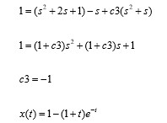
(s²*x(s) – s¹*x(0) – s⁰x’(0)) + 4(s¹*x(s) – s⁰*x(0)) + 3*x(s) = 1/s
s²*x(s) + 4s*x(s) + 3*x(s) = 1/s ⬄ x(s)[s² + 4s + 3] = 1/s ⬄

Slide 2
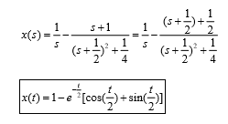
2(s²*x(s) – s¹*x(0) – s⁰x’(0)) + 2(s¹*x(s) – s⁰*x(0)) + x(s) = 1/s
2*s²*x(s) + 2s*x(s) + x(s) = 1/s ⬄

