Slide 1
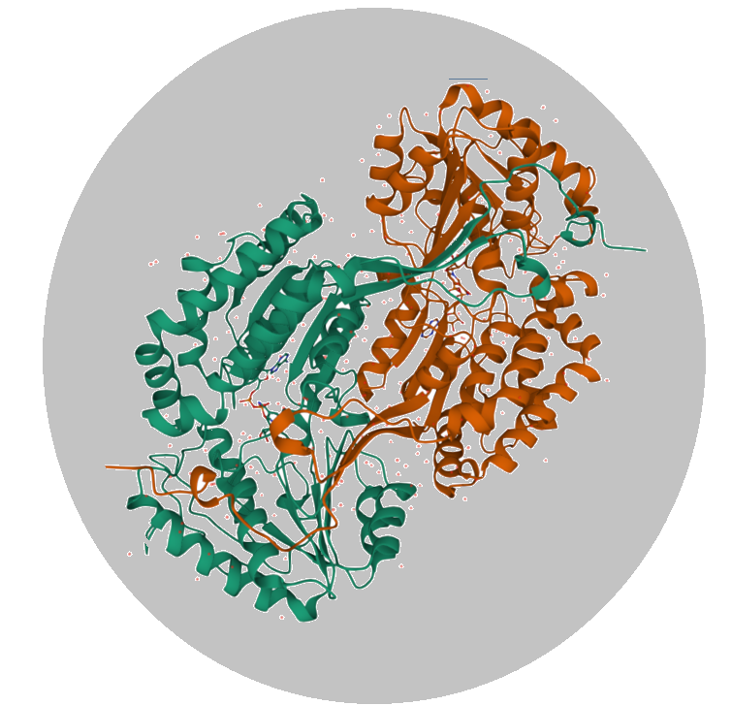
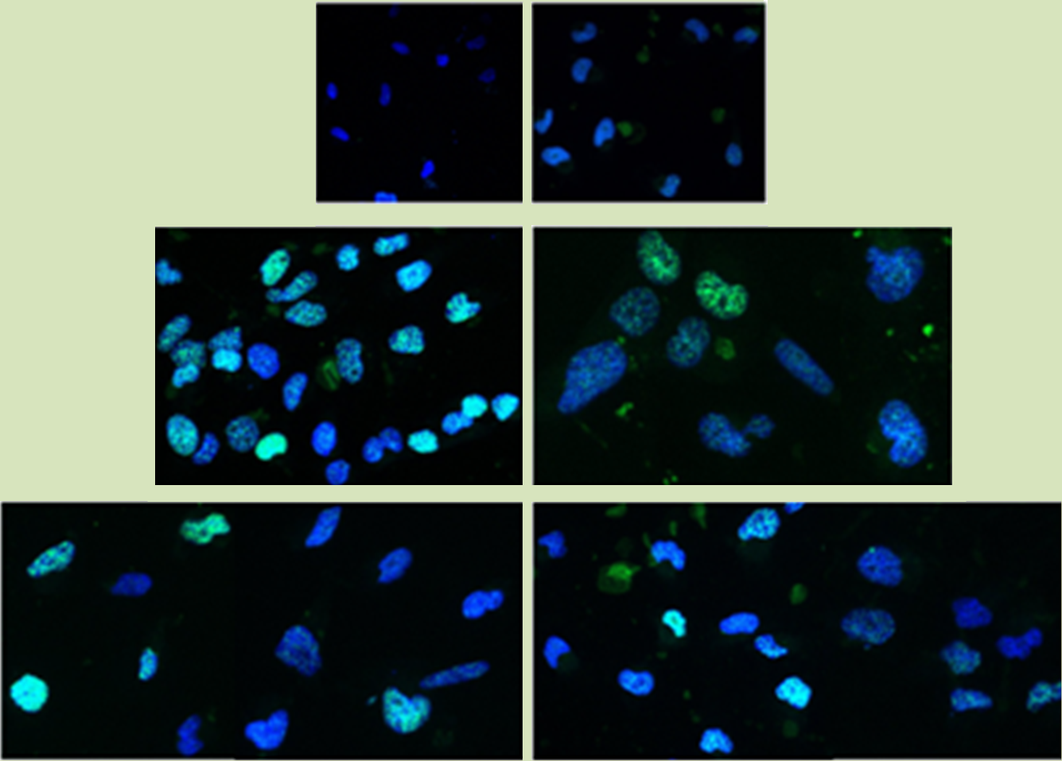
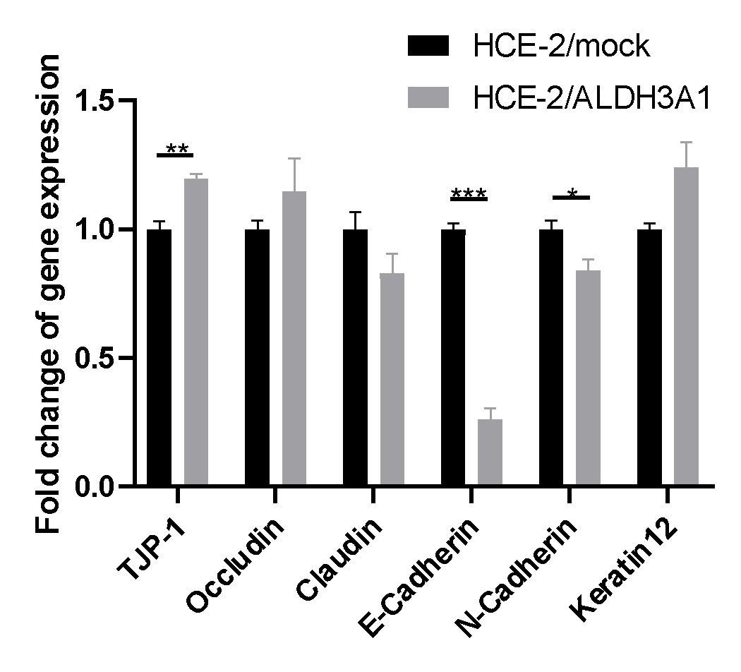
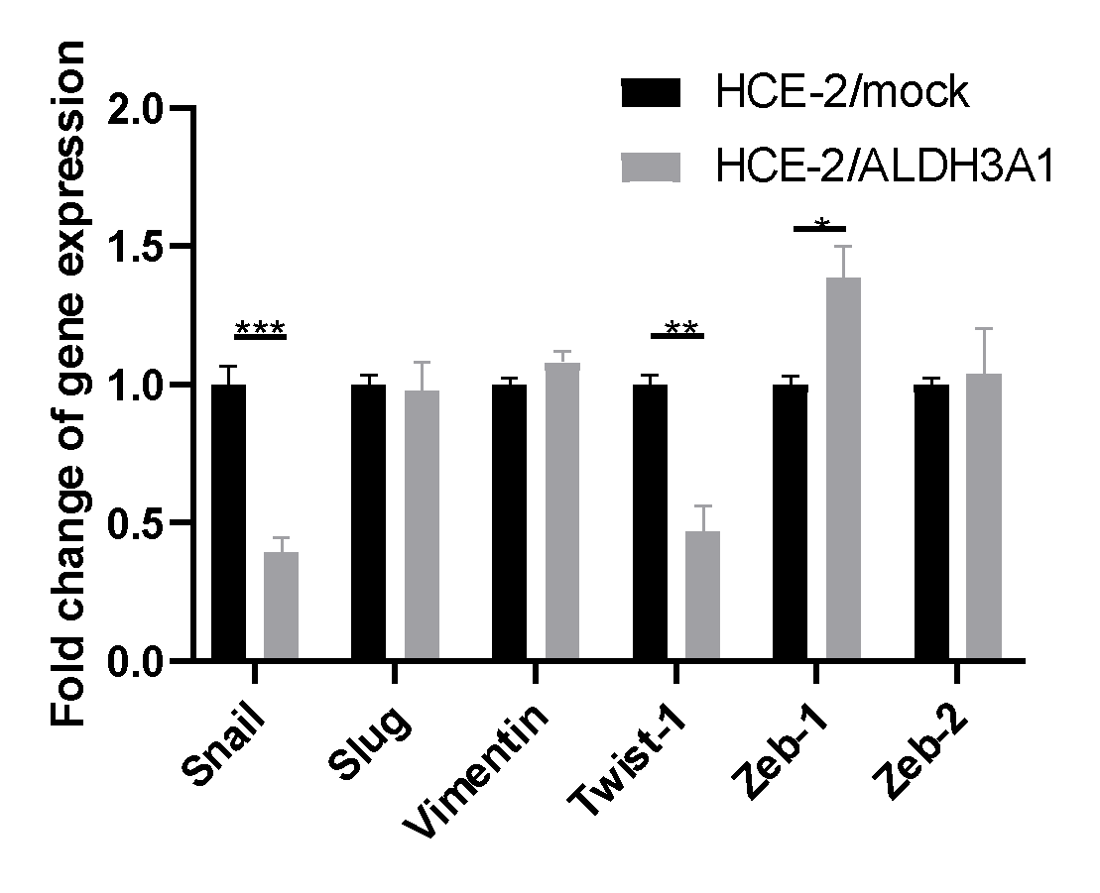
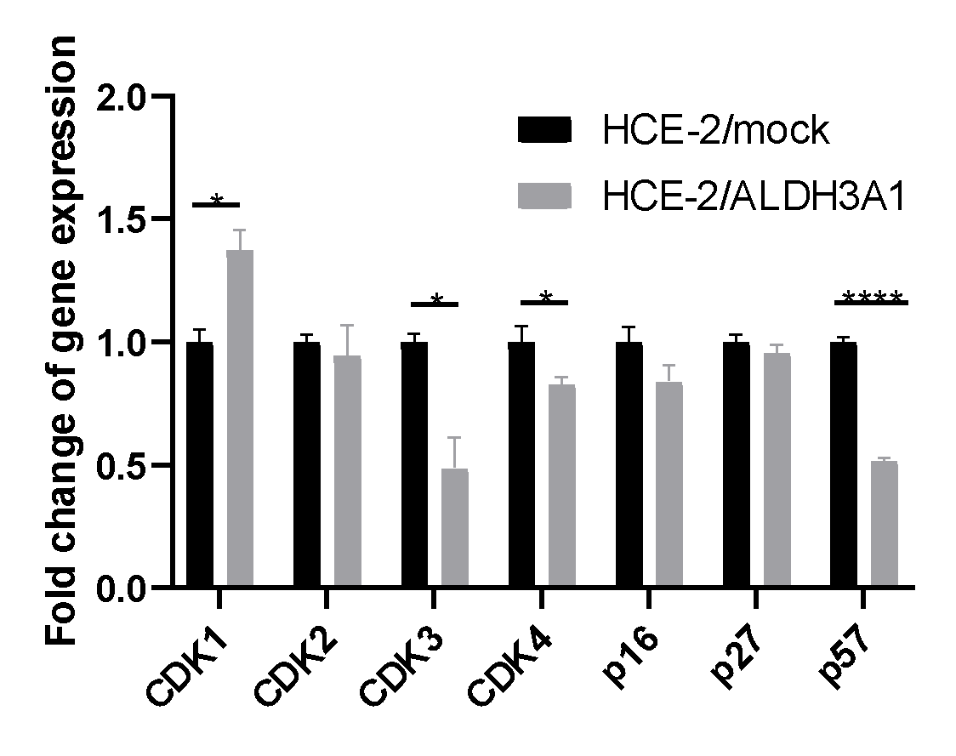
IS IT AN EYE-RANGER? Antioxidant defense mechanisms in human corneal epithelium
Venetikidou M., Voulgaridou G.,Pappa A Department of Molecular Biology & Genetics, Democritus University of Thrace, Alexandroupolis, Greece
INTRODUCTION
METHODS
Aldehyde dehydorgonases (ALDHs) are intracellular NAD(P)⁺-dependent enzymes that catalyze the oxidation of a wide range of endogenous and exogenous aldehydes to their corresponding acids. ALDHs are involved in multiple homeostatic processes. ALDH3A1 has been characterized as corneal crystalline due to its high abundance in mammalian corneal epithelia. ALDH3A1 is involved mainly in the protection against UV and oxidative stress-induced cytotoxicity in human cornea. However, its mechanisms of action are yet to be clarified. The aim of the present study was to investigate the mechanisms underlying the cytoprotective role of ALDH3A1 isoform in human corneal epithelial cells (HCE-2) under conditions of exposure to oxidative (H₂O₂) and genotoxic (etoposide: VP-16) agents.
Immunofluorescence for γΗ2ΑΧ detection after treatments with agents (H₂O₂ & Etoposide)
Isogenic HCE-2 cell line pair differing only in the expression of ALDH3A1 enzyme
RT - PCR for the expression of a panel of cell morphology, cell adhesion and cell cycle genes
RESULTS
ALDH3A1 reduces the formation of γH2Ax-foci in HCE-2 transfected cells after treatments with H₂O₂ (200μΜ) and etoposide (50μΜ).
ALDH3A1 alters gene expression of a panel of cell cycle, cell morphology and cell adhesion-related genes in HCE-2 cells.
i. untreated mock HCE-2 cells
ii. untreated ALDH3A1- HCE-2 cells
Fig 2. A panel of genes related with cell morphology and cell-cell interactions.
iii. mock cells treated with 200μM H₂O₂
iv. ALDH3A1- cells treated with 200μM H₂O₂
v. mock cells treated with 50μM Etoposide
vi. ALDH3A1- cells treated with 50μM Etoposide
Fig 3. Expression of wound healing markers differs between mock/ and ALDH3A1/ HCE-2 cells.
Fig 4.Differential expression of cell cycle genes. ALDH3A1 is associated with reduced cell proliferation rate.
Fig 1. Immunofluorescence for the evaluation of γH2Ax foci formation (green).
CONCLUSIONS
WE AIM TO
ALDH3A1 enzyme can be related with:
reduced DNA damage, as revealed by the lower recruitment of DNA Damage Repair (DDR) protein, γH2AX.
alterations in cell morphology and cell-cell interaction .
altered cell cycle regulation. ALDH3A1 molecule may serve a mechanism ensuring cell viability under stress conditions.
further investigate ALDH3A1 function as a cytoprotective molecule
better understand its specific involvement in DDR pathway and cell cycle regulation
REFERENCES
Koppaka, V. et al. ALDH3A1 plays a functional role in maintenance of corneal epithelial homeostasis. PLoS One 11, 1–20 (2016).
GP, V. et al. Aldehyde dehydrogenase 3A1 confers oxidative stress resistance accompanied by altered DNA damage response in human corneal epithelial cells. Free Radic. Biol. Med. 150, 66–74 (2020).
A, P. et al. Human aldehyde dehydrogenase 3A1 inhibits proliferation and promotes survival of human corneal epithelial cells. J. Biol. Chem. 280, 27998 – 28006 (2005).

