Slide 1
Water & Climate Information Services for society Υδρο-κλιματολογικές υπηρεσίες πληροφόρησης για την κοινωνία
Spyros Paparrizos
Assistant Professor Water & Climate Information Services
Water Systems and Global Change Group (WSG)
Wageningen University & Research (WUR), Netherlands
spyros.paparrizos@wur.nl

Slide 2
Previous week..
Part I: Introduction to Water and Climate Information Services
Story on Climate Change
1st + 2nd generation WCIS
Domains of WCIS
Data for decisions
Stakeholder engagement for services co-production
Part II: Exercise on sectoral WCIS

Slide 3
What are Climate Information Services?

Slide 4
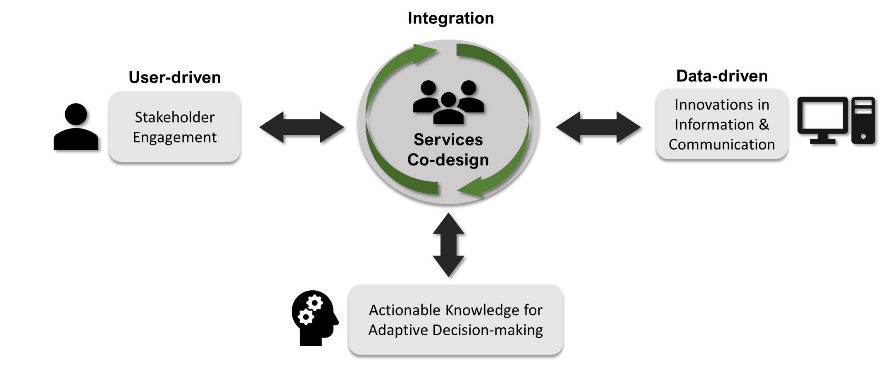
Take home message
Tailor-made services to the needs of end-users Integration is key!
Notes:
ενσωμάτωση

Slide 5
Outline – DAY 2
Part I: Examples of services
Part II: Assignment exercise explanation (graded)

Slide 6
Part I: Examples of services

Slide 7
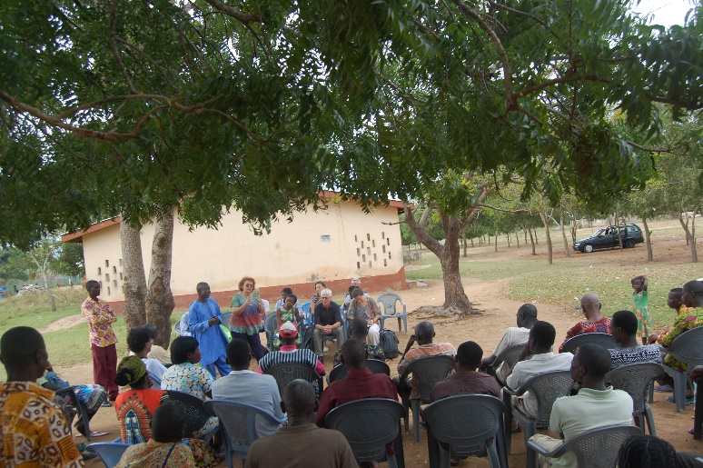
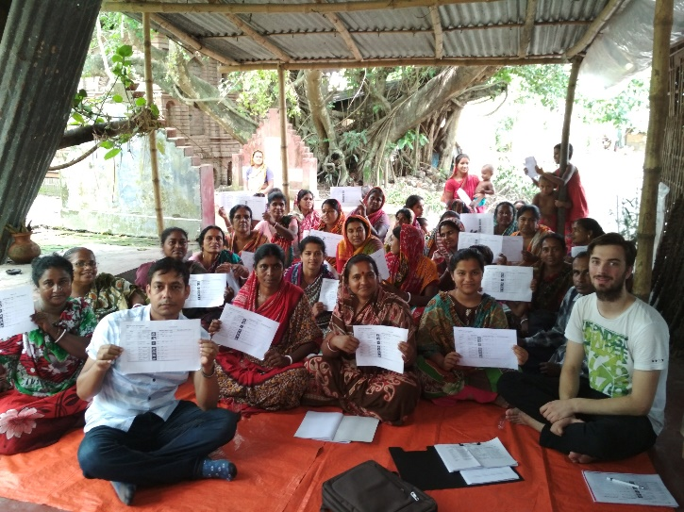
WATERAPPS
2016-2021
Aim
Co-develop tailor-made hydro-climate information services with and for farmers for sustainable agriculture in peri-urban delta areas
Ada, Ghana
Khulna, Bangladesh
Source: WaterApps website
Notes:
Overall RQ:
How can we combine and leverage the potential of water and climate availability forecasts and knowledge sharing platforms and virtual communities
-> to support adaptive decision-making for sustainable agriculture in peri-urban delta areas ?
How can the potential of water and climate availability forecasts and knowledge sharing platforms and virtual communities be leveraged to provide hydro-climate information services to support adaptive decision-making for sustainable agriculture in peri-urban delta areas ?

Slide 8
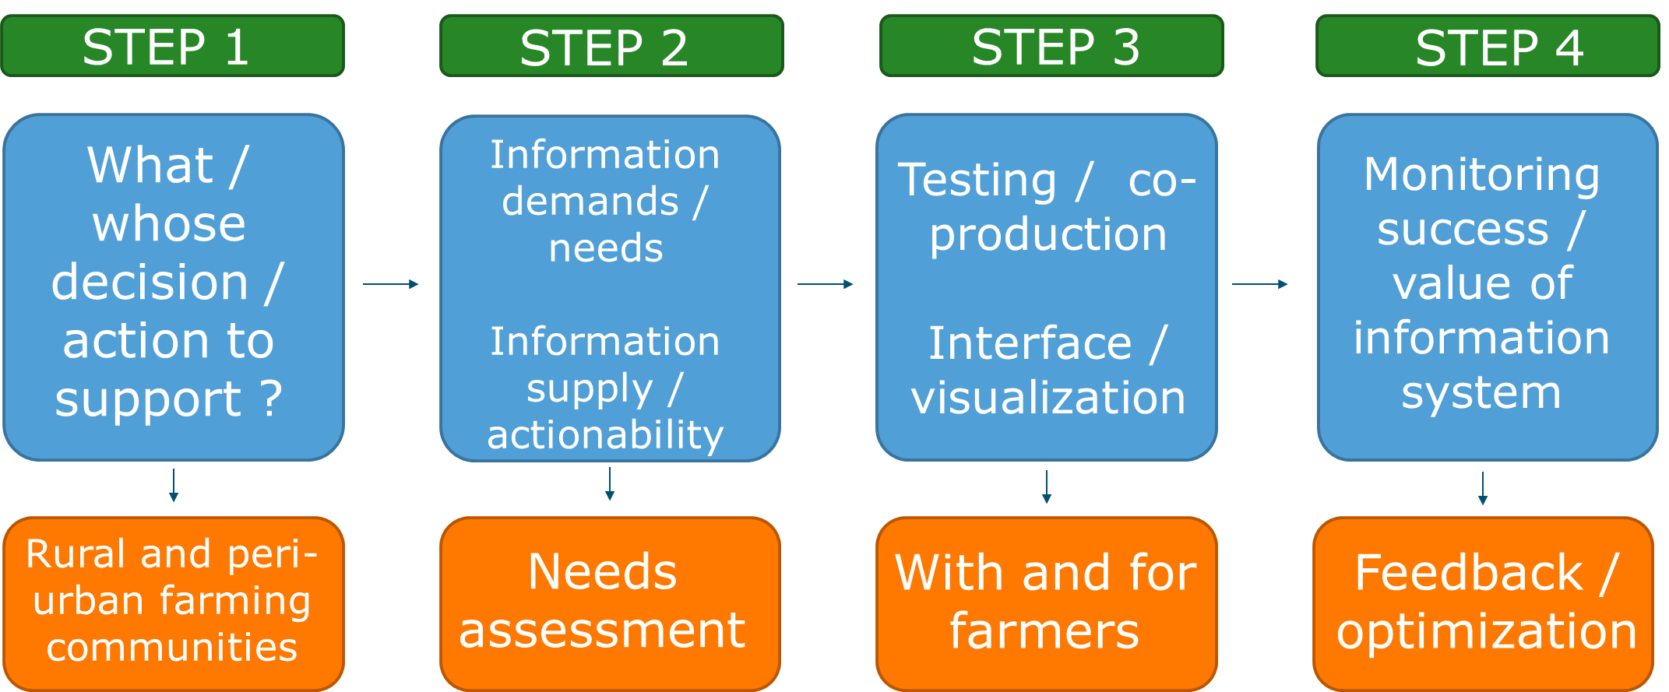
Conceptual framework
Notes:
We are trying to provide answers to the overal question as well as the sub-questions that have arisen from the main one through a conceptual framework where initially we perform a baseline study to see what is there and what are the users needs.
peri-urban farming communities
2a. Needs assessment
2b. What do we have now ?
WHEN WE KNOW WHAT IS THERE AND WHAT THE FARMERS NEED, WE GO AHEAD AND:
3. Co-develop tailor-made weather and climate information services with and for farmers through engagement in a participatory way
4. Feedback and evaluation of the information system

Slide 9
Harnessing local forecast knowledge on weather and climate
Study case 1: Accra & Tamale, Ghana

Slide 10
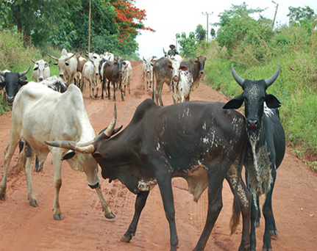
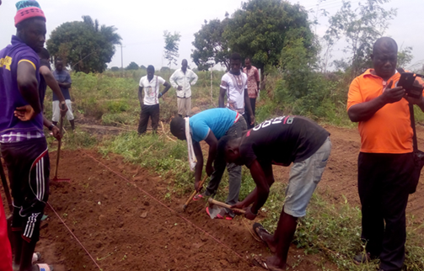
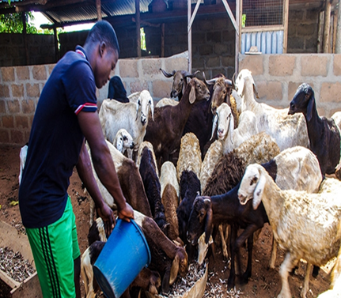
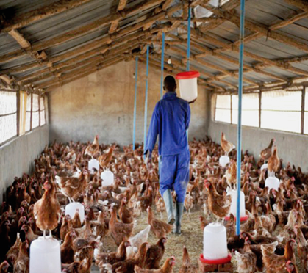
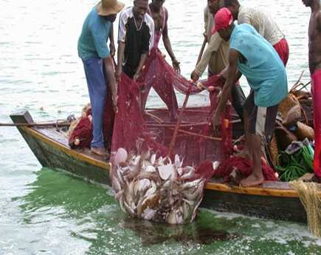
Ghana study case - Background
About 80% of households is involved in crop farming
Farming is mainly rainfed
Variable climate conditions (tropical climate) – increased variability
Population growth, urbanization, agriculture intensification (Volta Delta)
Need to improve crop yield and farmers’ income

Slide 11
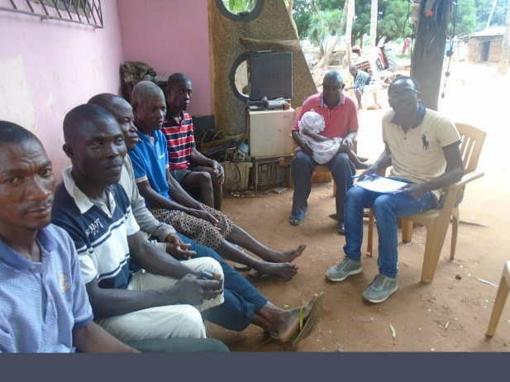
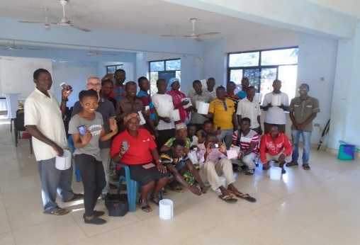
Services co-production (with digital tools)
Easily understandable information
scientists
Reduce chain of communication
Farmers
Farmers
Respond to users’ needs
More reliable information
scientists
Notes:
After the baseline and needs assessment study, the target was to respond the users’ needs and reduce the chain of communication, while at the same time co-developing easily understandable and more reliable information because we were aware that rainfall is characterized by local patterns in the study areas that we are currently working.
One community has rainfall, the next 5 km away does not.

Slide 12
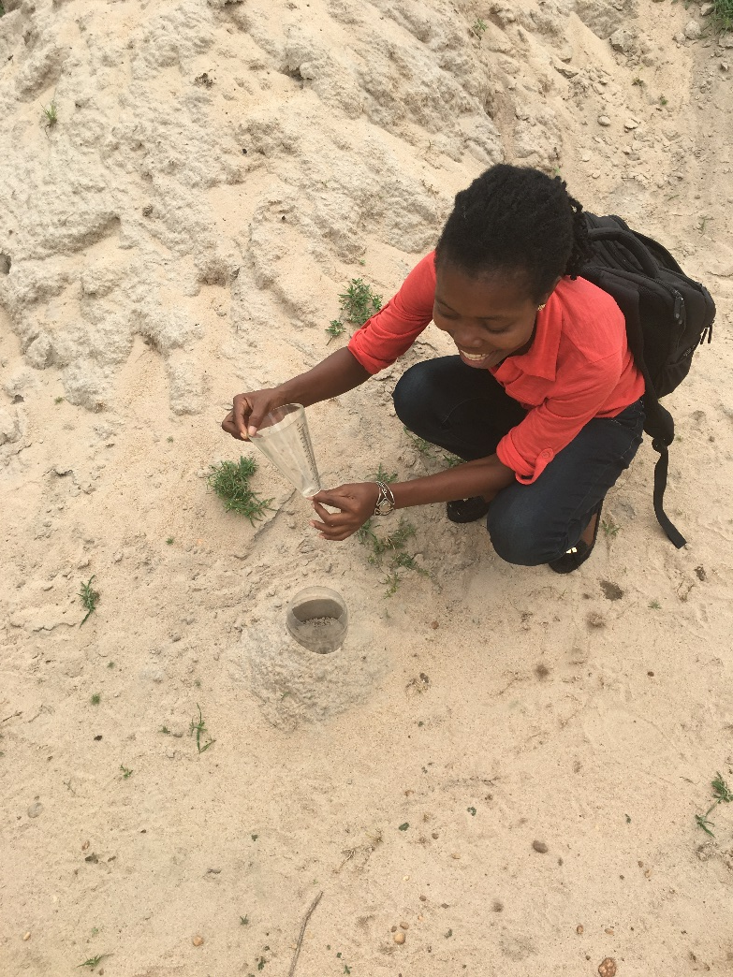
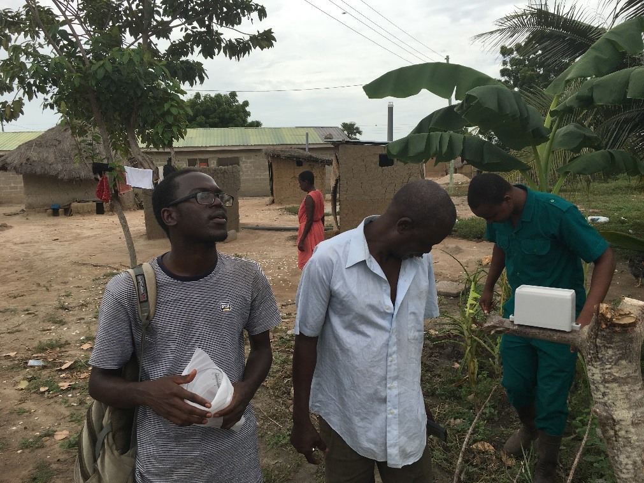
Field implementation
WATERAPPS PhD student Mr. Talardia Gbangou (left) with local farmers on the field
WATERAPPS PhD student Ms. Rebecca Sarku teaching local farmers how to install and measure rainfall

Slide 13
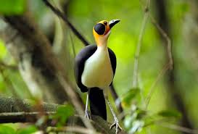
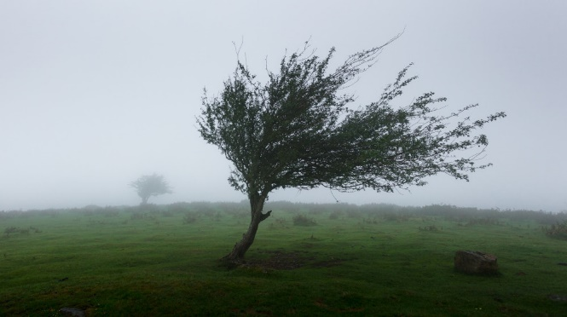
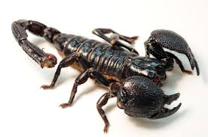
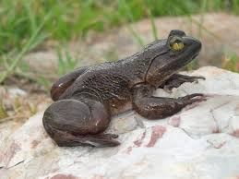
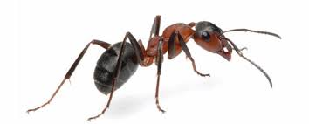
Local
Forecast
Knowledge
Notes:
Γνώση τοπικών προβλέψεων

Slide 14
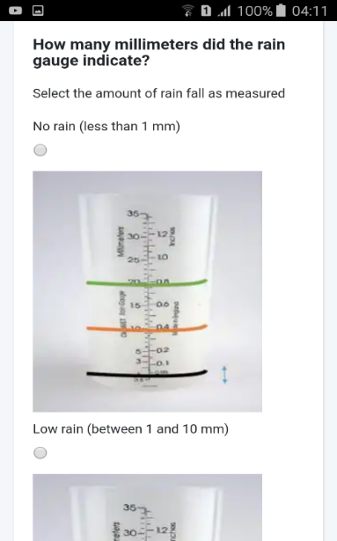
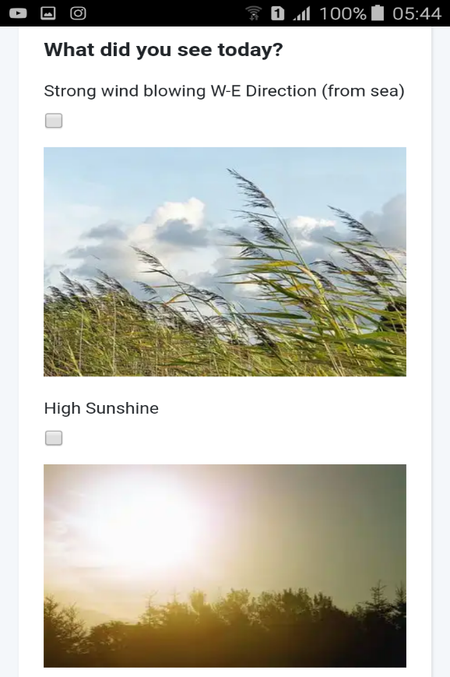
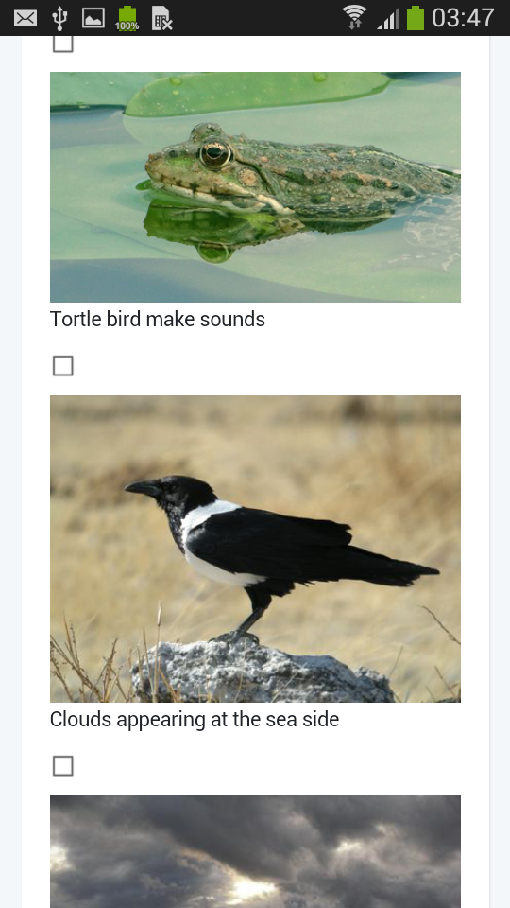
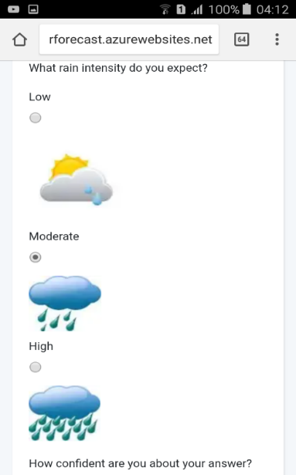
Experimentation: Farmers collect observations
Improve ability to select, submit observations with Web App

Slide 15
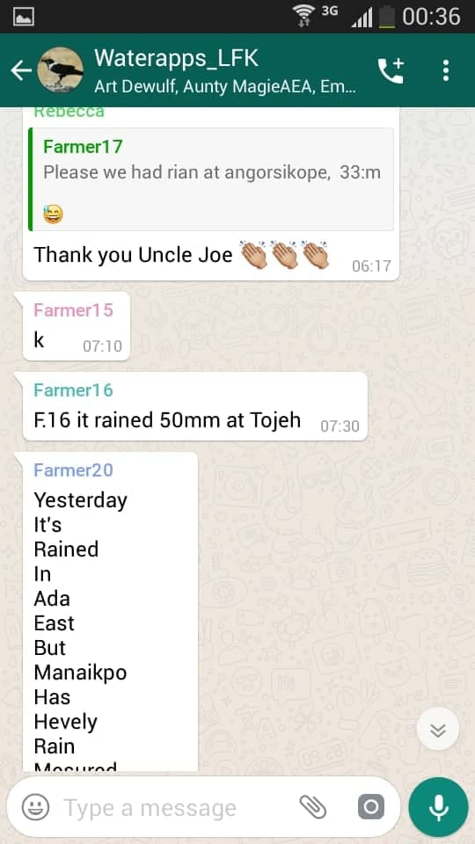
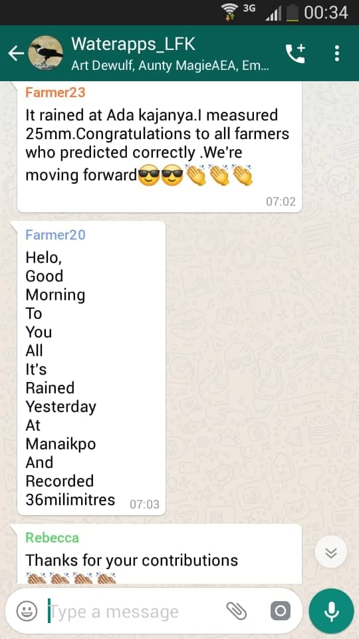
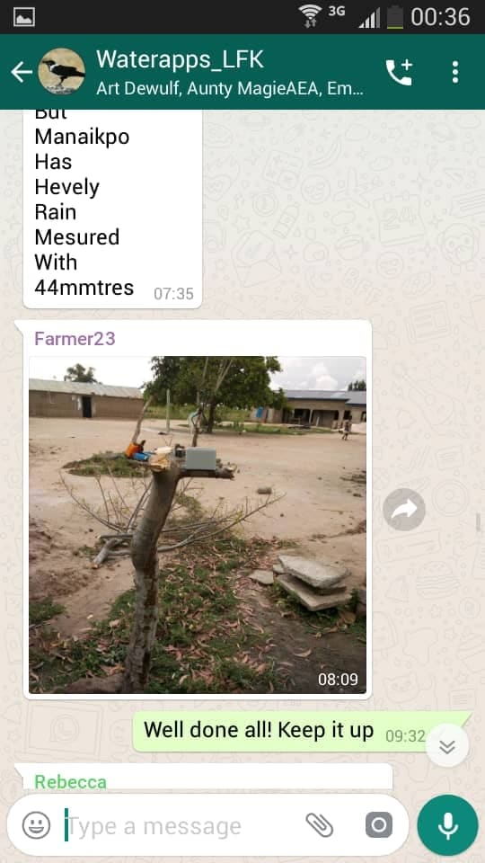
Experimentation: Farmers interact
Improve ability to receive feedback

Slide 16
Preliminary outcomes
Farmers are willing to provide their indigenous forecast
Ability receive forecast with WhatsApp
Discussions on the forecast outcome on WhatsApp
Ability to use a smart phone for the first time by some farmers
Ability to make decisions afterwards based on their measurements and their indigenous (local) observations
Notes:
Οι αγρότες είναι πρόθυμοι να παράσχουν τις εγχώριες προβλέψεις τους
Δυνατότητα λήψης πρόβλεψης με το WhatsApp
Συζητήσεις για το αποτέλεσμα πρόβλεψης στο WhatsApp
Δυνατότητα χρήσης έξυπνου τηλεφώνου για πρώτη φορά από ορισμένους αγρότες
Ικανότητα λήψης αποφάσεων στη συνέχεια με βάση τις μετρήσεις τους και τις γηγενείς (τοπικές) παρατηρήσεις τους

Slide 17
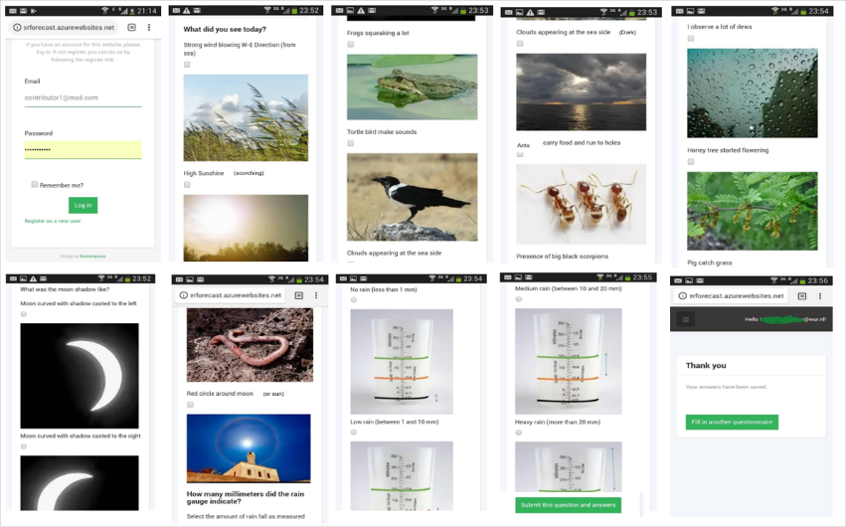
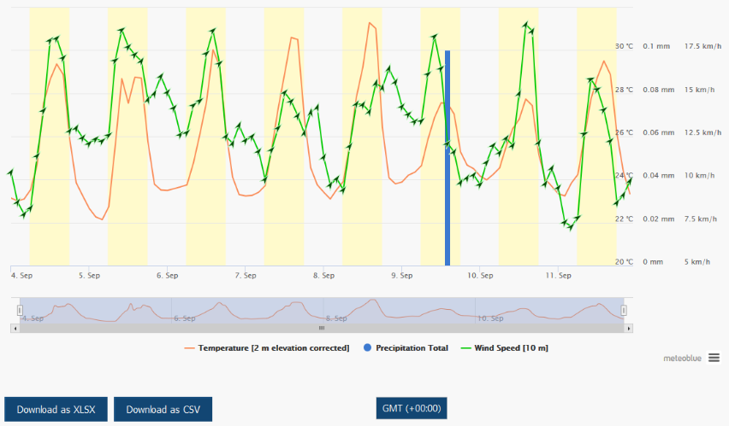
Skills assessment of local & scientific forecast
Metrics: ROCSS, H-K discrimination score, ...
Data from farmers (Local forecast - LFK)
Data from meteoblue (Scientific forecast - SFK)
LFK
Analysis period:
5th April – 17th July 2019
Skills assessment against actual observations
SFK
Notes:
Relative Operating Characteristic Skill Score (ROCSS): For discrimination of Below Normal (BN), Near Normal (NN) and Above (AN) categories
Hanssen-Kuipers (H-K): discrimination

Slide 18
Skills assessment of meteoblue (scientific) forecast Vs observations
 | Event-observed | Event-not observed | Total
Event-forecasted | Hits (a) | False alarms (b) | Yes forecasted (a + b)
Event-not forecasted | Misses (c) | Correct rejection (d) | No forecasted (c + d)
Total | Yes observed (a + c) | No observed (b + d) | Total forecasts (n)
82
120
38
23
222
245
105
260
365
H-K = POD – POFD with POD = a/(a+c) and POFD=b/(b+d)
POD = 82/(82+23) and POFD=38/(38+222)
H-K = 0.78 – 0.14 = 0.63 ~ 60%
Notes:
Example of H-K
Relative Operating Characteristic Skill Score (ROCSS): For discrimination of Below Normal (BN), Near Normal (NN) and Above (AN) categories
Hanssen-Kuipers (H-K) discrimination skill score (range: 0 to 1) were also used in the analysis. The H-K discriminant score is also used to verify (or better classify) events and non-events and it is universally acceptable to provide the best estimate when evaluating binary (yes/no) forecasts for decision-making purposes.
POD: Probability of detection (0-1, 1)
POFD: Probability of False Detection (0-1, 0)
FAR: False Alarm Ratio (0-1, 0)

Slide 19
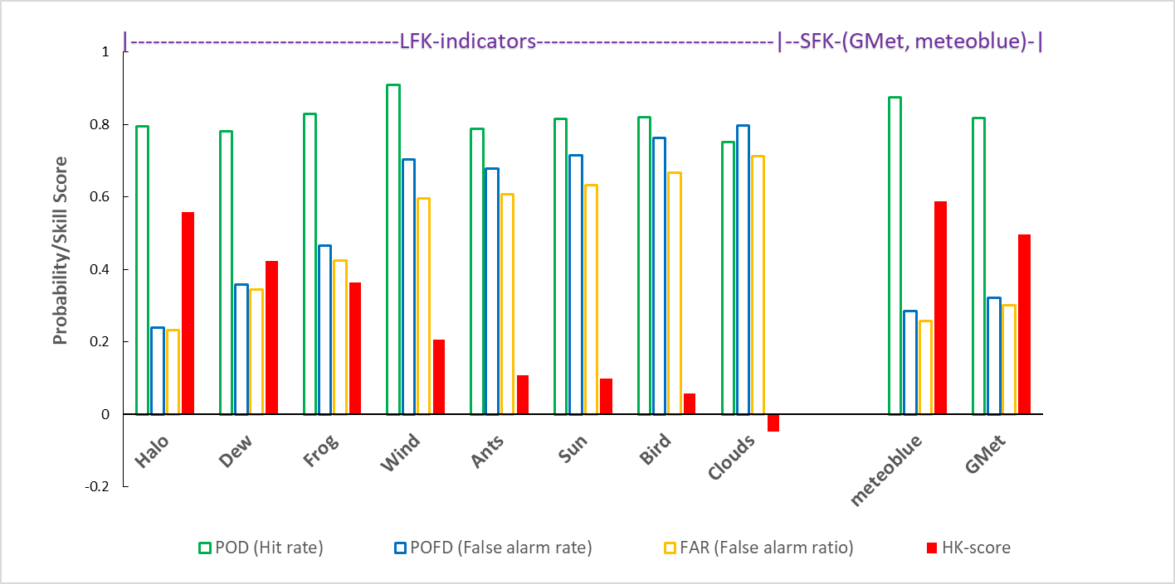
Skills assessment – Ada (southern Ghana)
POD: Probability of detection (0-1, perfect score: 1)
POFD: Probability of False Detection (0-1, perfect score: 0)
FAR: False Alarm Ratio (0-1, perfect score: 0)
H-K: Hanssen & Kuiper’s score (-1-1, perfect score: 1)
Notes:
Overall skills of local forecast (LFK-Indicators) and scientific forecasts (GMet, meteoblue) over from 5th April to 17th July 2019 period.
Hit rate, False alarm rate, and False alarm ratio are presented in different colors. Local and scientific forecasts skills are assessed against gauge observations.
Skills are classified from the highest to the lowest.
POD: Probability of detection (0-1, 1)
POFD: Probability of False Detection (0-1, 0)
FAR: False Alarm Ratio (0-1, 0)

Slide 20
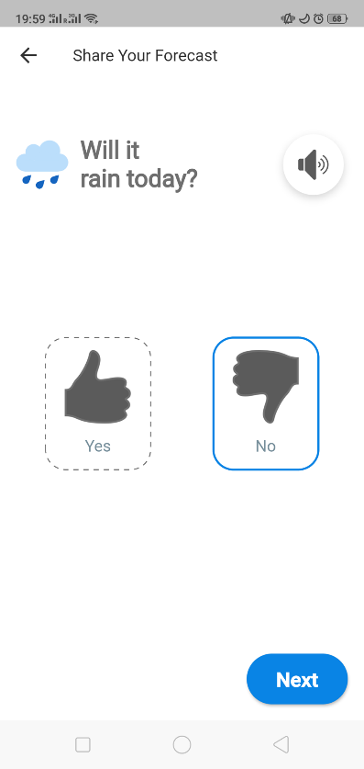
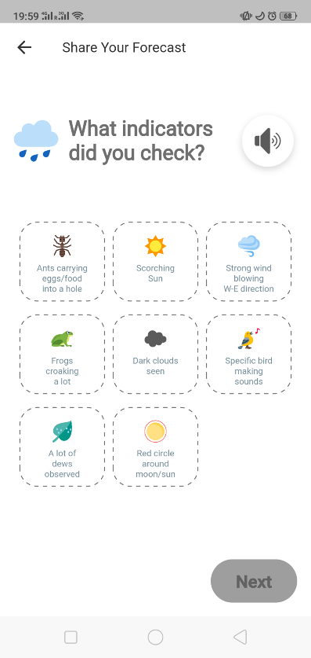
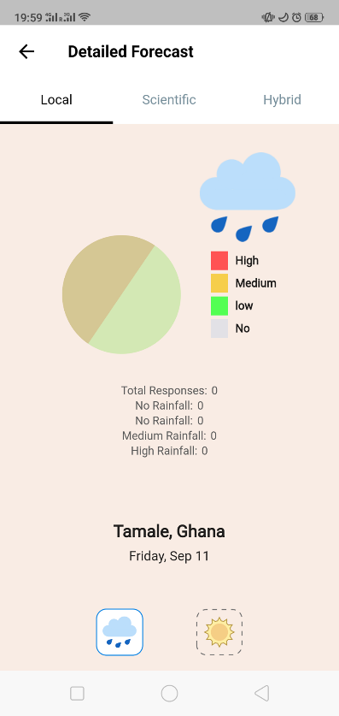
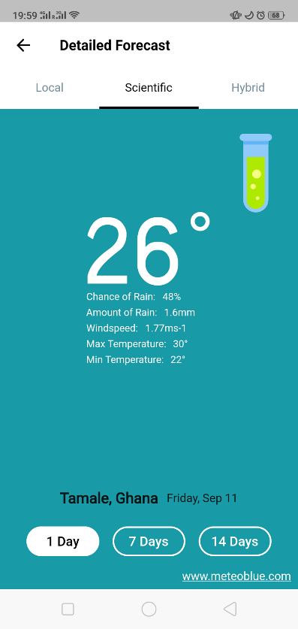
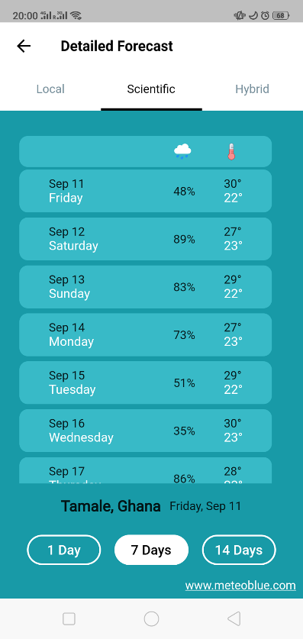
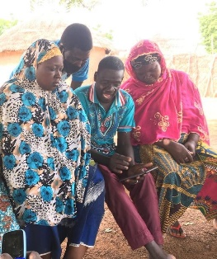
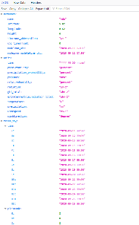
...into an actual information service
Farmers insert data
meteoblue provides data
Source: FarmerSupport app - WATERAPPS

Slide 21
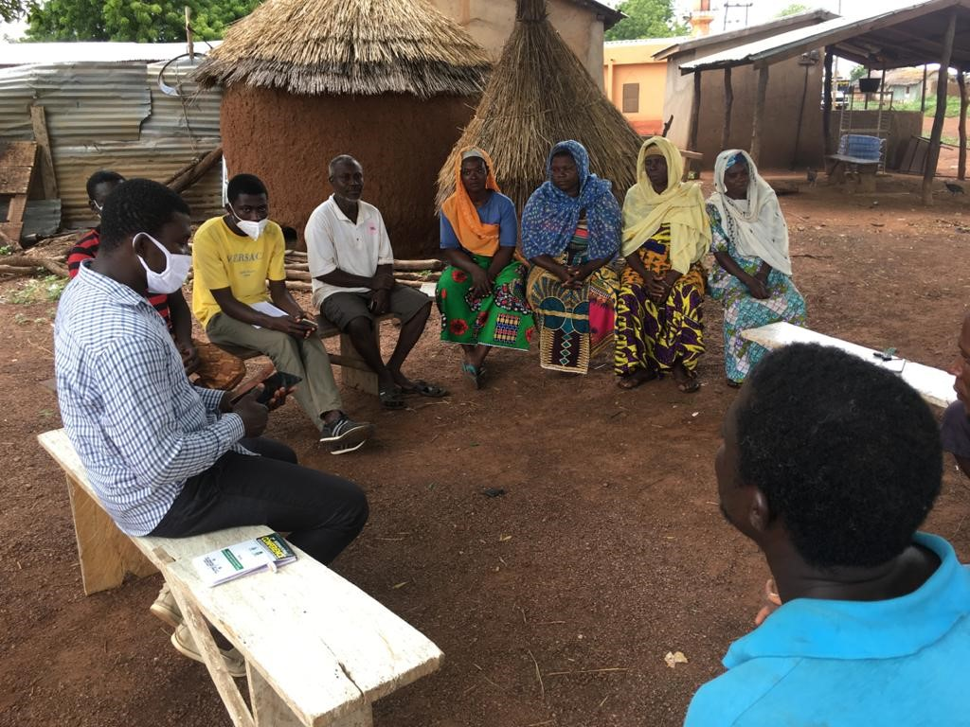
App field implementation
Focus Group Discussions
Provide Local Forecast (LF) + receive Scientific Forecast (SF)
Build capacity towards weather, water, and climate procedures
Build capacity towards ICT and the use of apps
Co-develop water-climate-agricultural advisory services
Notes:
Demonstrating how to enter predictions into the app

Slide 22
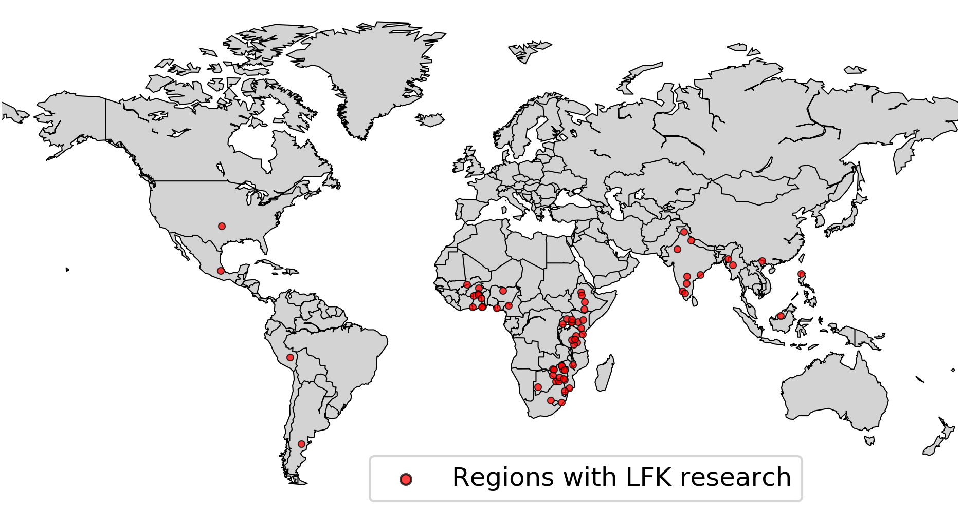
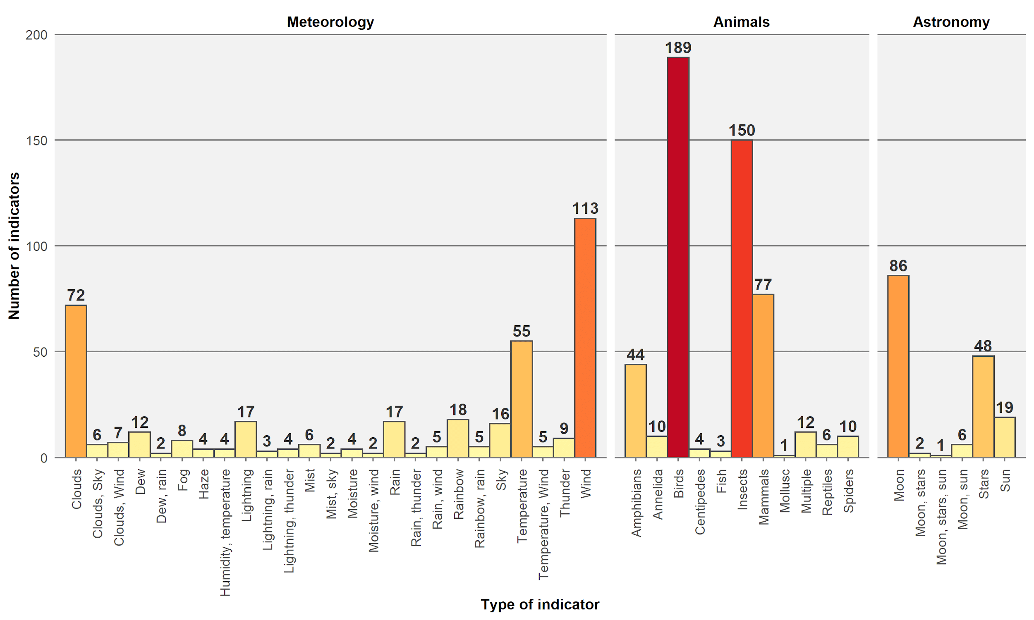
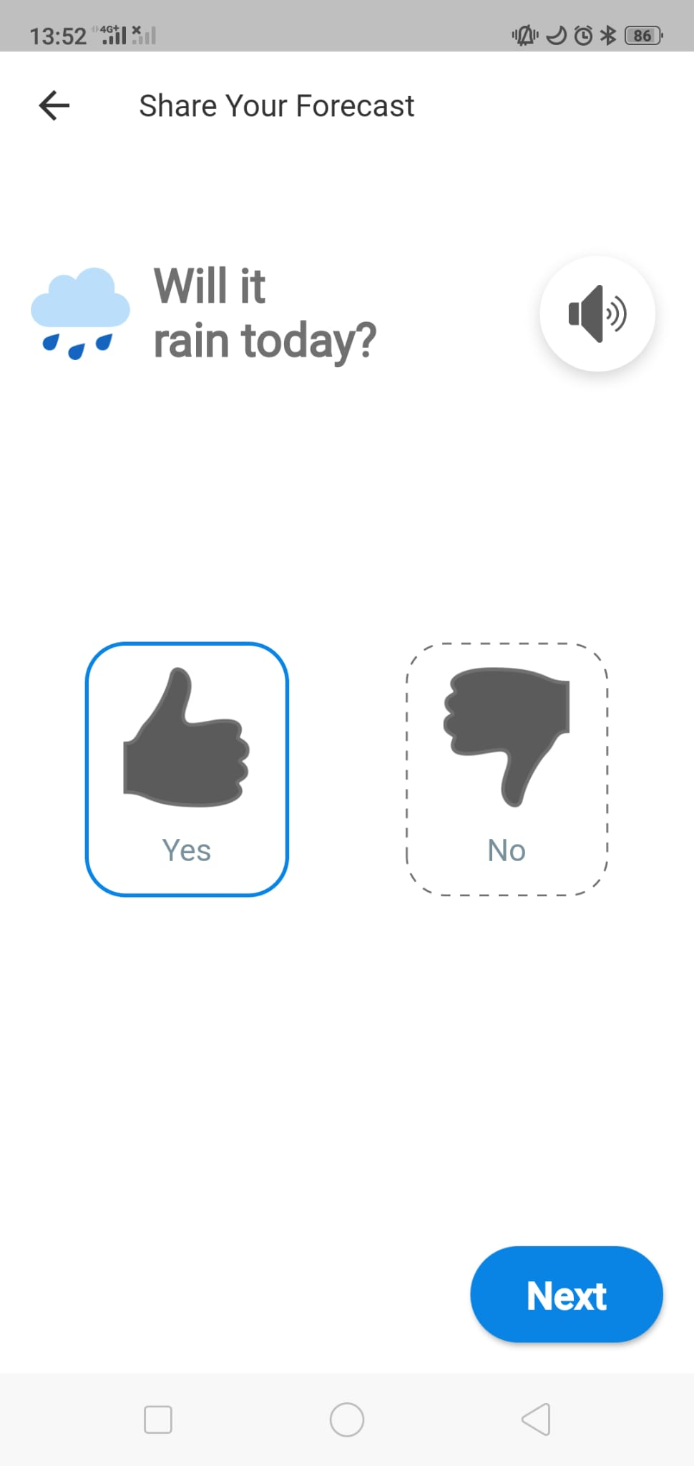
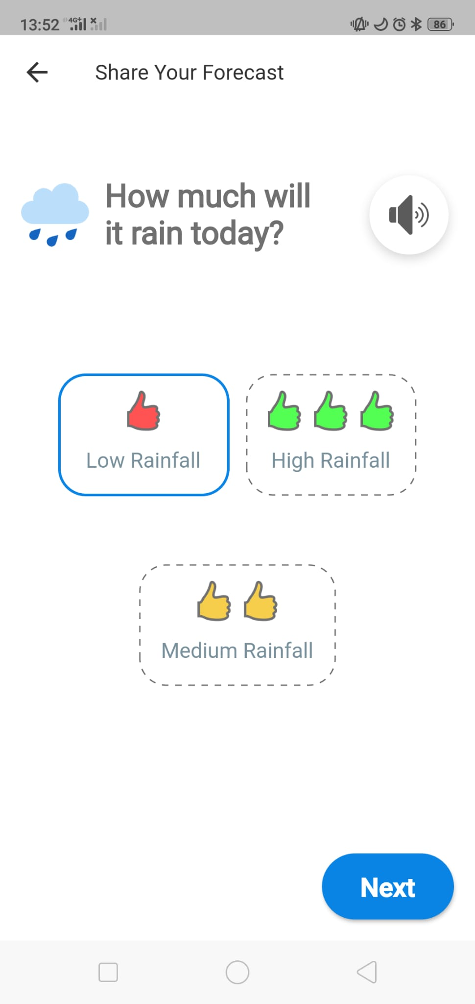
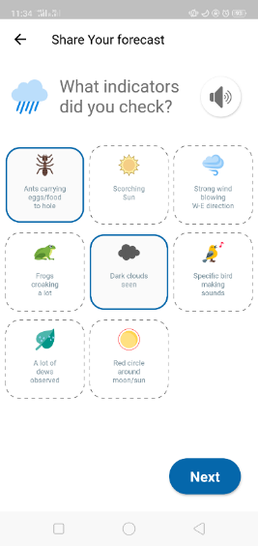
Harness Local Forecast Knowledge worldwide...
> 65 regions
> 1350 indicators
Notes:
Overall skills of local forecast (LFK-Indicators) and scientific forecasts (GMet, meteoblue) over from 5th April to 17th July 2019 period.
Hit rate, False alarm rate, and False alarm ratio are presented in different colors. Local and scientific forecasts skills are assessed against gauge observations.
Skills are classified from the highest to the lowest.
POD: Probability of detection (0-1, 1)
POFD: Probability of False Detection (0-1, 0)
FAR: False Alarm Ratio (0-1, 0)

Slide 23
Verification of forecast information in relation to the peri-urban farmers’ needs
Study case 2: Khulna, Bangladesh

Slide 24
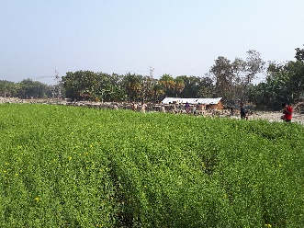
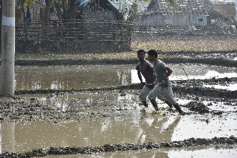
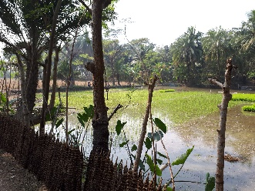
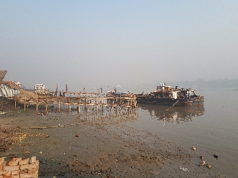
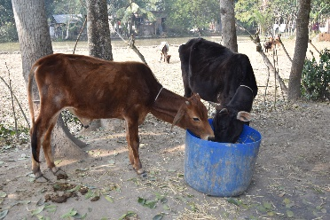
Bangladesh study case - Background
About 40% of households is involved in crop farming
Seasonal rain information is the most relevant for farmers in Khulna, especially at the beginning and before harvest periods
Farmers are interested in information about cyclone, hailstorm, drought
Farmers believe weather is GOD’s phenomenon

Slide 25
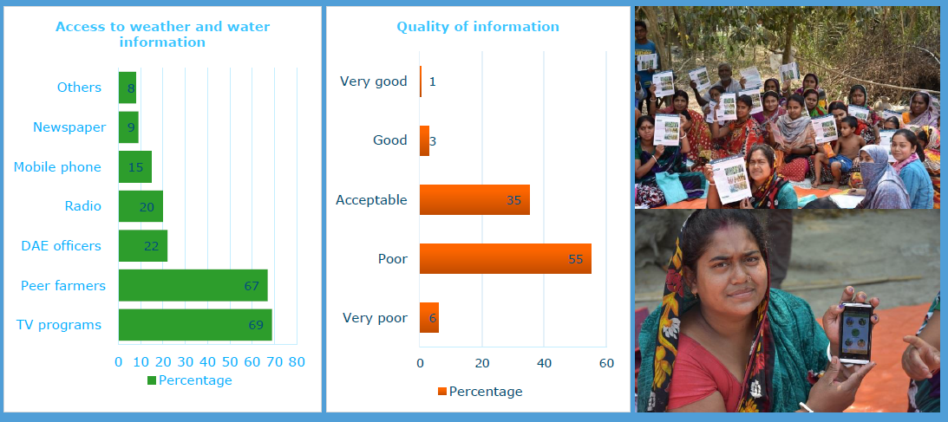
Preliminary analysis - needs assessment
Available water information & perceived value

Slide 26
Experiment...
Hypothesis
Farmers around Khulna are highly sensitive to hydro-climatic hazards.
Location and time specific information is important for agricultural decision-making.
Forecast visualization and information communication using mobile phones/app is faster and could better influence the farmers’ decision-making.

Slide 27
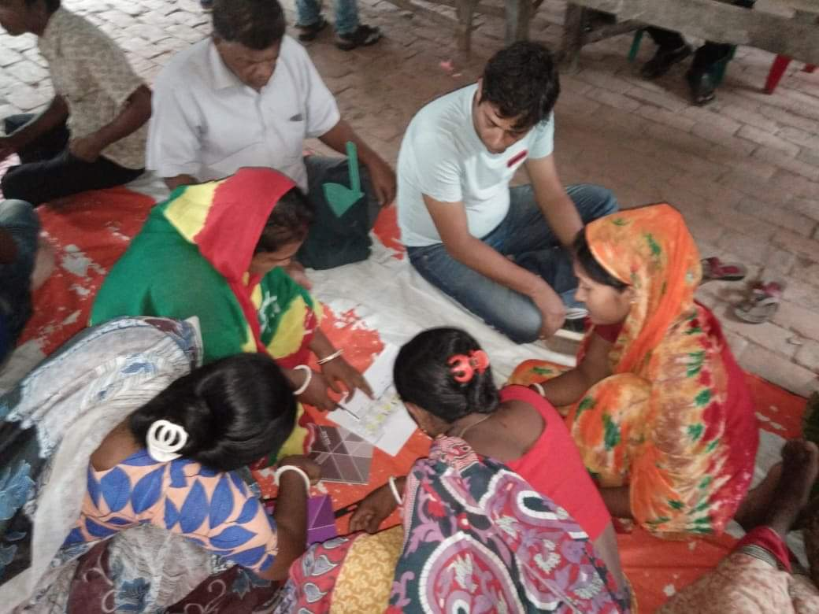
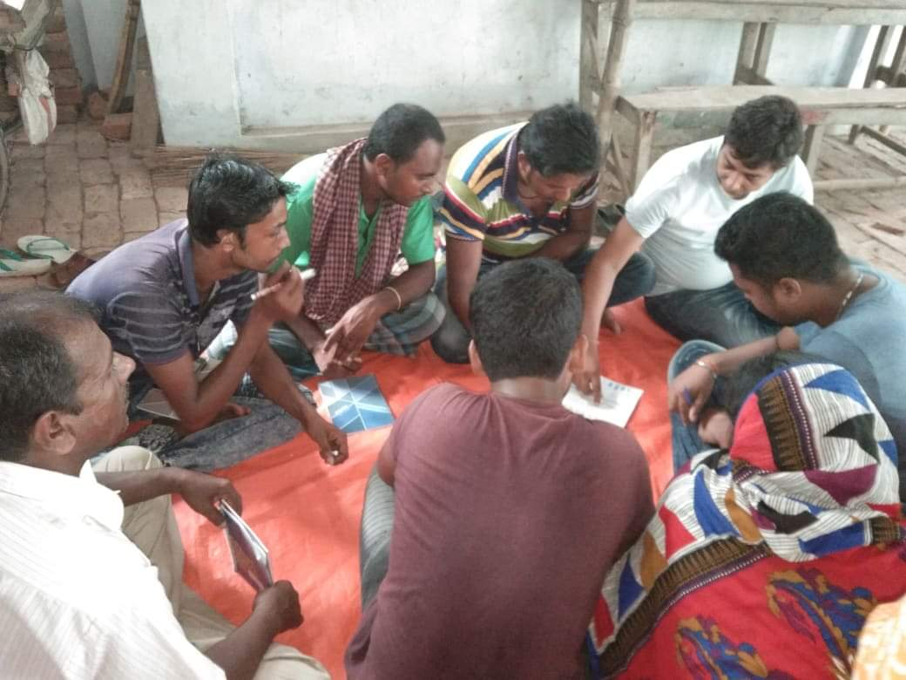
Experimental setup – Farmer Field School
Experimental elements
Tailor/co-production of climate services
Farmer field schools (FFS) at 2 villages (32+26 ppl / FFS)
Crop season: Aman (rainfed season in Bangladesh)
Season duration: mid-Jul/Aug - Mid-Nov/Dec
Weekly meetings, feedback and process monitoring

Slide 28
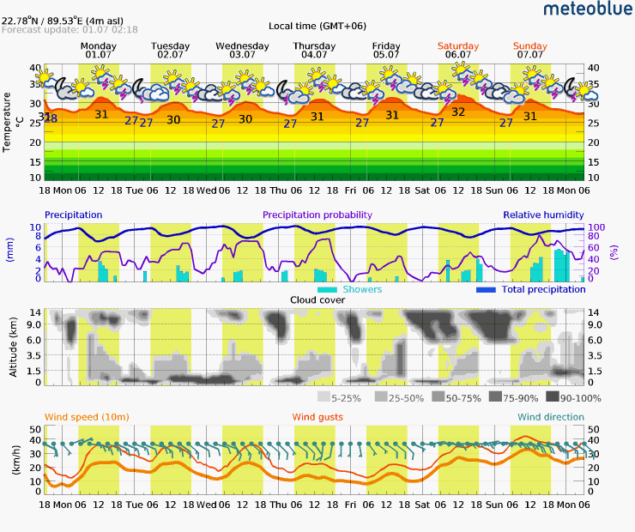
Provided forecast products
7-days
Seasonal (3 months)
14-days
Source: meteoblue

Slide 29
Advisory services with and for farmers
Female farmers sharing weekly agricultural advice and information that was developed by themselves
Weekly session with three tasks:
1st 30 min feedback session
2nd 30 min forecasts sharing and discussion
3rd 30 min preparation of weekly advice for farmers

Slide 30
Evaluation –outcomes
Facebook groups (feedback)
Time in advance
Information
needs
Notes:
We are currently on the evaluation phace, and we are already receiving the first outputs..
We have facebook groups where besides provide forecast information, farmers could also provide their feedback in real time..
Plots (right): baseline and now they include the endline.
Farmers are more knowledgable to select the advance time that they want to have information.
- Information needs include more parameters, mainly because the farmers know which indicator is crucial for each period and cultivation phase.

Slide 31
Integration
Ability to capture forecast: poor → implications
Build farmers’ capacity on forecast uncertainties
Potential benefits of skilful forecasts (subsidies, boost entrepreneurship,..)
Improve forecasting using ground observations (local patterns challenging to capture) + Indigenous knowledge
Notes:
Implications:
- More water in less time (water stress, management,...)

Slide 32
WATERAPPScale
2021-2023
scale
Aim
upscale WATERAPPS water and climate information services for sustainable food production in peri-urban delta areas in Bangladesh
Sources:
Fsapp on Google Store
Fsapp story – field implementation
Notes:
WATERAPPSscale aims to bridge the gap between existing national weather and climate services and the local needs by upscaling the work of the WATERAPPS throughout Bangladesh. The WATERAPPS research showed that combining scientific with local farmer’s forecast knowledge and co-producing forecasts information results in improved climate and weather information services and has multiple advantages. The main one is the initiation of a learning process, both with information service producers and farmers which improves the quality of the provisioned services. The Bangladesh Delta Plan 2100 Knowledge Agenda prioritizes climate and weather information services in the framework of adaptation to climate change. WATERAPPSscale addresses this challenge by upscaling the WATERAPPS activities following the ‘weather club’ example, to other regional farming communities in Bangladesh by:
implementing the design principles for information services that were co-produced at a local scale into 5 new locations, serving as basis for generic Bangladesh design principles and
upscale the FarmerSupport app (section 2) for use in Bangladesh to increase the resilience of local vulnerable farmers to a changing climate and unlock their farm potential.

Slide 33
WAGRINNOVA
2019-2022
Aim
Co-innovations across scales to enhance sustainable intensification, resilience & food and nutritional security in water-managed agricultural systems in West Africa.
Tamale, Ghana

Slide 34
Soil moisture tool - framework

Slide 35
DROP app
DROP app outlook
APP providing Soil Moisture (SM) forecasts up to 7 days ahead
Farmers’ can provide their indigenous forecasts
Tailored to farmers’ need and specific crops in Ghana
Front page
Local forecasts
Scientific forecasts
SM forecasts

Slide 36
C3S User Learning Services
Commercial project providing free training and educational activities on the principles of designing a climate services and use of climate data.
Independently, we are researching the principles for capacity building for tailored climate services using this commercial project as a base line.
ULS training Lithuania – November 2019
ULS training Norway – March 2020
Notes:
We provide free training activities across Europe. The topics covered in our learning activities include:
Data discovery and use of climate data available from the Climate Data Store (including its toolbox) for climate adaptation case studies
Sectoral applications (eg agriculture, water, energy, shipping)
Communication of uncertainty in climate change adaptation
Our free online training resources can be consumed anytime and anywhere through the C3S ULS portal (uls.climate.copernicus.eu). Resources are organised in learning paths to meet specific (personalised) learning goals.
We aim to research capacity building of users, training modules, co-learning, etc.

Slide 37
C3S (Copernicus Climate Change Services)
Source: https://climate.copernicus.eu/

Slide 38
Climate Data Store (CDS)
Source: https://cds.climate.copernicus.eu
Notes:
The C3S (Copernicus Climate Change Service) - Climate Data Store (CDS) is a place to find information about the climate: past, present and future.
It provides access to a wide range of climate datasets via a searchable catalogue.
An online toolbox is available that allows users to build workflows and applications suited to their needs.
The CDS infrastructure is designed to provide a single entry point for users to discover and process data and products from distributed data repositories. It also includes functions for managing users, product catalogues and the toolbox.

Slide 39
Climate Data Store (CDS)
Notes:
Data search using KeyWords + Relevancy criteria such as :
Product type (climate indices, clim. Projections, reanalysis, in-situ observations, satellite, seasonla forecasts)
Variable domain (land, ocean, atmospheric variables)
Spatial coverage (Europe, Global)
Temporal coverage (past, present, future)
Sector (Water, Agriculture, Health, ...)
Provider (ECMWF, EUMETSAT, other related providers...)

Slide 40
Example of datasets: ERA5
Notes:
ERA5 re-analysis dataset
Comprehensive overview with dataset and variables’ description
Spatial and temporal resolution + file format (GRIB, we usually work in netcdf)

Slide 41
Example of datasets: ERA5
Product type
Variable (categorization)
Period (Year, month, time)
Geographical area (extend)
Format
Easy retrieval
More info about ERA5: ERA5 – ECMWF website

Slide 42
CDS Toolbox
Notes:
If you go to the toolbox within the Climate Data Store, you will get something like this.
Documentation that would guide you effectively through the CDS Toolbox, tutorials, how-to-guides, etc
API Reference in case you want to call functions on your server to request data (that they will subsequently be shown and automatically updated)

Slide 43
CDS Toolbox – Toolbox editor
Notes:
Toolbox editor to make your own (online) scripts

Slide 44
CDS Toolbox – Toolbox editor
Notes:
Toolbox editor to make your own (online) scripts

Slide 45
Exercise
1 -2 hrs
- Choose a WCI service of your preference (mainly around Greece or SEE), and construct the table that is provided on the following slide.
- Work on the service according to what we have done last and this week and answer the following questions:
- Provide some identification (your name, affiliation, student data, etc)
- Provide a general description of the service we are debating (max 250 words)
- What are the main users of the service?
- What are the actions/decisions the services support?
- Type of data sources used?
- How the service describes the design process USER ENGAGEMENT of the WCIS between the users and developers? Use one of the 4 categories
(deadline: Παρασκευή 23 Δεκεμβρίου 2022) -> spyros.paparrizos@wur.nl
MAX 1 PDF page – GR or EN!

Slide 46
[Service name]
Users
Actions/decisions the service supports
Type & data sources
User engagement

Slide 47
Thank you! Dank U! Ευχαριστώ!
Wageningen University,
The Netherlands

Slide 48
CSA Bangla
The aim of the project is to create a research institute for Climate Smart Agriculture with a new Master and different related research lines:
Opportunities for the use of Climate Information Services by farmers in forecasting plant disease in coastal Bangladesh
Engaging women in climate information services to address and overcome the gap in access and information
Salt intrusion management and modeling
Etc.
coastal Bangladesh

