Slide 1
Analysis of Electronic Converters DC / AC

Slide 2
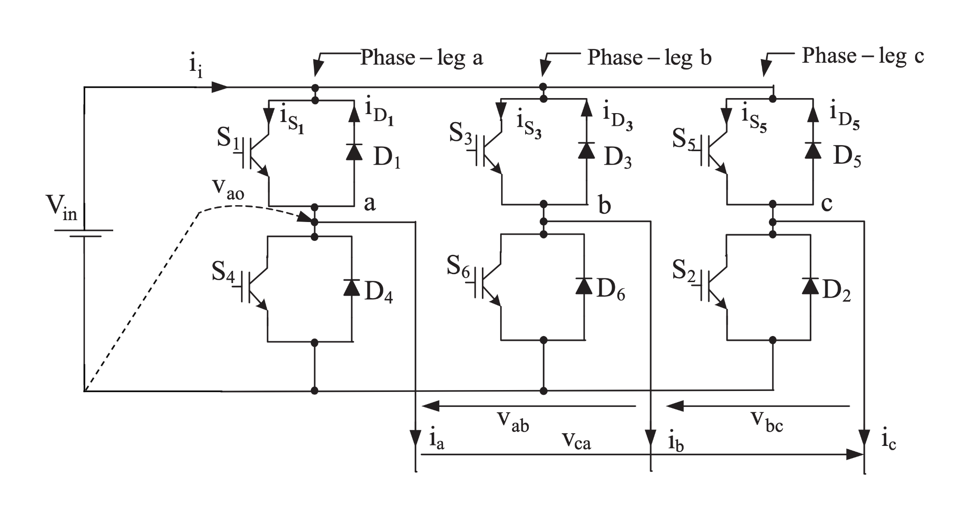
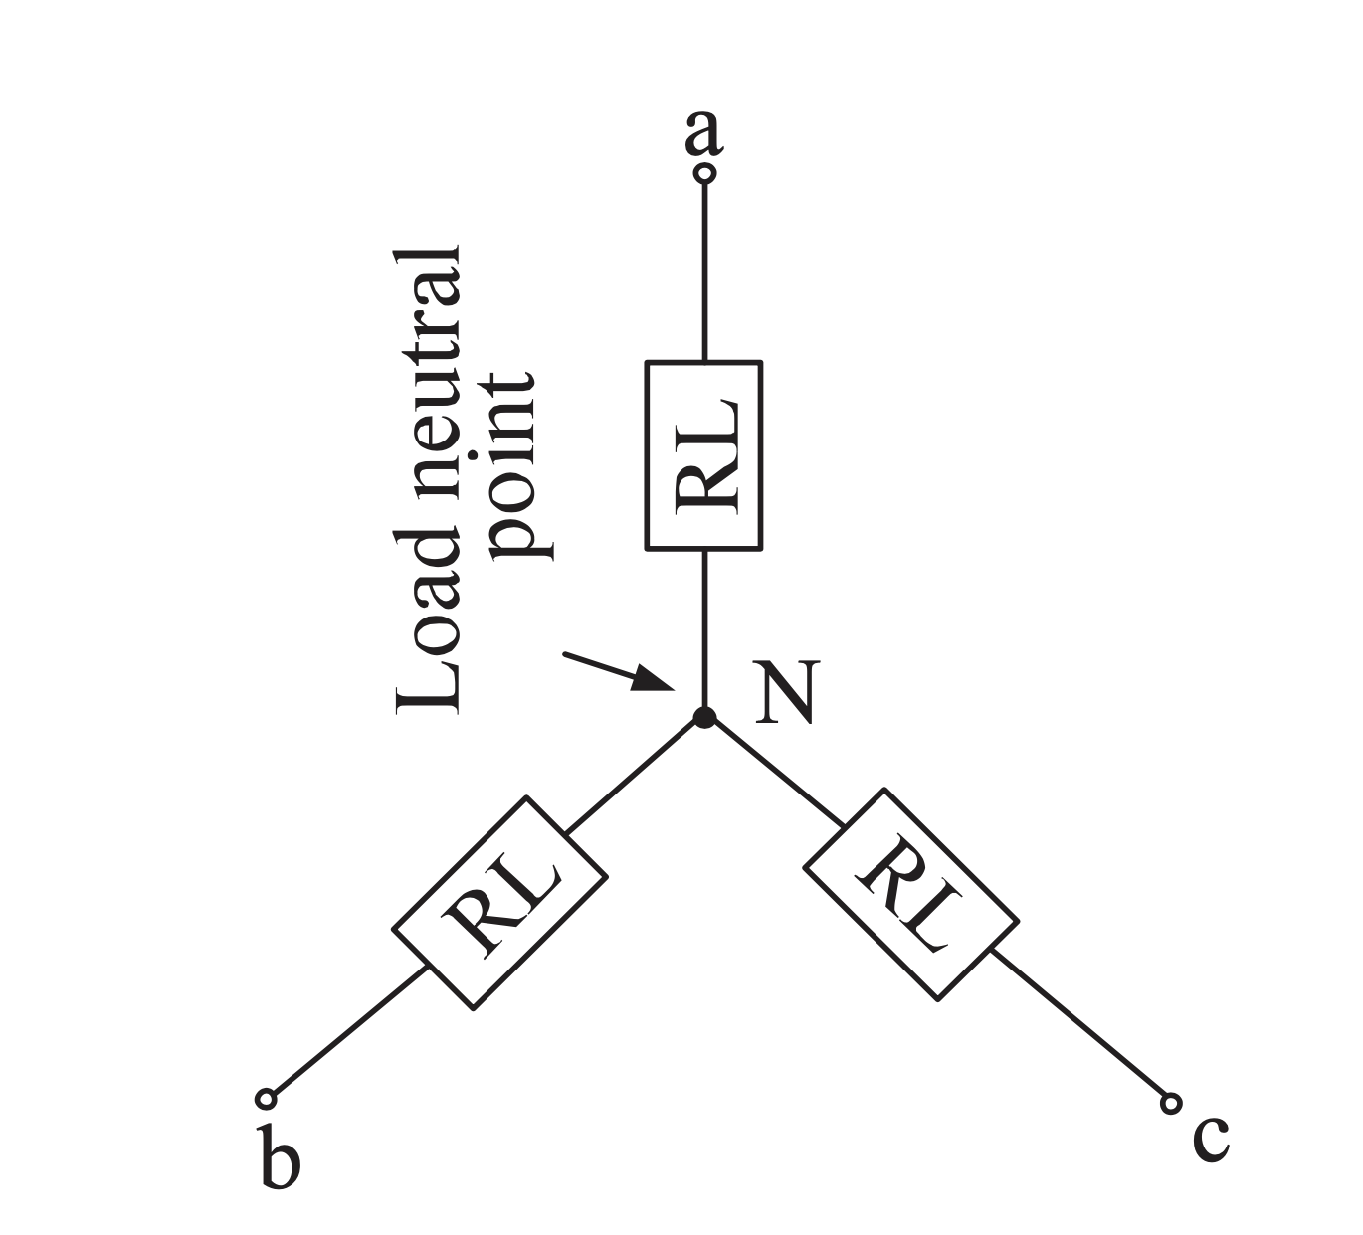
Task:
For a Voltage Source Inverter (VSI) which supplies symmetrical three-phase loads of star wiring and the conduction interval of each switching element is 180° calculate the harmonic component analysis for both the phase to neutral and the phase to phase voltage of this converter.
Fig. 1 Three-phase voltage source inverter.

Slide 3
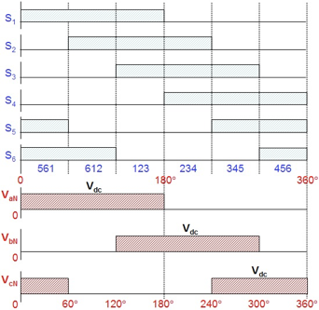
Solution:
In this converter the simplest method of creating a three phase output voltage is the six step one.
In this method we have a new conducting switching element every 60° and every switching element conducts for a time period of 180°.
Through this consecutive conduction of the 6 switching elements a rough sinusoidal waveform is produced at the output.
Because of that the output waveform is enriched with a variety of harmonic components.
Fig. 2 Waveforms of gating signals, switching sequence, line to negative voltages for six-step voltage source inverter.

Slide 4
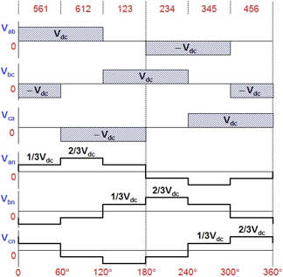
Solution:
In this converter there are two types of voltages depending on the reference of them:
Line to line voltages (Vab, Vbc, Vca)
called polar voltage:
Vab = VaN - VbN
Vbc = VbN - VcN
Vca = VcN - VaN
Line to neutral voltages (Van, Vbn, Vcn)
called phase voltage:
Van = 2/3VaN - 1/3VbN - 1/3VcN
Vbn = -1/3VaN + 2/3VbN - 1/3VcN
Vcn = -1/3VaN - 1/3VbN + 2/3VcN
Fig. 3 Waveforms of line to neutral (phase) voltages and line to line voltages for six-step voltage source inverter.

Slide 5
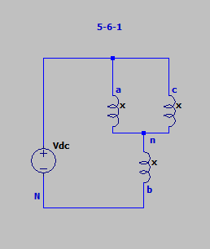
Solution:
For 561 conduction
The Phase to Neutral Voltages are:
The Phase to Phase Voltages are:

Slide 6
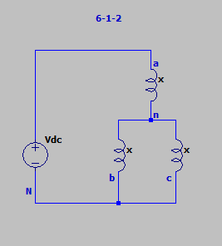
Solution:
For 612 conduction
The Phase to Neutral Voltages are:
The Phase to Phase Voltages are:

Slide 7
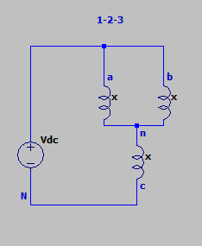
Solution:
For 123 conduction
The Phase to Neutral Voltages are:
The Phase to Phase Voltages are:

Slide 8
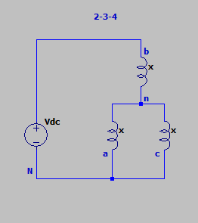
Solution:
For 234 conduction
The Phase to Neutral Voltages are:
The Phase to Phase Voltages are:

Slide 9
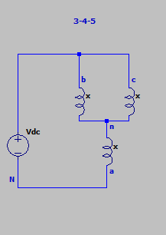
Solution:
For 345 conduction
The Phase to Neutral Voltages are:
The Phase to Phase Voltages are:

Slide 10
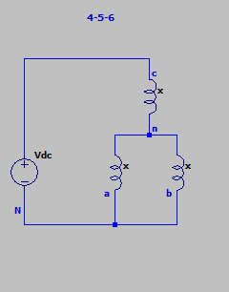
Solution:
For 456 conduction
The Phase to Neutral Voltages are:
The Phase to Phase Voltages are:

Slide 11
Solution:
The Fourier series of line-to-line voltages:
Where Vab,n is the amplitude of Vab:

Slide 12
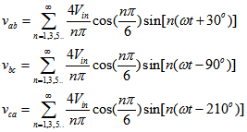
Solution:
Finally the line-to-line voltages:

Slide 13
Solution:
The output voltage amplitude for the first 21 harmonics:
n=1 Vab,1= 623.75V
n=5 Vab,5= 124.75V
n=7 Vab,7= 89.1V
n=11 Vab,11= 56.7V
n=13 Vab,13= 48V
n=17 Vab,17= 36.7V
n=19 Vab,19= 32.8V
For the rest of them between 1 and 21 the voltage amplitude is 0V.
The amplitudes were calculated with
which is the output voltage of a 3-phase rectifier.
The amplitudes for Vab, Vbc and Vca are the same. The phases of them are simply 120° apart between of waveforms.

Slide 14
Solution:
The load phase voltages can be replaced with the Fourier series:
Where V_{aN} is the amplitude of v_{aN}:

Slide 15
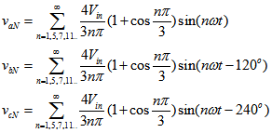
Solution:
Finally the load phase voltages are:

Slide 16
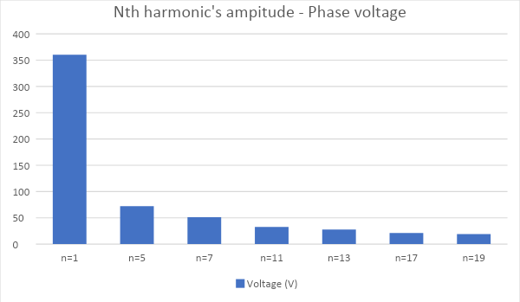
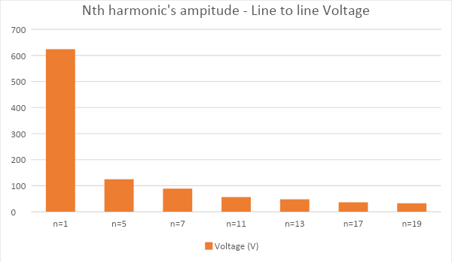
Solution:
It’s worth mentioning that due to the lack of the neutral connection the third and the multiples of the third harmonic are not existing.
Also due to the 90°-symmetry there is also lack of the even harmonics in the output voltage of this converter.

Slide 17
Thank you for your attention!

