Slide 1
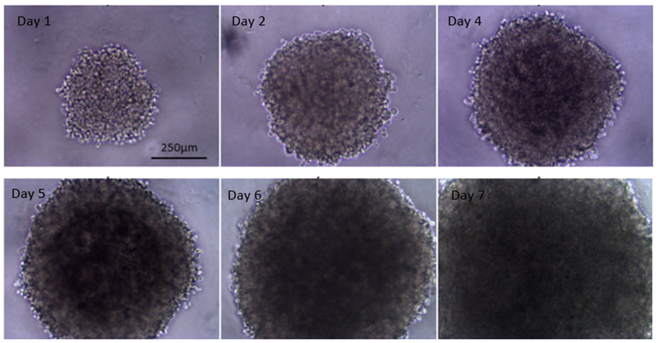
Efficiency evaluation of 3D cell culture protocols for multicellular spheroid formation
Lito Karkaletsou¹, Stylianos Didaskalou¹, Christos Efstathiou^{1,2}, Avgi Tsolou¹, Andreas Girod², Maria Koffa^{1*}
Summary
Cancer is a multifactorial and multilevel disease and one of the greatest medical problems of all time. Although the most accurate approach to study cancer is in tumors in vivo, their great degree of complexity and difficulties in manipulation make them unsuitable for wide use in the everyday laboratory practice.
The simplest and widely used in vitro model for the study of cancer is the two-dimensional (2D) culture of established cancer cell lines. However, 2D cultures have some disadvantages, which stem mainly from the difference in the behavior of cancer cells in 2D and 3D environments.
Department of Molecular Biology and Genetics, Democritus University of Thrace, Alexandroupolis, Greece
Department of Life Sciences and Medicine, University of Luxembourg, Esch-sur-Alzette, Luxembourg
*mkoffa@mbg.duth.gr
Three-dimensional (3D) cell cultures mimic more accurately the environment of a tumor compared to 2D cell cultures. In a multicellular spheroid, cells proliferate in close proximity, thus better mimicking cell-cell interactions, signaling pathways and spatial constrain. Moreover, the 3D geometry of spheroids restricts the flow of growth nutrients and oxygen towards the inner layers, forming proliferation gradients, commonly found in tumors. To this end, we tested different 3D culture methods, in order to establish a protocol for the formation of multicellular spheroids, which can be utilized for the study of cancer-related phenomena.
Methods
Results
In this study, three similar culture methods were tested:
Day 1
Day 2
Day 4
Day 6
1) Liquid overlay in agarose-coated wells of a 96-well plate
Day 7
Day 9
Day 11
Low melting point agarose was dissolved in culture medium to a final 1% concentration and autoclaved before usage
2) Liquid overlay in agarose-coated wells of a 96-well plate, in Matrigel-supplemented culture medium
250μm
HeLa Kyoto spheroids cultured in low-attachment round-bottom wells for 7 days
(Objective lens magnification: 4x)
HeLa Kyoto spheroids cultured in agarose-coated wells for 11 days
(Objective lens magnification: 4x)
3) Liquid overlay in low-attachment round-bottom wells of a 96-well plate
Day 1
Day 2
Day 4
Day 6
Three-dimensional observation of a HeLa Kyoto spheroid
marker: mcherry-tagged histone H2B
(image obtained with an Ultramicroscope II SPIM microscope)
Day 7
Day 9
Day 11
0
1
250μm
y
x
z
y
200g, 10min
HeLa Kyoto spheroids cultured in the presence of 2.5% Matrigel in agarose-coated wells for 7 days
(Objective lens magnification: 4x)
Centrifugation
z
x
Cell suspension
Aggregation
Spheroidization
Although the proper formation of tumor spheroids doesn’t provide much cancer-related information by itself, it is a required step for every downstream experiment. Thus, an easy and reproducible method of culturing must be established before using spheroids in any kind of laboratory procedure.
The liquid overlay in agarose-coated wells seemed promising. However, it produced variable results, as the coating procedure was not always successful, due to limitations derived from agarose properties. Nevertheless, there were occasions in which cells succeeded to aggregate into densely packed 3D structures, which had the potential to become spheroids. The addition of the extracellular matrix-mimicking substance “Matrigel’ enhanced spheroidization to a significant degree, but also led to the formation of secondary spheres in each well. Culture in low-attachment round-bottom 96-well plates proved to be the most efficient among the tested methods, as the resulting aggregates exhibited a greater degree of sphericity and compactness. This latter was confirmed by the utilization of a SPIM microscope, which enables the three-dimensional observation of thick samples, like multicellular spheroids.
K. Stock, M.F. Estrada, S. Vidic et al., Capturing tumor complexity in vitro: Comparative analysis of 2D and 3D tumor models for drug discovery, Sci Rep 2016, 6:28951, doi: 10.1038/srep28951
G. Bresciani, L.J. Hofland, F. Dogan et al., Evaluation of Spheroid 3D Culture Methods to Study a Pancreatic Neuroendocrine Neoplasm Cell Line, Front. Endocrinol., 04 October 2019, 10:682, doi: 10.3389/fendo.2019.00682
A. Hornung, M. Poettler, R.P. Friedrich et al., Toxicity of Mitoxantrone-loaded Superparamagnetic Iron Oxide Nanoparticles in a HT-29 Tumour Spheroid Model, Anticancer Research June 2016, 36 (6) 3093-3101
J. Swoger, F. Pampaloni and E.H.K. Stelzer, Imaging Cellular Spheroids with a Single (Selective) Plane Illumination Microscope, Cold Spring Harb Protoc, 2014, doi:10.1101/pdb.prot080176
Discussion
References

