Slide 1
Τίτλος εργασίας
Τα ονόματά σας
Παρουσίαση εργασίας –Μάϊος 2024
Μάθημα 8^{ου} εξαμήνου «Περιβαλλοντική Μηχανική»

Slide 2
Δομή παρουσίασης
What is phosphogypsum
Environmental concerns - Potential utilization
Our research approach – Lab-scale experimentation
Results
Conclusions
Τίτλος Εργασίας

Slide 3
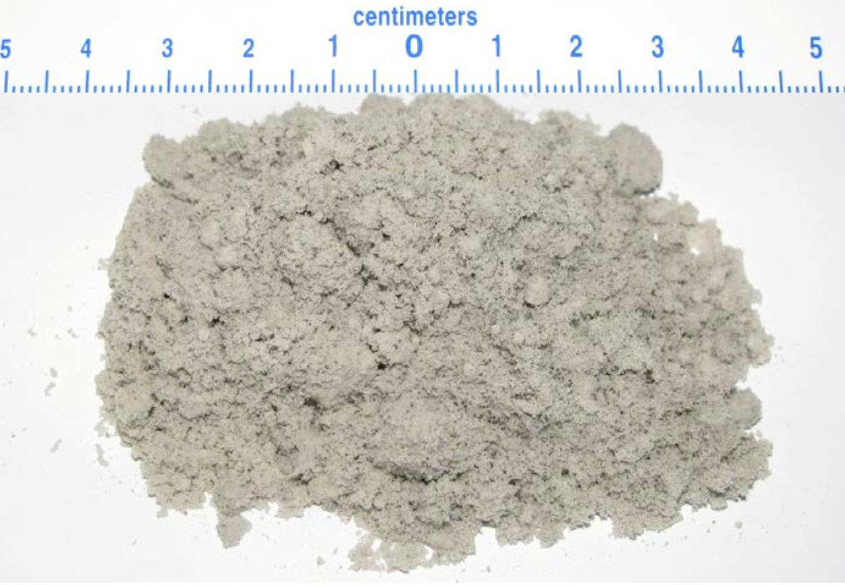
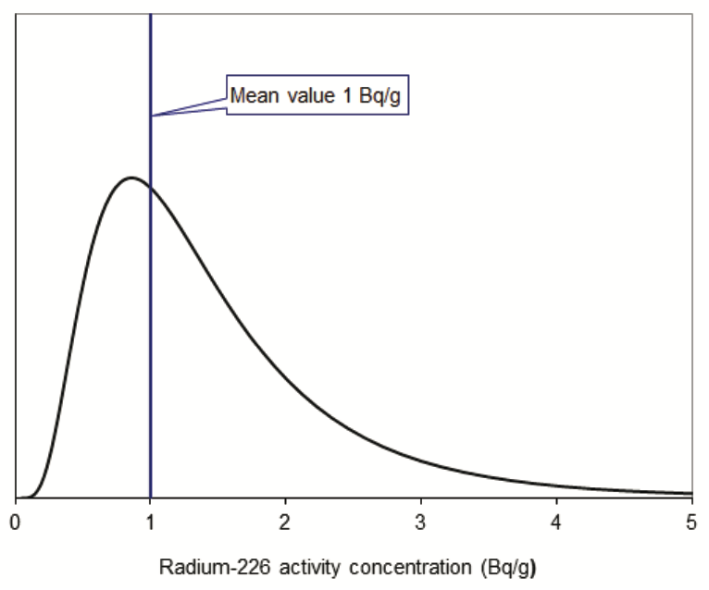
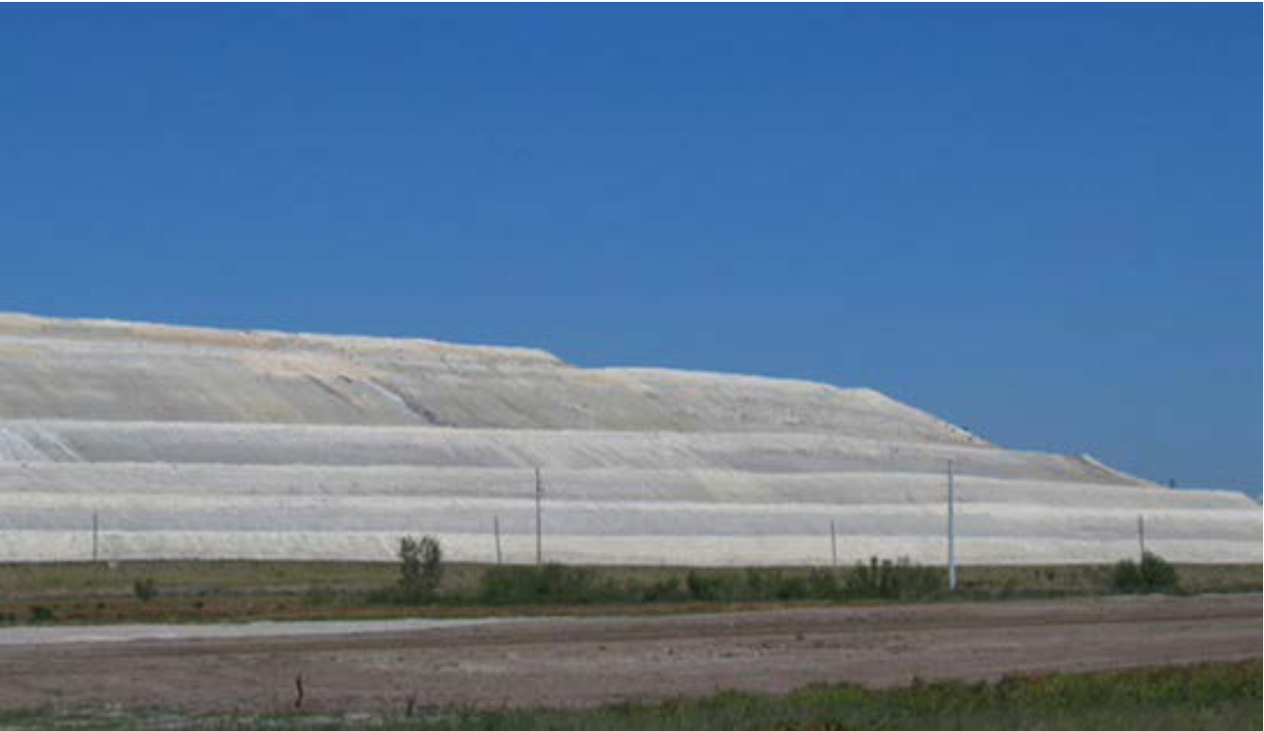
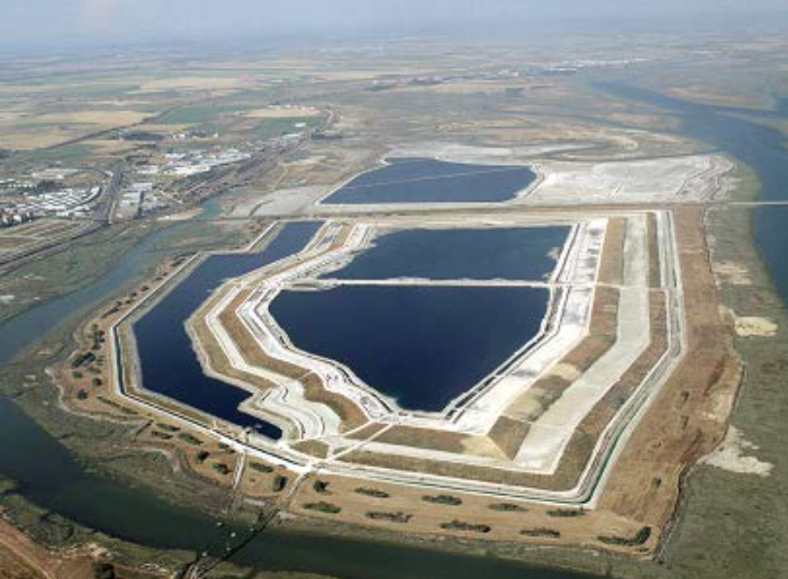
What is Phosphogypsum
Phosphogypsum (PG) is a by-product of the phosphate fertilizer industry, produced during the production of phosphoric acid.
Approximately 5t of PG are produced per ton of phosphoric acid (US EPA, 2002)
Annual worldwide PG production between 100 - 280Mt (Yang et al., 2009)
Approximately 15% of this quantity is being reused beneficially (Tayibi et al., 2009)
85% is stockpiled on large dumps in a controlled or uncontrolled manner depending on the country and the legislative framework
Wind erosion – air pollution (particulate matter)
Ground water pollution with heavy metals and elements
Sea water pollution
Potentially radioactive
Embankement stability
Τίτλος Εργασίας

Slide 4
……………..…………………
Τίτλος Εργασίας

Slide 5
……………..…………………
Τίτλος Εργασίας

Slide 6
……………..…………………
Τίτλος Εργασίας

Slide 7
……………..…………………
Τίτλος Εργασίας

Slide 8
……………..…………………
Τίτλος Εργασίας

Slide 9
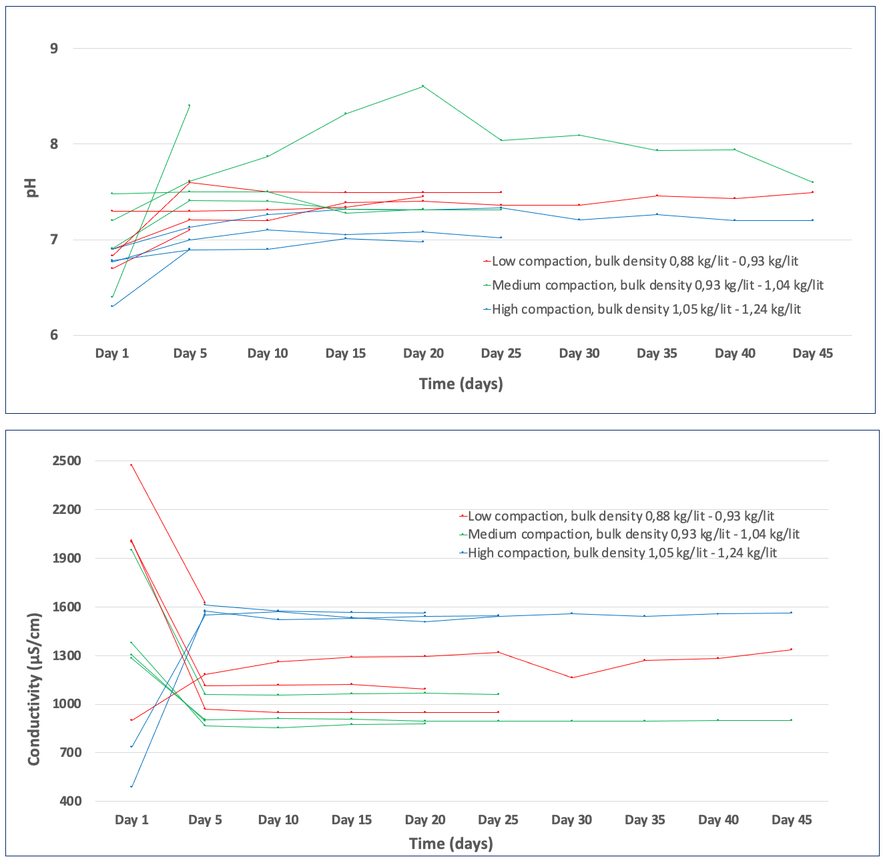
Συμπεράσματα - Προτάσεις
Leachates emanated from old/new PG and PG mixtures with alkaline material show an improvement in physico-chemical parameters and quality after the 4th day of irrigation (1080 - 1240 mm of rain).
Leachates emanated from compacted PG show an improved environmental behavior.
Leachates produced from old PG (>5 years) are generally of better quality compared to those produced from recently disposed PG (<1 year). This can be probably explained by the long-term washing effect of old PG due to solubility of elements to rain water.
Leachates produced from the same sample of PG or PG mixture, exhibit an improving quality after an irrigation period of 3 weeks (5800-6900 mm of rain). This finding can be explained also, if we consider the solubility of metals and the washing effect in the sample due to the continuous irrigation.
Leachates quality satisfies the environmental limits for the disposal of the respective waste at landfills for non-hazardous wastes, and with the exception of F⁻ and SO₄²⁻ ions for the disposal of the respective waste at landfills for inert wastes,
Consequently, the results obtained support the potential utilization of large quantities of PG, either alone or with other materials as mixtures, under certain conditions, as an alternative material for uses such as an earthfill material for quarries reclamation workings.
Τίτλος Εργασίας

Slide 10
Ευχαριστώ για την προσοχή σας !
Τα ονόματά σας
Παρουσίαση εργασίας – Μάϊος 2024
Μάθημα 8^{ου} εξαμήνου «Περιβαλλοντική Μηχανική»

