Slide 1
ELGC06
H-Bridge Inverter Basics

Slide 2
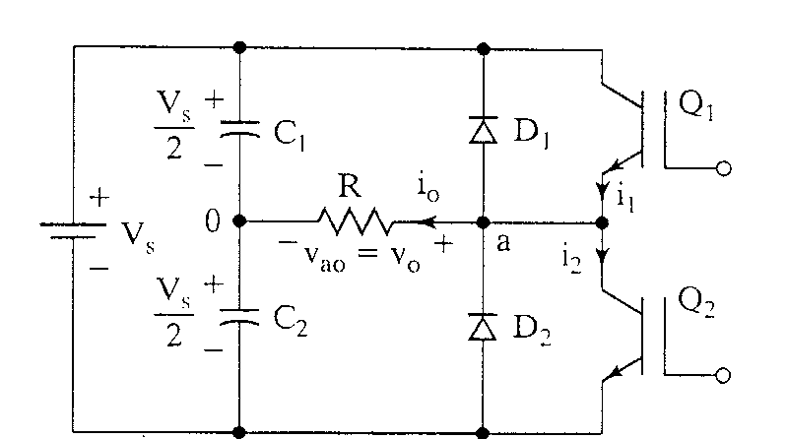
Single-phase half-bridge inverter

Slide 3
Operational Details
3-wire DC source
Consists of 2 choppers, 3-wire DC source
Transistors switched on and off alternately
Need to isolate the gate signal for Q₁ (upper device)
Each provides opposite polarity of V_{s}/2 across the load

Slide 4
Q₁ on, Q₂ off, v_{o} = V_{s}/2
Peak Reverse Voltage of Q₂ = V_{s}

Slide 5
Q₁ off, Q₂ on, v_{o} = -V_{s}/2

Slide 6
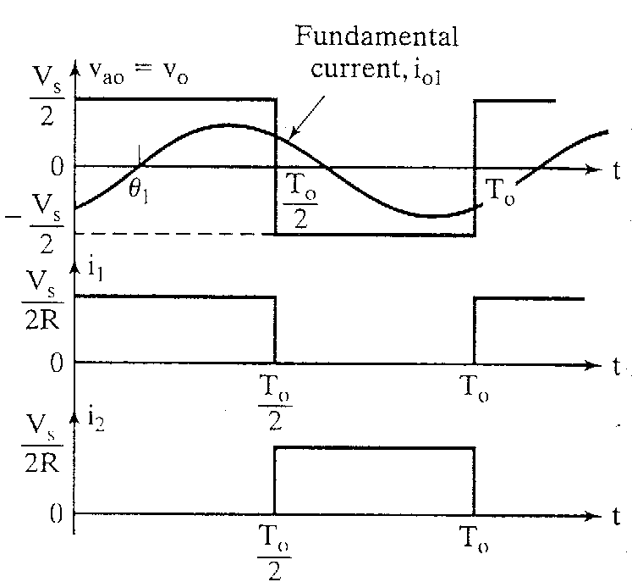
Waveforms with resistive load

Slide 7
Look at the output voltage
rms value of the output voltage, V_{o}

Slide 8
Fourier Series of the instantaneous output voltage

Slide 9
rms value of the fundamental component

Slide 10
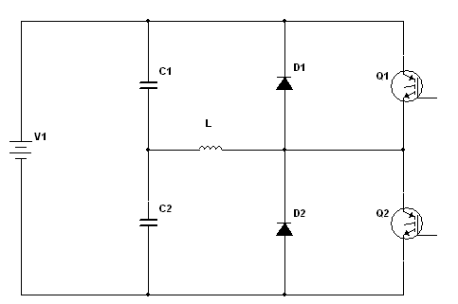
When the load is highly inductive

Slide 11
Turn off Q₁ at t = T_{o}/2
Current falls to 0 via D₂, L, V_{s}/2 lower
+
V_{s}/2
-
+
V_{s}/2
-

Slide 12
Turn off Q₂ at t = T_{o}
Current falls to 0 via D₁, L, V_{s}/2 upper
+
V_{s}/2
-
+
V_{s}/2
-

Slide 13
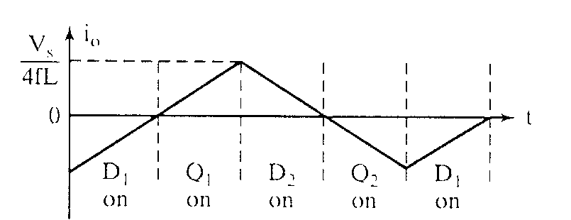
Load Current for a highly inductive load
Transistors are only switched on for a quarter-cycle, or 90°

Slide 14
Fourier Series of the output current for an RL load

Slide 15
Fundamental Output Power
In most cases, the useful power

Slide 16
DC Supply Current
If the inverter is lossless, average power absorbed by the load equals the average power supplied by the dc source.
For an inductive load, the current is approximately sinusoidal and the fundamental component of the output voltage supplies the power to the load. Also, the dc supply voltage remains essentially at V_{s}.

Slide 17
DC Supply Current (continued)

Slide 18
Performance Parameters
Harmonic factor of the nth harmonic (HF_{n})
for n>1
V_{on} = rms value of the nth harmonic component
V₀₁ = rms value of the fundamental component

Slide 19
Performance Parameters (continued)
Total Harmonic Distortion (THD)
Measures the “closeness” in shape between a waveform and its fundamental component

Slide 20
Performance Parameters (continued)
Distortion Factor (DF)
Indicates the amount of HD that remains in a particular waveform after the harmonics have been subjected to second-order attenuation.
for n>1

Slide 21
Performance Parameters (continued)
Lowest order harmonic (LOH)
The harmonic component whose frequency is closest to the fundamental, and its amplitude is greater than or equal to 3% of the amplitude of the fundamental component.

Slide 22
!
H-Bridge Inverter Basics – Creating AC from DC
Single-phase H-bridge (voltage source) inverter topology:
Switching rules
•
Either A+ or A
–
is closed,
Vdc
but never at th
e same time *
•
Either B+ or B
–
is closed,
but never at the same time *
*same time closing would cause a short circuit from Vdc to ground
(shoot-through)
*To avoid shoot-through when using real switches (i.e. there are turn-on and turn-off delays) a dead-time or blanking time is implemented
A+
B+
Va
Load
Vb
A
–
B
–
Corresponding values of Va and Vb
•
A+ closed, Va = Vdc
•
A
–
closed, Va = 0
•
B+ closed, Vb = Vdc
•
B
–
closed, Vb = 0

Slide 23
H BRIDGE INVERTER
Corresponding values of Vab
•
A+ closed
and B
–
closed, Vab = Vdc
Vdc
•
A+ closed and B+ closed, Vab = 0
•
B+ closed and A
–
closed, Vab =
–
Vdc
•
B
–
closed and A
–
closed, Vab = 0
A+
B+
+ Vdc −
•
The free wheeling diodes permit current
to flow even if al
l switches are open
Va
Load
Vb
•
These diodes also permit lagging
currents to flow in inductive loads
A
–
B
–

Slide 24
H BRIDGE INVERTER
Corresponding values of Vab
•
A+ closed
and B
–
closed, Vab = Vdc
Vdc
•
A+ closed and B+ closed, Vab = 0
•
B+ closed and A
–
closed, Vab =
–
Vdc
•
B
–
closed and A
–
closed, Vab = 0
A+
B+
+ 0 −
•
The free wheeling diodes permit current
to flow even if al
l switches are open
Va
Load
Vb
•
These diodes also permit lagging
currents to flow in inductive loads
A
–
B
–

Slide 25
H BRIDGE INVERTER
Corresponding values of Vab
•
A+ closed
and B
–
closed, Vab = Vdc
Vdc
•
A+ closed and B+ closed, Vab = 0
•
B+ closed and A
–
closed, Vab =
–
Vdc
•
B
–
closed and A
–
closed, Vab = 0
A+
B+
− Vdc +
•
The free wheeling diodes permit current
to flow even if al
l switches are open
Va
Load
Vb
•
These diodes also permit lagging
currents to flow in inductive loads
A
–
B
–

Slide 26
H BRIDGE INVERTER
Corresponding values of Vab
•
A+ closed
and B
–
closed, Vab = Vdc
Vdc
•
A+ closed and B+ closed, Vab = 0
•
B+ closed and A
–
closed, Vab =
–
Vdc
•
B
–
closed and A
–
closed, Vab = 0
A+
B+
+ 0 −
•
The free wheeling diodes permit current
to flow even if al
l switches are open
Va
Load
Vb
•
These diodes also permit lagging
currents to flow in inductive loads
A
–
B
–

Slide 27
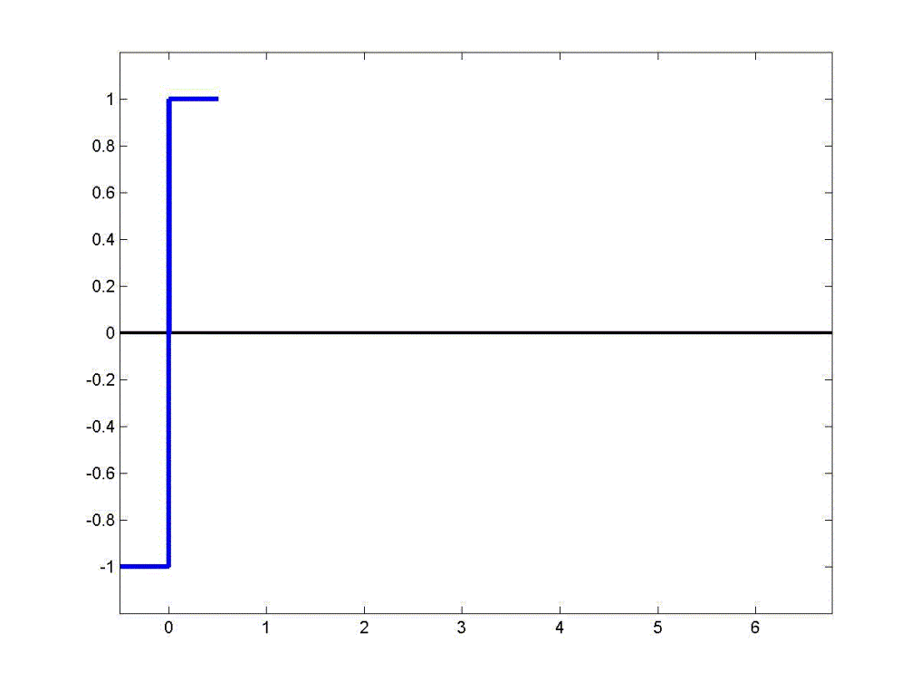
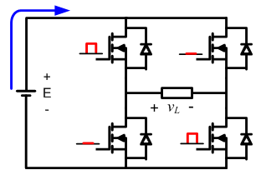
H-Bridge Inverter
Square wave modulation:

Slide 28
Basic Square Wave Operation
(sometimes used for 50 Hz or 60Hz applications)
!
Corresponding values of Vab
•
A+ closed
and B
–
closed, Vab = Vdc
•
A+ closed and B+ closed, Vab = 0
V_{load}
•
B+ closed and A
–
closed, Vab =
–
Vdc
•
B
–
closed and A
–
closed, Vab = 0
Vdc
−Vdc
The Vab = 0 time is not required but can be used to reduce the rms value of V_{load}

Slide 29
Many Loads Have Lagging Current – Consider an Inductor
There must be a provision for voltage and current to have opposite signs with respect to each other
!
V_{load}
Vdc
−Vdc
I_{load}
I
−I

Slide 30
Load Current Can Always Flow, Regardless of Switching State
Example - when current flows left to right through the load
Vdc
A+
B+
here
or here
Va
Load
Vb
A
–
here
B
–
or here

Slide 31
Load Current Can Always Flow, cont.
Example - when current flows right to left through the load
Vdc
A+
B+
here
here
Va
Load
Vb
A
–
B
–
or here
or here

Slide 32
Load Current Can Always Flow, cont.
H BRIDGE INVERTER
Corresponding values of Vab
•
A+ closed
and B
–
closed, Vab = Vdc
Vdc
•
A+ closed and B+ closed, Vab = 0
•
B+ closed and A
–
closed, Vab =
–
Vdc
•
B
–
closed and A
–
closed, Vab = 0
•Load consuming power
A+
B+
•Load generating power
+ Vdc −
Va
Load
Vb
A
–
B
–

Slide 33
Load Current Can Always Flow, cont.
H BRIDGE INVERTER
Corresponding values of Vab
•
A+ closed
and B
–
closed, Vab = Vdc
Vdc
•
A+ closed and B+ closed, Vab = 0
•
B+ closed and A
–
closed, Vab =
–
Vdc
•
B
–
closed and A
–
closed, Vab = 0
•Load consuming power
A+
B+
•Load generating power
+ Vdc −
Va
Load
Vb
A
–
B
–

Slide 34
!
The four firing circuits do not have the same ground reference. Thus, the firing circuits require isolation.
Vdc
(source of power delivered to load)
A
+
B
+
Local ground
Local ground
reference for A
+
reference for
B
+
firing circuit
firing circuit
S
Load
S
A
–
B
–
Local ground
Local ground
reference for A
−
reference for
B
−
firing circuit
firing circuit
S
S

Slide 35
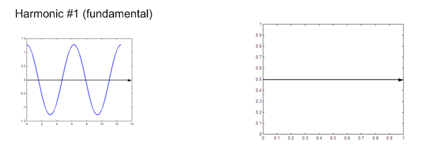
H-Bridge Inverter
Harmonics with square wave modulation

Slide 36
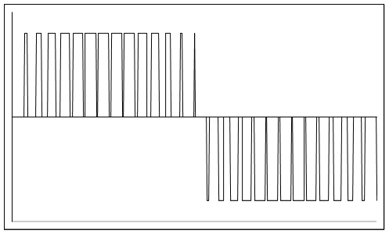
Question - How can a sinusoidal (or other) input signal be amplified with low distortion?
!
Answer – the switching can be controlled in a smart way so that the FFT of V_{load} has a strong fundamental component, plus high-frequency switching harmonics that can be easily filtered out and “thrown into the trash”
Progressivelywider pulses at the center
Progressively narrower pulses at the edges
V_{load}
Vdc
Unipolar Pulse-Width Modulation (PWM)
−Vdc

Slide 37
!
Implementation of Unipolar Pulse Width Modulation (PWM)
Vcont is the input signal we want to amplify at the output of the inverter.
Vcont is usually a sinewave, but it can also be a music signal.
Vcont
Vtri
−Vcont
The implementation rules are:
Vcont > Vtri , close switch A+, open
switch A
–
, so voltage Va = Vdc
Vcont < Vtri , open switch A+, close
switch A
–
, so voltage Va = 0
–
Vcont > Vtri , close switch B+, open
switch
B
–
, so voltage Vb = Vdc
–
Vcont < Vtri , open switch B+, close
switch B
–
, so voltage Vb = 0
V_{tri} is a triangle wave whose frequency is at least 30 times greater than Vcont.
Ratio m_{a} = peak of control signal divided by peak of triangle wave
Ratio m_{f} = frequency of triangle wave divided by frequency of control signal

Slide 38
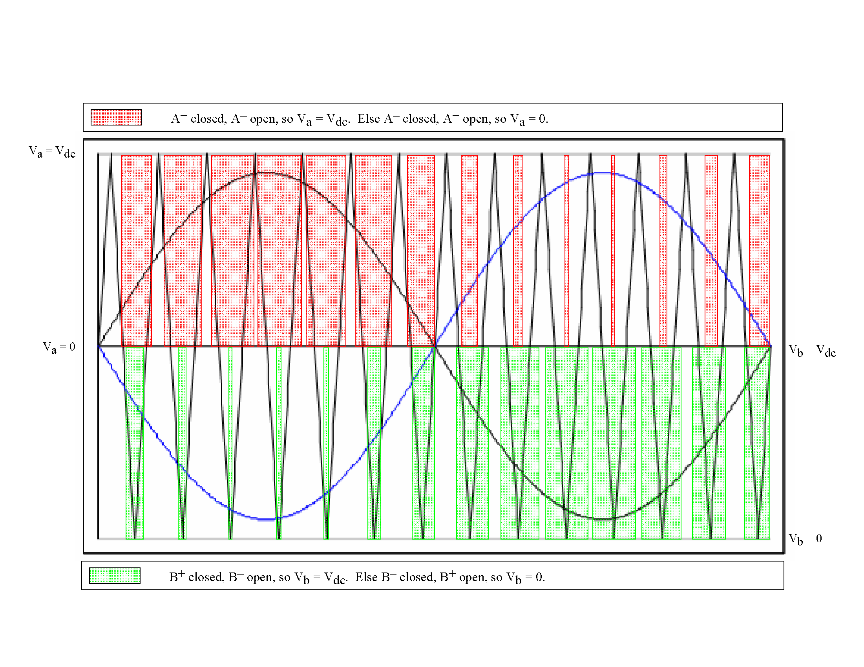

Slide 40
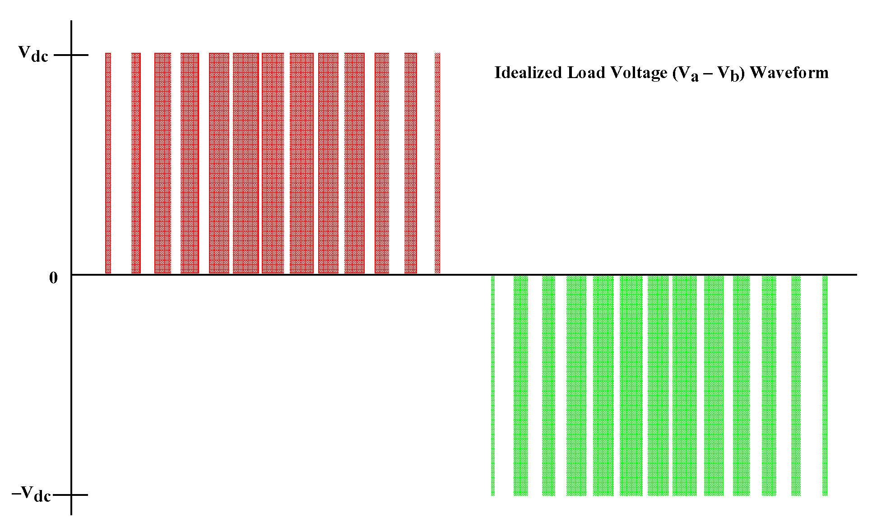

Slide 41
Ratio m_{a} = peak of control signal divided by peak of triangle wave
Ratio m_{f} = frequency of triangle wave divided by frequency of control signal
Load voltage with
m_{a} = 0.5
(i.e., in the linear region)

Slide 42
Load voltage with
m_{a} = 1.5
(i.e., overmodulation)

Slide 43
!
Variation of RMS value of no-load fundamental inverter
output voltage (V_{1rms} ) with m_{a}
For single-phase inverters m_{a} also equals the ratio between the peak output voltage and the input V_{dc} voltage.
V
1rms
asymptotic
to
4
•
V
dc
π
square wave
2
value
V
dc
2
m_{a} is called the modulation index
m
a
0 1
linear
overmodulation
saturation

Slide 44
RMS magnitudes of load voltage frequency components with respect to
for f_{tri} >> f_{cont}

Slide 45
100Hz Signal as Input, Inverter Output

Slide 46
FFT of 100Hz Inverter Output

Slide 47
Inverter Performance with Music Input

Slide 48
PWM controlled H-Bridge Inverter
!
Very efficient
Distortion higher than linear amplifier, but a linear amplifier has, at best, 50% efficiency
Perfectly suited for motor drives where voltage and frequency control are needed
Well suited for bass music amplification, such as automotive applications, or where high power is more important than a little loss in quality

