Slide 1
SCRIBAL ERRORS
Raiders of the Lost
Error

Slide 2
mentis
clavis
manus
pennae
plumae
loquendi
lectionis
Lapsus
(lubricum)
memoriae
linguae
scriptae
digiti
digitorum
calami

Slide 3
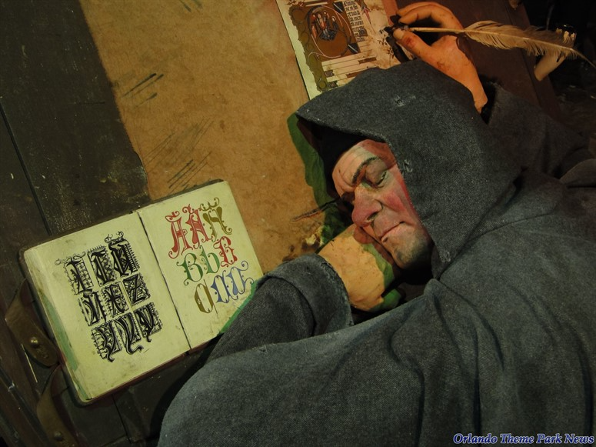
SCRIBAL ERRORS

Slide 4
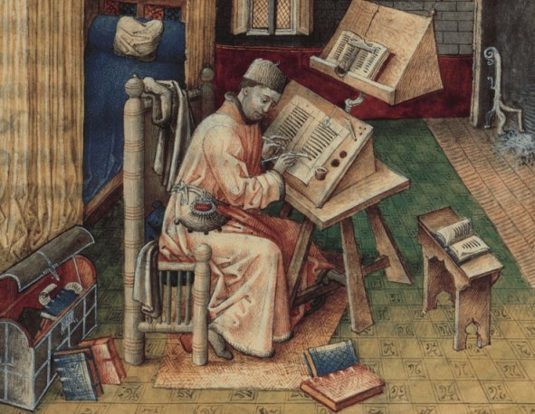
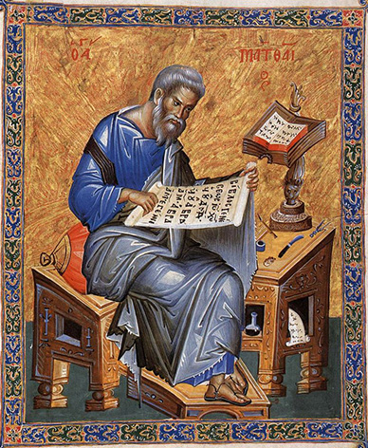
SCRIPTORIUM

Slide 5
8
The procedure of copying
PASSAGE A
PASSAGE B
PASSAGE Γ
1.
Visual image
Visual image
---
↓
↓
↓
2.
[Inner dictation]
[Inner dictation]
---
↓
↓
↓
3.
Auditory image
Auditory image
---
↓
↓
↓
4.
Mental image
Mental image
---
↓
↓
↓
5.
Mnemonic image
Mnemonic image
---
↓
↓
↓
6.
Mental image
Mental image
---
↓
↓
↓
7.
[Inner dictation]
[Inner dictation]
---
↓
↓
↓
8.
New auditory image
New auditory image
---
↓
↓
↓
9.
jeu de main
jeu de main
jeu de main
PASSAGE A
PASSAGE B
PASSAGE Γ

Slide 6
CONTEXT
AUTHOR → AUTOGRAPH → TRANSMISSION → COPY
To Tm Tt
CONTEXT
MESSAGE
CODE
3
CHANNEL
TEXTUAL TRANSMISSION
CONTEXT
CHANNEL
MESSAGE
CODE
01
SENDER
⟶
⟶
RECEIVER
02
CONTEXT
CHANNEL
NOISE
SENDER
→
MESSAGE 0
→
→
MESSAGE 1
→
RECEIVER
03
AUTHOR
To
→
AUTOGRAPH
Tm
→
TRANSMISSION
→
COPY
Tt
Tt = To + Tm
Tt − Tm = To
To = Textus originalis
Tm = Textus maculatus
Tt = Textus traditionis
Tc = Textus criticus

Slide 7
Features of the ms
Omissions
Additions
Transpositions
Alterations
Interventions
TYPOLOGY OF ERRORS
6+
01
04
Features of
the manuscript
Transpositions
02
05
Omissions
Alterations
BROAD GROUPS
03
06
Additions
Interventions

Slide 8
Similarity of letterforms
ERRORS CAUSED BY FEATURES OF THE MS
01
Greek uncials (from 300 BC):
Α = Δ = Λ / Γ = Τ / Ε = Θ = Ο = C / Η = ΕΙ / Η = Ν = Κ = ΙC / ΛΛ = Μ / ΑΙ = Ν / Τ = Υ
Greek minuscule (from the 9th c.):
α = ου / α = ει / α = ευ / β = κ = μ / ε = ευ / η = κ / μ = ν / ν = ρ / π = σσ
02
—Pl. Grg. 467b: σχέτλια λέγεις καὶ ὑπερφυῆ, ὦ Σώκρατες
σχέτλια : ἔχεται ἅ
—A. Ch. 935–936: Ἔμοιγε μὲν δίκᾳ Πριαμίδαις χρόνῳ, / βαρύδικος ποινά
βαρύδικος : καρύδικος
—Arist. Po. 1462b:
λέγω δ᾽ οἷον εἴ τις τὸν Οἰδίπουν θείη τὸν Σοφοκλέους ἐν ἔπεσιν ὅσοις ἡ Ἰλιάς.
ἡ Ἰλιάς : ἡ ἰδίας codd.
—Eratosth. Cat. XXXIII:
περὶ τούτου ἱστορεῖται ὅτι ἐστὶν ὁ δοθεὶς Εὐρώπῃ φύλαξ μετὰ τοῦ ἄκοντος.
ἄκοντος corr. edd. post Kopplers : δράκοντος ELOM, FRAGM. VAT., et dracone, i.e. δράκοντος, hab. Sch. GERM., ARAT. LAT.

Slide 9
Misreading of an abbreviation and nomina sacra
12
ERRORS CAUSED BY FEATURES OF THE MS
ΠΡΙ = ΠΡΙΝ ΠΑΤΡΙ
ΑΝΟC = ΑΛΛΟΣ ΑΝΘΡΩΠΟΣ
Numbers represented by letters
—Thucydides III 50.1: τοὺς δ᾽ ἄλλους ἄνδρας οὓς ὁ Πάχης ἀπέπεμψεν ὡς αἰτιωτάτους ὄντας τῆς ἀποστάσεως Κλέωνος γνώμῃ διέφθειραν οἱ Ἀθηναῖοι (ἦσαν δὲ ὀλίγῳ πλείους χιλίων), καὶ Μυτιληναίων τείχη καθεῖλον καὶ ναῦς παρέλαβον.
—Apollod. Epit. V 14: εἰς τοῦτον (sc. Δούρειον Ἵππον) Ὀδυσσεὺς εἰσελθεῖν πείθει πεντήκοντα τοὺς ἀρίστους, ὡς δὲ ὁ τὴν μικρὰν γράψας Ἰλιάδα φησὶ τρισχιλίους.
Α
Λ
Δ
Γ
Τ

Slide 10
ERRORS CAUSED BY A FEATURE OF THE MS
Word division
01
—A. Eum. 224: Δίκας δὲ Παλλάς τῶνδ᾽ ἐποπτεύσει θεά
δὲ Παλλάς Sophianus :
δ᾽ ἐπ᾽ ἄλλας ms.
02
—Pi. O. X 55: τὸ δὲ σαφανὲς ἰὼν πόρσω κατέφρασεν
τὸ δὲ σαφανές :
τὸ δ᾽ ἐς ἀφανές
CDEγP
03
—S. Tr. 615: ἐπὸν μαθήσεται
(form restored by Billerbeck); MSS LA read
ἐπ᾽ ὄμμα θήσεται,
from ΕΠΟΝΜΑΘΗΣΕΤΑΙ

Slide 11
Confusion between similar words or meanings
ERRORS CAUSED BY FEATURES OF THE MS
01
02
Spelling or pronunciation errors
—Pi. P. IV 90: καὶ μὰν Τιτυὸν βέλος Ἀρτέμιδος θήρευσε κραιπνόν
κραιπνόν] τερπνόν C
—Eratosth. Cat. VI: ὃν Ζεὺς χαριζόμενος Ἀπόλλωνι εἰς τὰ ἄστρα ἀνήγαγεν
ἄστρα EL : ὅπλα OM
—D.L. IX 10:
[ἔφη] ἡμέραν τε καὶ νύκτα γίνεσθαι καὶ μῆνας καὶ ὥρας ἐτείους καὶ ἐνιαυτοὺς ὑετοὺς τε καὶ πνεύματα καὶ τὰ τούτοις ὅμοια κατὰ τὰς διαφόρους ἀναθυμιάσεις.
ἐτείους F : αἰτίους BP
—Theoc. VII 112: we find εὗρον for Ἕβρον
—S. Tr. 314: κεκρινοῖς for καὶ κρίνοις

Slide 12
Haplography
OMISSIONS
01
Omission of an entire line of text
Omission of line 800 of Soph. O.T. in MS L (s. XI), as opposed to MSS ΑΦ (s. XIII)
3+
02
—Ar. Ach. 221–222: μὴ γὰρ ἐγγένοι ποτὲ / μηδὲ περ γέροντας ὄντας ἐκφυγὼν Ἀχαρνέας.
ὄντας is omitted in most MSS, but is necessary.
TYPES
03
Saut du même au même
—Ar. Ach. 692–695:
ταῦτα πῶς εἰκότα, γέροντ᾽ ἀπο[λέσαι / πολιὸν ἄνδρα περὶ κλεψύδραν, / πολλὰ δὴ ξυμπονήσαντα καὶ θερμὸν ἀπο]μορξάμενον ἀνδρικὸν ἱδρῶτα δὴ καὶ πολύν.
MS A omits [ ]

Slide 13
Dittography (letters or syllables)
ADDITIONS
01
02
Addition prompted by an interlinear gloss
—Sen. Ep. LXXVIII 14: deinde quod acerbum fuit ferre, tulisse iucundum est.
ferre, tulisse Bartsch : ferre retulisse Q
—A. A. 549: καὶ πῶς; ἀπόντων κοιράνων ἔτρεις τινάς;
κοιράνων Triclinius : τυράννων F

Slide 14
Incorporation of glosses into the main text
ADDITIONS
01
02
Incorporation of passages from commentaries
—Eratosth. Cat. VI:
ὡς καὶ τοὺς ἤδη τεθνηκότας ἐγείρειν, ἐν οἷς καὶ Ἱππόλυτον ἔσχατον [τὸν Θησέως],
Ἱππόλυτον ἔσχατον praeuntibus Westermann Maass, e codd. rec., sed uerba τὸν Θησέως ut glossam interpolatam secl. Pàmias : ἔσχατον Ἱππόλυτον post Heyne transp. Matthiae Robert Olivieri : τὸν Θησέως E, iam edd. post Heyne : τοῦ Θησέως LOM : <τὸν> τοῦ Θησέως Struve, Maass
——D.L. V 76:
λέγεται δ᾽ ἀποβαλόντα αὐτὸν τὰς ὄψεις ἐν Ἀλεξανδρείᾳ κομίσασθαι αὖθις παρὰ τοῦ Σαράπιδος.
ἀποβαλόντα BP : τυφλωθέντα F
—A. Pers. 253: οἴμοι, κακὸν μὲν πρῶτον ἀγγέλλειν κακά
MS M has this marginal verse: στέργει γὰρ οὐδεὶς ἄγγελον κακῶν ἐπῶν (cf. S. Ant. 277).

Slide 15
Transposition of letters
TRANSPOSITIONS
01
02
Transposition of verses and hyperbaton
—A. A. 1205: ἁβρύνεται γὰρ πᾶς τις εὖ πράσσων πλέον.
ἁβρύνεται F : βαρύνεται Tr
—Confusions such as βαλών – λαβών, suscipit for suspicit
—Pi. N. VII 36–37: ὁ δ᾽ ἀποπλέων / Σκύρου μὲν ἅμαρτε, πλαγχθέντες δ᾽ εἰς Ἐφύραν ἵκοντο
πλαγχθέντες δ᾽ εἰς Ἐφύραν ἵκοντο corr. Boeck : ἵκοντο δ᾽ εἰς Ἐφύραν πλαγχθέντες codd.

Slide 16
Vitium byzantinum
TRANSPOSITIONS
01
02
Byzantine prose rhythm
∪ ∪
—A. A. 1105: ἐκεῖνα δ᾽ ἔγνων· πᾶσα γὰρ πόλις βοᾷ.
πόλις βοᾷ M : βοᾷ πόλις F Tr
—Plu. Mor. 522 (de curiositate XIII):
ὁμοίως οὐδ᾽ Ἀλέξανδρος εἰς ὄψιν ἦλθε τῆς Δαρείου γυναικὸς ἐκπρεπεστάτης εἶναι λεγομένης
τῆς Δαρείου γυναικὸς ἐκπρεπεστάτης εἶναι λεγομένης codd. plerique :
τῇ Δαρείου γυναικὶ εὐπρεπεστάτῃ λεγομένῃ τυγχάνειν codd. familiae Λ.

Slide 17
Case influenced by neighbouring words
ALTERATIONS
01
02
Attractio
—E. Rh. 776–777:
ἤπυσα δ᾽ αὐτοῖς μὴ πελάζεσθαι στρατῷ, / κλῶπας δοκήσας συμμάχων πλάθειν τινάς.
πελάζεσθαι : πλάθειν V
—Hes. Th. 454: MS B reads, instead of χρυσοπέδιλον, χρυσοστέφανον (through attraction to this compound, which occurs at 17 and 136).
—E. Hel. 1243: κενοῖσι θάπτειν ἐν πέπλων ὑφάσμασιν.
πέπλων Scaliger : πέπλοις L
—E. HF 364: τάν τ᾽ ὀρεινόμον ἀγρίων Κενταύρων ποτὲ γένναν
One MS reads ὀρεινόμιον

Slide 18
Errors caused by Christian ideology
DELIBERATE INTERVENTIONS
01
02
Deliberate errors
Correction of difficult words or passages that the copyist wishes to simplify
—Eratosth. Cat. II: γενέσθαι δὲ Διὸς τροφὸν καὶ διὰ τοῦτο ἐν οὐρανῷ τιμῆς ἀξιωθῆναι.
ἐν οὐρανῷ iam Jacoby post Heyne, corr. Pàmias ex FRAGM. VAT. (cf. in caelo ARAT. LAT.) :
ἐν οὐρανοῖς ELOM
Ὅσοις ὅσσοισι
Ἀνατείνας ἀντείνας
Deinde dein
Laudauerit laudarit

Slide 19
Restoration of damage or lacunae
DELIBERATE INTERVENTIONS
01
02
Technical corrections
—Hom. Il. IX 453: τῇ πιθοίμην καὶ ἔρεξα
τῇ πιθοίμην καὶ ἔρεξα : τῇ οὐ πιθοίμην οὐδ᾽ ἔρεξα
—h. Ven. 4–5: χαῖρε θεὰ Σαλαμῖνος εὐκτιμένης μεδέουσα / καὶ πάσης Κύπρου
These words were illegible in M's exemplar and were therefore supplied as
μάκαιρα Κυθήρης ἰ εἰναλίης τε.
Censorship
Propagandistic alteration
Interpolatio

Slide 20
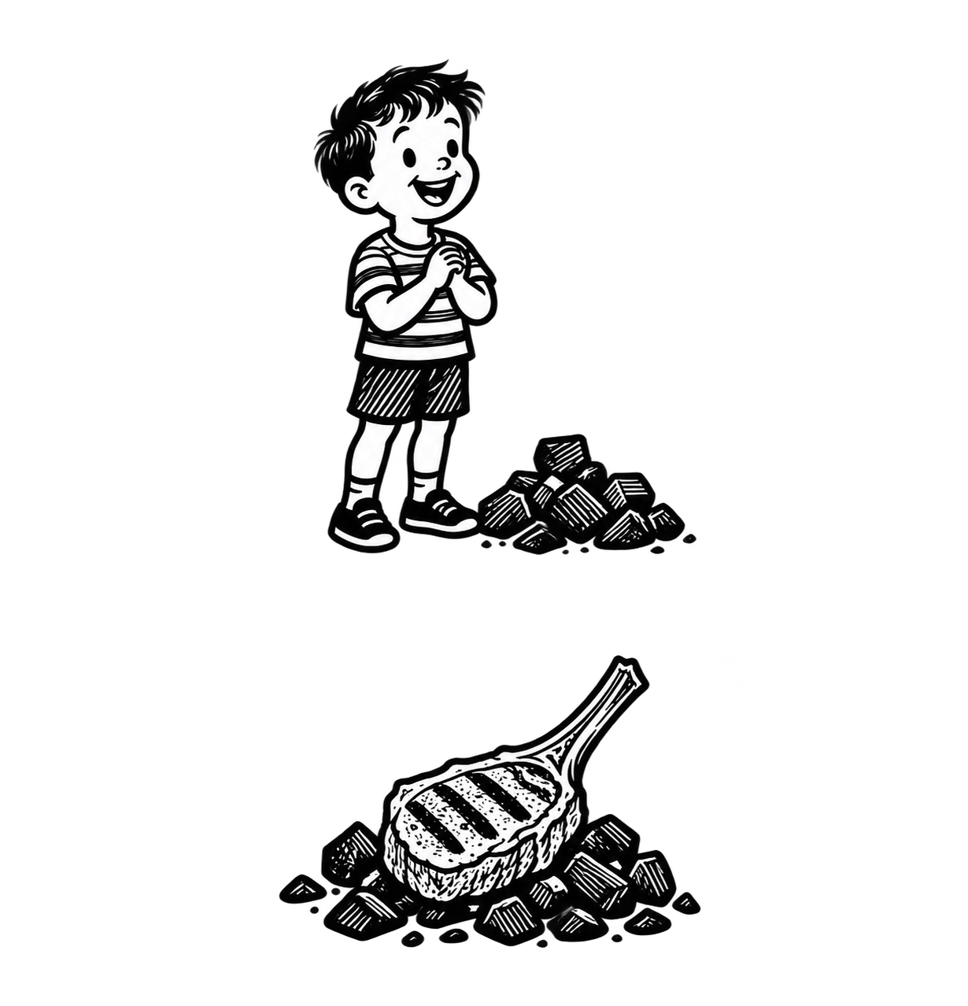
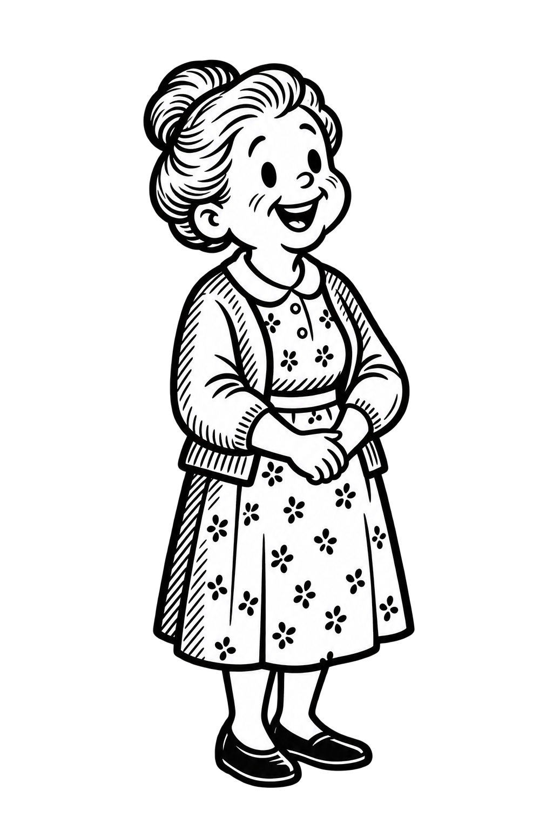
EXCURSUS: EDITORIAL ERRORS
Punctuation and diacritics save lives!
03
01
Παιδάκια στα κάρβουνα
PORTA PATENS ESTO NULLI CLAUDATUR HONESTO
Porta patens esto. Nulli claudatur honesto
Let the door remain wide open. Let it not be closed to any honest man.
Porta patens esto nulli. Claudatur honesto
Let not the door be opened to anybody. Let it be closed to the honest man
02
Let’s eat grandma!
Παϊδάκια στα κάρβουνα
Let’s eat, grandma!
Images generated using OpenAI's ChatGPT

