Slide 1



English for Specific Purposes I
APA system
Charitomeni Giouroglou

Slide 2
APA style citation
School of Education Sciences – Primary Education Department
Subject: English for Specific Purposes I, Winter Semester
In-text citations
Referencing

Slide 3
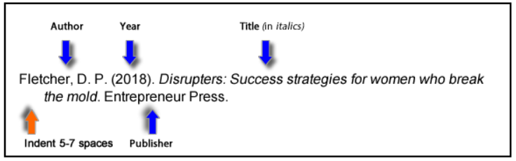
How to cite a book: Referencing
School of Education Sciences – Primary Education Department
Subject: English for Specific Purposes I, Winter Semester
Author/authors. The surname is followed by first initials
Year of publication (in brackets)
Book title (in italics)
Edition (in brackets)
Publisher
DOI (Digital Object Identifier)
https://libraryguides.vu.edu.au/apa-referencing/7Books

Slide 4

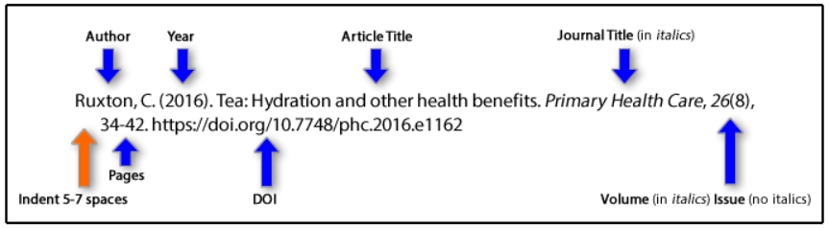
How to site a journal paper: Referencing
School of Education Sciences – Primary Education Department
Subject: English for Specific Purposes I, Winter Semester
https://libraryguides.vu.edu.au/apa-referencing/7JournalArticles
Author or authors
Year of publication (in brackets)
Article title
Journal title (in italics).
Volume of journal (in italics).
Issue number of journal in round brackets (no italics).
Page range of article.
DOI or URL

Slide 5
How to cite a book/journal article: In-text citation
School of Education Sciences – Primary Education Department
Subject: English for Specific Purposes I, Winter Semester
Surname of author/authors, year of publication, page (in brackets).
e.g. “Experience is the only perceived indicator of capability” (Fletcher, 2018, p. 107)
(Moran & Toner, 2017, p. 207)
(Khan et al., 2017, p. 344)
When you refer to the author, put only the year of publication in brackets.
e.g. Fletcher (2018) notes that “experience is the only perceived indicator of capability” (p. 107).

Slide 6

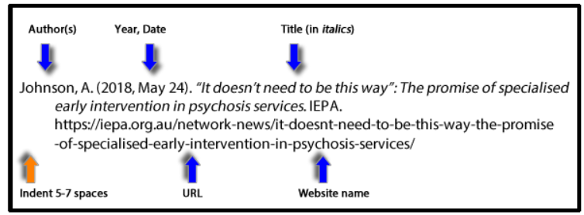
How to cite a webpage when there is an author
School of Education Sciences – Primary Education Department
Subject: English for Specific Purposes I, Winter Semester
Author or authors
Year, Month Day (in brackets)
Title (in italics)
Website name
URL
https://libraryguides.vu.edu.au/apa-referencing/7Webpages

Slide 7
How to cite a webpage on a website of an organization (as author)
School of Education Sciences – Primary Education Department
Subject: English for Specific Purposes I, Winter Semester
Organization
Year, Month Day (in brackets)
Title (in italics)
URL
https://libraryguides.vu.edu.au/apa-referencing/7Webpages
Example:
UNESCO. (2024). Education for sustainable development. https://www.unesco.org/en/sustainable-development/education

Slide 8
How to cite a webpage of a government agency (as author)
School of Education Sciences – Primary Education Department
Subject: English for Specific Purposes I, Winter Semester
Government agency
Year, Month Day (in brackets)
Title (in italics)
URL
https://libraryguides.vu.edu.au/apa-referencing/7Webpages
Example:
Department of Education. (2011, 31 October). Research reports 2011 - The nature and extent of pupil bullying in schools in the North of Ireland. https://www.education-ni.gov.uk/publications/research-reports-2011-nature-and-extent-pupil-bullying-schools-north-ireland

Slide 9
How to cite a webpage when there is no author
School of Education Sciences – Primary Education Department
Subject: English for Specific Purposes I, Winter Semester
Title (in italics)
Year, Month Day (in brackets)
Website name
URL
Example:
Researchers replicate famous marshmallow test, make new observations. (2018, May 25). Medical Xpress. https://medicalxpress.com/news/2018-05-replicate-famous-marshmallow.html?utm_source=tabs&utm_medium=link&utm _campaign=story-tabs

Slide 10
How to cite a webpage: In-text citation
School of Education Sciences – Primary Education Department
Subject: English for Specific Purposes I, Winter Semester
With author: Author, year (in brackets)
e.g. …family experience with psychosis (Johnson, 2018).
or
Ava Johnson (2018) reflects on her own experiences…
With organization: Organization, year (in brackets)
e.g. (UNESCO, 2024)
With government agency: Government agency, year (in brackets)
e.g. (Department of Education, 2011)
With no author: Title, year (in brackets)
e.g. …may not predict outcomes in later life (Researchers Replicate Famous, 2018).

